Slide 1
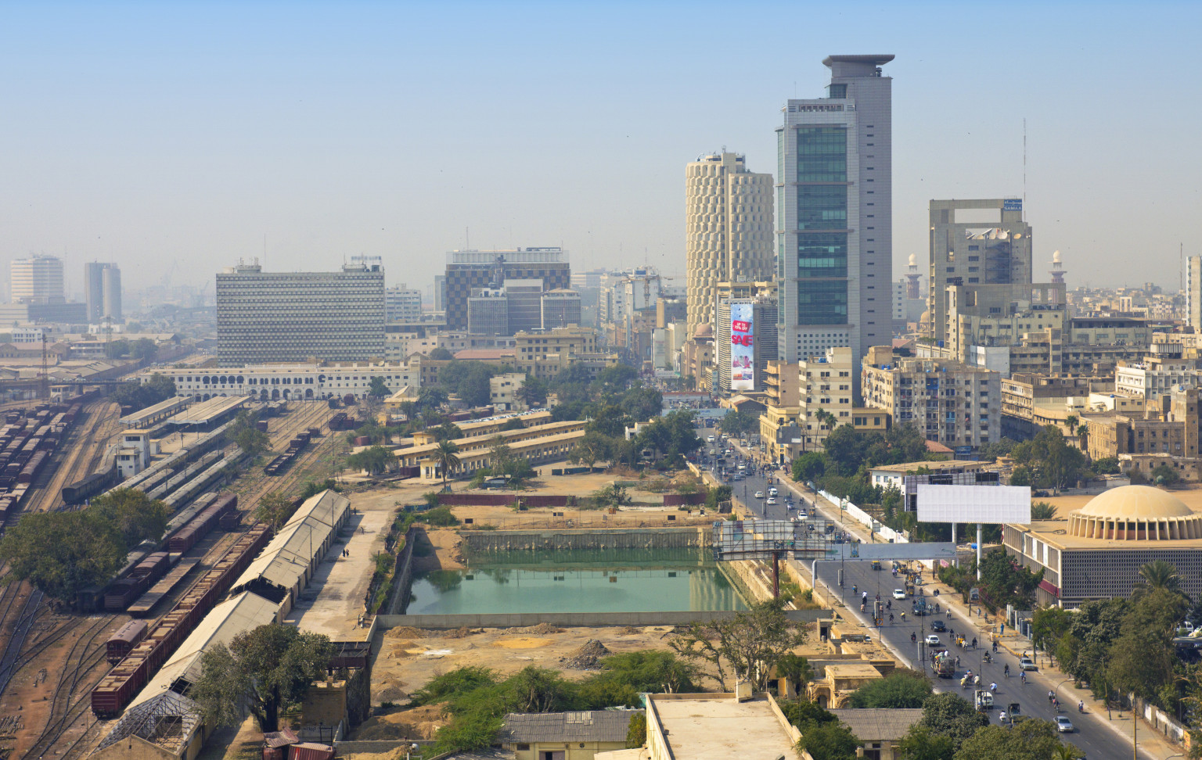
1
ADA Dialogue V, Islamabad – 6 September, 2019
web: www.arifhasan.org email: arifhasan37@gmail.com

Slide 2
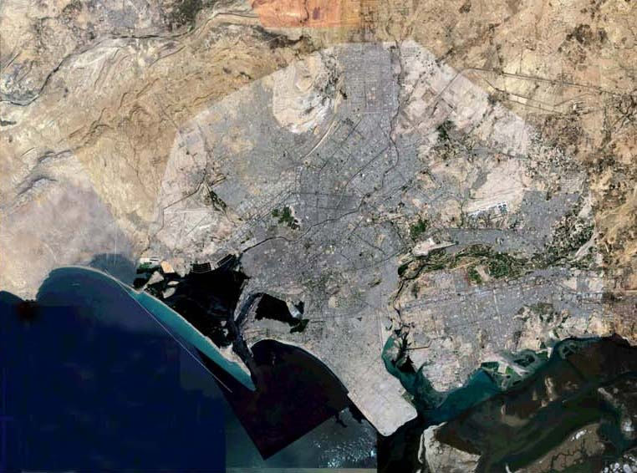

Slide 3
THE KARACHI CONTEXT
Population
- 435,887 (in 1941)
22,000,000 (in 2011)
- Karachi contains (1998 figures):
10% of Pakistan’s total population
25% of Pakistan’s urban population
Major source of information: Television 77% of households
Migration
Over 84 % of Karachi’s present population consists of migration from India and other parts of Pakistan between 1947 and 2015.
Though there is a decline in population growth in percentage terms, there is a substantial increase in numbers. Percentages are deceptive.
Karachi is a non-Sindhi speaking capital of a Sindhi speaking province.
This is a cause of conflict between the province and the city, especially related to governance issues.
Karachi’s involvement in regional conflicts due to its location
Economy
- Karachi’s Pakistan’s only port
- It contributes 20% of the country’s GDP and 62% of income tax
- 40% of employment in large scale manufacturing is located in Karachi’s 4,500 formal sector industrial units
75% of the working population is employed in the informal sector in garment, leather, textile, carpet and light engineering works

Slide 4
The Languages Spoken in Karachi
Language | Percentage of Population
Urdu | 43%
Punjabi | 13%
Pashto | 13%
Sindhi | 11%
Balochi | 4%
Saraiki | 2%
Other languages | 14%
The category ‘other languages’ includes languages such as: Gujarati, Memoni, Marwari, Dari, Brahui, Makrani, Hazara, Khowar, Shina, Burushaski, Balti, Arabic, Farsi, and Bengali.

Slide 5
Religions Practiced in Karachi
Islam (Sunni, Shi’a, Zikri, Ismaili) (3,000 Mosques and Imambargahs, 15 shrines)
Hinduism (30 Active Hindu Temples)
Christianity (46 Churches)
Zoroastrianism (1 Fire Temple)
Sikhism (8 Gurdwaras)
Buddhism (?)
Judaism (2 Synagogues – only one survives)

Slide 6
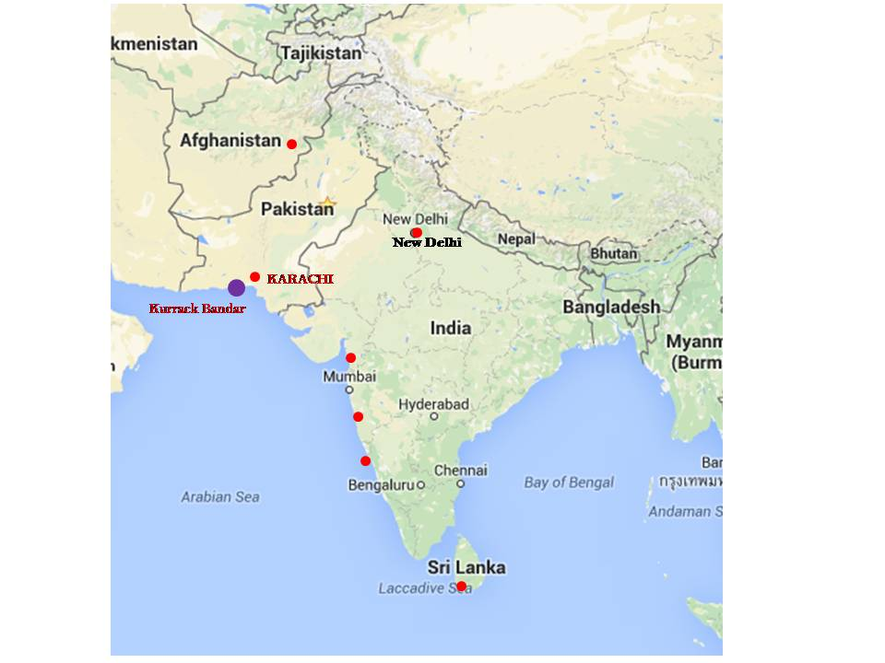

Slide 7
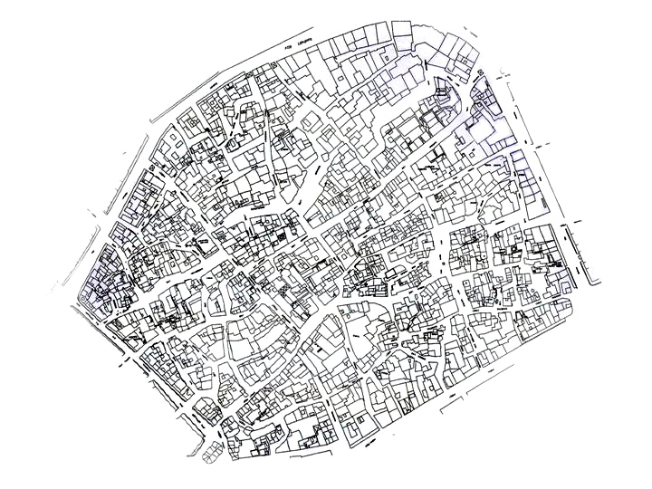
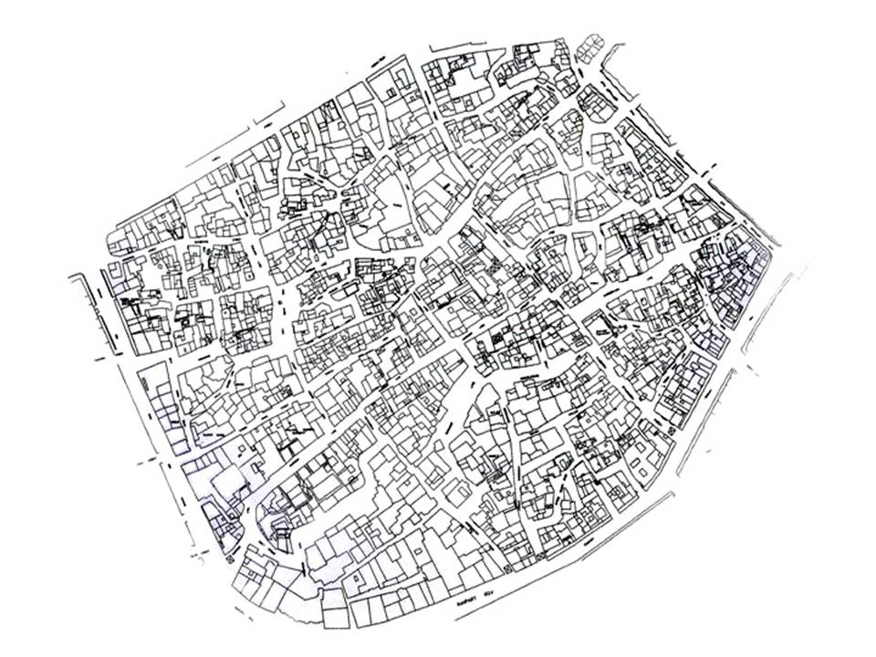

Slide 8
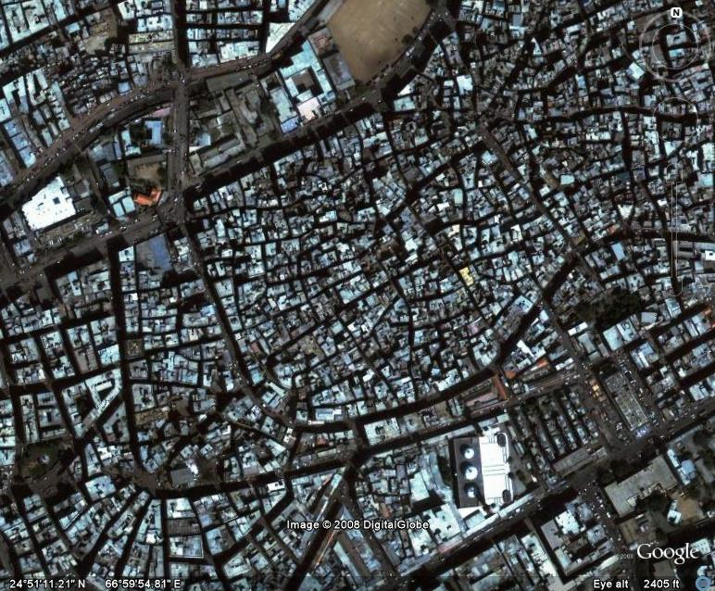

Slide 9
THE MANY NAMES OF KARACHI
S.No | NAME | SOURCE | DATE
01 | KHARACHI | Pehlavi texts | 230BC
02 | KALACHI | Sindhi Legend of Morrio/Mangar | 12th century
03 | ‘ KARAZI’ (Description of a Karachi harbor) | Al-Fawaid (Work of Arab navigator Ibn Majid) | 1500
04 | ‘RAS AL KARAZI’ | Al Mahri’s Umdah (Arab Navigator Sulayman) | 1511
05 | ‘RAS KARASHI’ | “ | “
06 | ‘KAURASHI’ | Turkish Captain Sidi Ali Ries’s book “Muhit” on navigator in the Persian Gulf | 1553-54
07 | DARBO | Stated in the Autobiography of Seth Naomal Hotchand | 1729
08 | ‘ KOLACHI JO KUN’ | “ | 1729
09 | ‘KHARACHAR DAAJA’ | Kalhora period records | 1761
10 | ‘KALATI BANDER’ | Khan of Kalat period records | 18th Century
11 | ‘ KOWARCHI and KARACHAY TOWN’ | British records | 18th century
12 | ‘KARASHER and DHAROJA’ | British records | 18th century
13 | ‘KARECHI’ | __ | 19th century
14 | ‘KHORALI’ | Henry Pottinger | 1809

Slide 10
PRE-BRITISH MUSLIM SHRINES
S.No | Name of Saint | Date | Location of Tomb
01 | Hazrat Syed Noor Ali Shah | 8th century | Tin Hatti
02 | Hazrat Yusuf Shah Ghazi (brother of Abdullah Shah Ghazi) | 9th-10th century | Manhora
03 | Hazrat Abdullah Shah Ghazi | 9th century | Clifton
04 | Hazrat Pir Hassan Shah Ghazi | 10th century | Jodia Bazar
05 | Hazrat Noor Ali Shah Ghazi | 10th century | Acchi Qabr, Bombay Bazaar
06 | Hazrat Haji Sakhi Sultan Manghopir | 12th-13th century | Manghopir
07 | Hazrat Qutb Alam Syed Alim Shah Bukhari | ? century | Hindu Road (near Eidgah)
08 | Hazrat Mewa Shah | 18th-19th century | Mewa Shah Graveyard
09 | Hazrat Sain Abdul Ghani | 19th century | Juna dhobi ghat
10 | Hazrat Syed Ismail Shah Ghazi | Early 19th century | Hindu Road (near Eidgah)
11 | Hazrat Ghaib Shah | Early 19th century | Keamari
12 | Hazrat Baba Imam Shah Bukhari | 18th century | Masjid-e-Khizra, Bhimpura
13 | Hazrat Pir Bachal Shah Al-Maroof Mastan Shah | Early 19th century | Gari Khata
14 | Hazrat Meeran Pir | ? century | Near Lea Market
15 | Hazrat Syed Haji Pir | ? century | Pir Lane, Bhimpura
16 | Hazrat Zinda Shah | ? century | Masoom Shah Mosque, Kharadar

Slide 11
PRE-BRITISH HINDU TEMPLES
Mahadev temple, Clifton, 800 BC ?
Punjmukhi Hanuman Maharaj Mandir, Soldier bazaar, 7th century ?
Krishna Mandir, Manora, 1665
Shitala Mata Mandir, Bhimpura, 1802
Devi Mandir, Mithadar 1836
(Source: Aqsa & Ammar)

Slide 12
KARACHI: 1729-1843 Important Events
1729 Establishment of Karachi Fort
1758 Shah Bunder choked
1759 ? Kalhoras occupy Karachi
1767 ? Karachi given to the Khan of Kalat as blood money by the Kalhoras for killing the Khan’s brother
1783 Talpurs take Sindh
1792 First siege of Karachi by the Talpurs
1794 Second siege of Karachi. Karachi taken
1795 Manora Fort constructed
1796 Suppression of the Vaghers of Gomti
1839 British occupy Karachi
1843 British annex Sindh

Slide 13
KARACHI: 1843-1947 Important Events
1843-56 Development of the port. Population increases to 57000
1848 Fortification walls demolished
1857 “Rebellion” against the British
1861 Construction of the Sindh Railway
Perennial irrigation schemes begun in Punjab and Sindh
1861-65 American civil war and its effects on Karachi
1868 Karachi becomes the largest exporter of wheat and cotton in India
1869 Railway link with Punjab
Suez Canal opened
1884 Tramway established
1901-11 The major Punjab-Sindh irrigation schemes completed
1914-22 Karachi becomes the headquarters for British intervention in Central Asia during the First World War.
1924 Karachi becomes first airport in India
1929 Miram’s plan for Karachi
1935 Karachi separated from Bombay
1947 Capital of Pakistan (First Centre-Karachi-Sindh conflict)

Slide 14
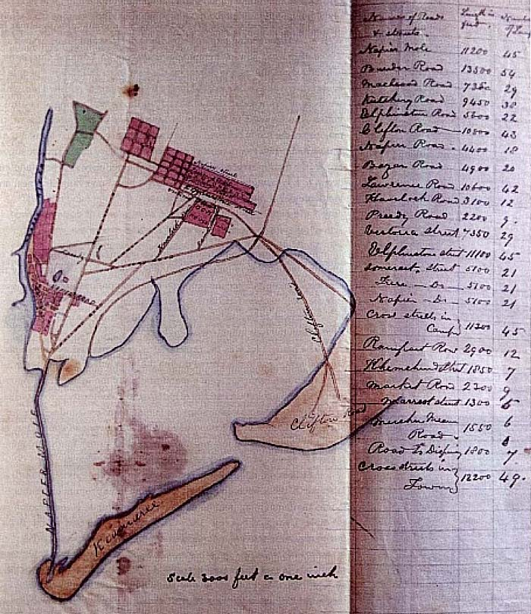

Slide 16
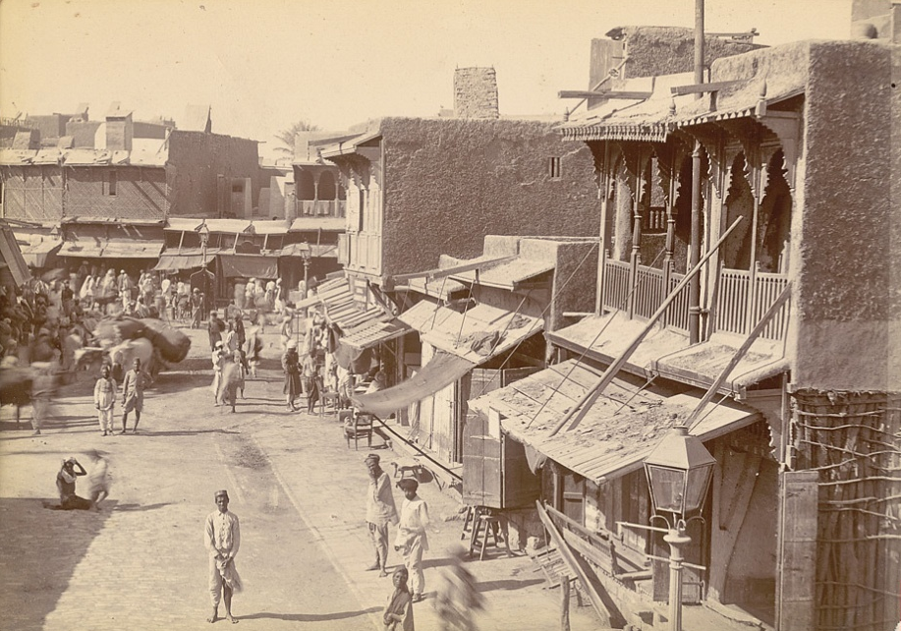

Slide 17
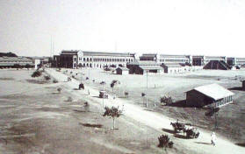

Slide 21
KARACHI’S DEMOGRAPHY ON THE EVE OF PARTITION
Population 450,000 (1,137,000 in 1951)
Languages spoken:
Sindhi 61.2% (8.6% in 1951)
Baluchi 8.6%
Urdu/Hindi 6.3% (50% in 1951)
Punjabi 4.3%
Gujrati 3.5%
Religions:
Hindus 51.0% (2% in 1951)
Muslims 42.0% (96% in 1951)
Christians 3.5%
Parsis 1.1%

Slide 25
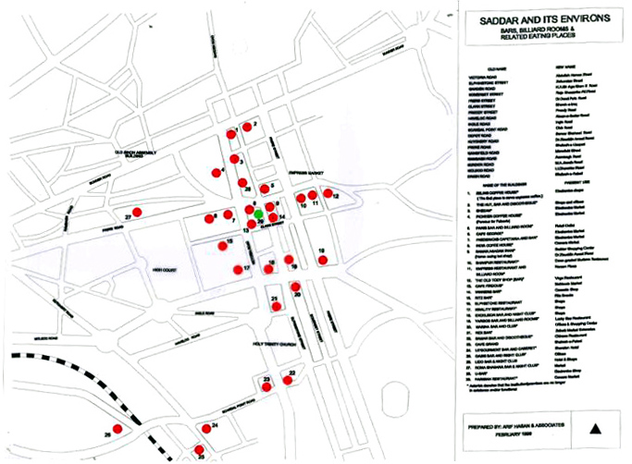

Slide 26
SADAR: WHAT WAS – WHAT IS COMPARISON
WHAT WAS WHAT IS
44 Old business houses 9
7 Halls 4
4 Playgrounds 2
5 Clubs / Associations 5
6 Churches 5
9 Schools 6
2 Health institutions 1
6 Libraries 2
17 Book shops 3
37 Eating Places 3
17 Bars 0
11 Billiard rooms 0
12 Cinemas (136 in Karachi) 4
4 Music and dance schools 0
181 Total 45

Slide 27
THE OLD CITY
Port activity 1951: 2.8 million tons per year (about 95% by railways)
Port activity 2006: 32 million tons per year (about 80% by roads)
Wholesales markets in inner city serve 1.3 million population in 1951
Wholesales markets in inner city serve 12 million population in 2006
The issue of warehousing / storage:
Dhan Mandi
The Chemical Market
The Metal Market
The Recycling Industry
Cargo terminals
Services sector to transportation

Slide 29
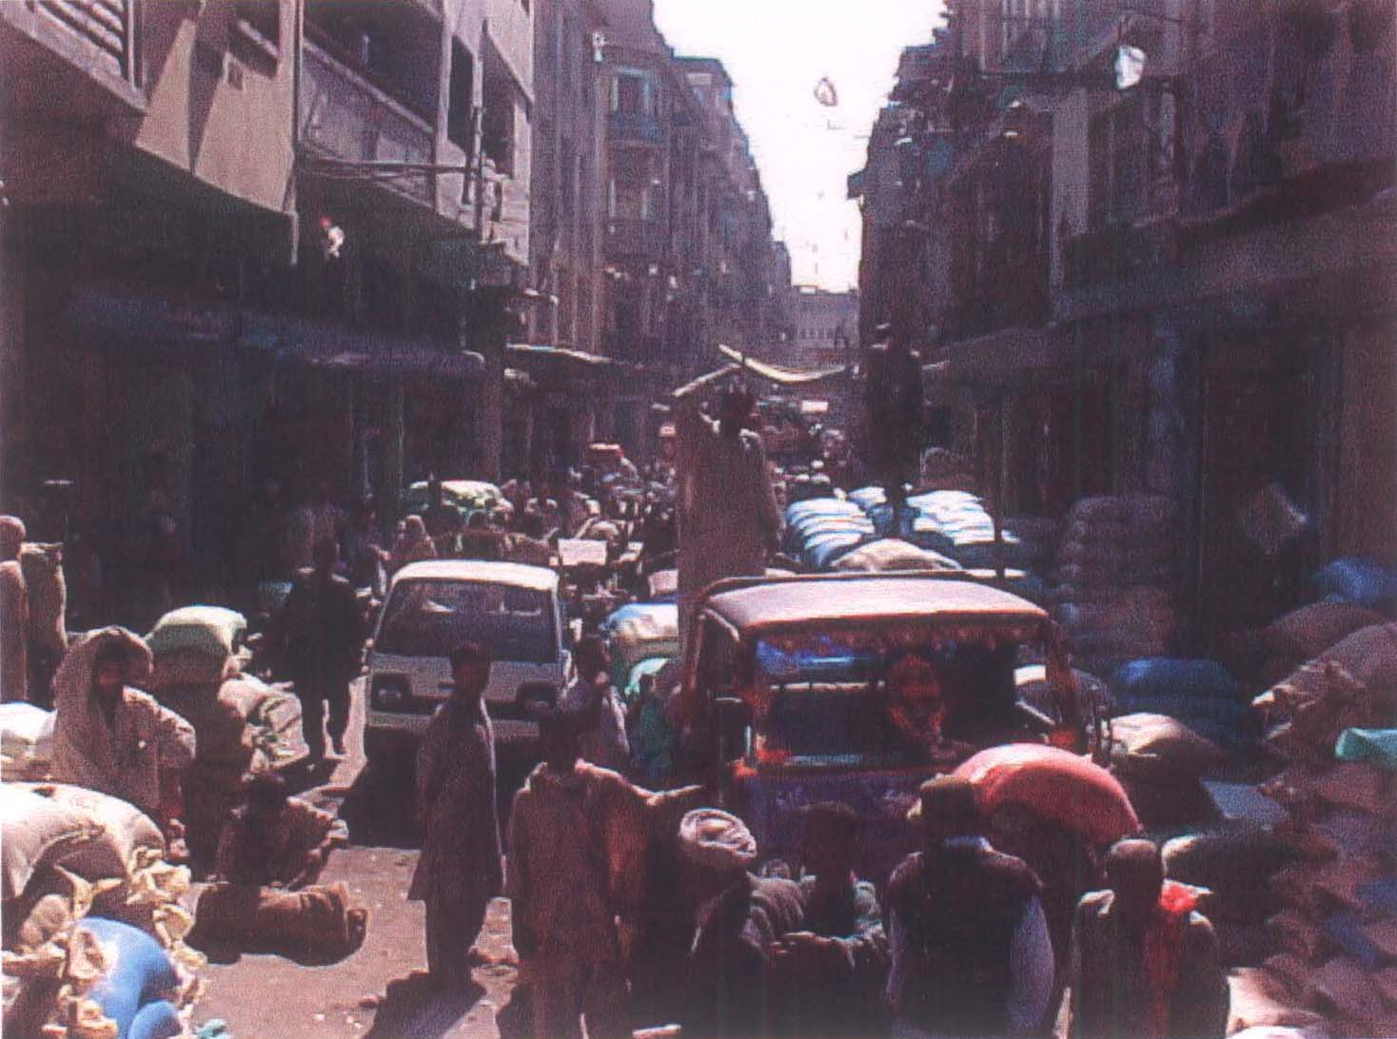
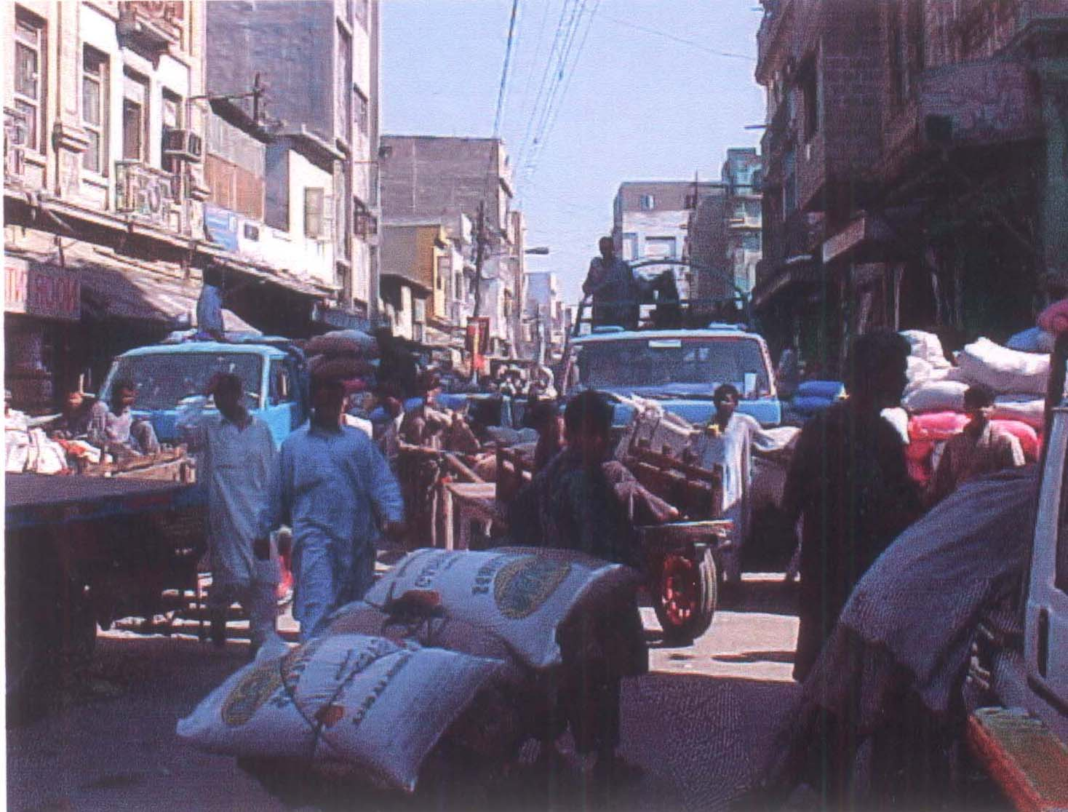

Slide 30
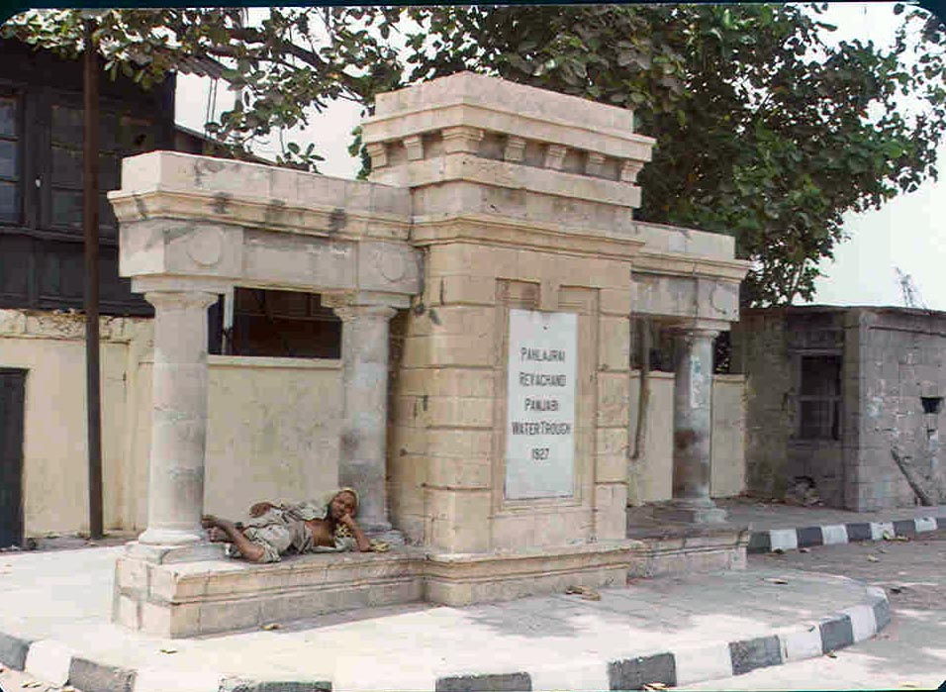
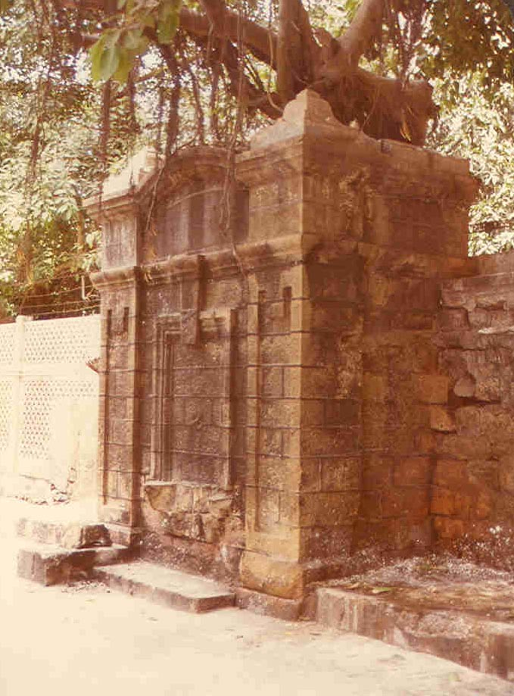
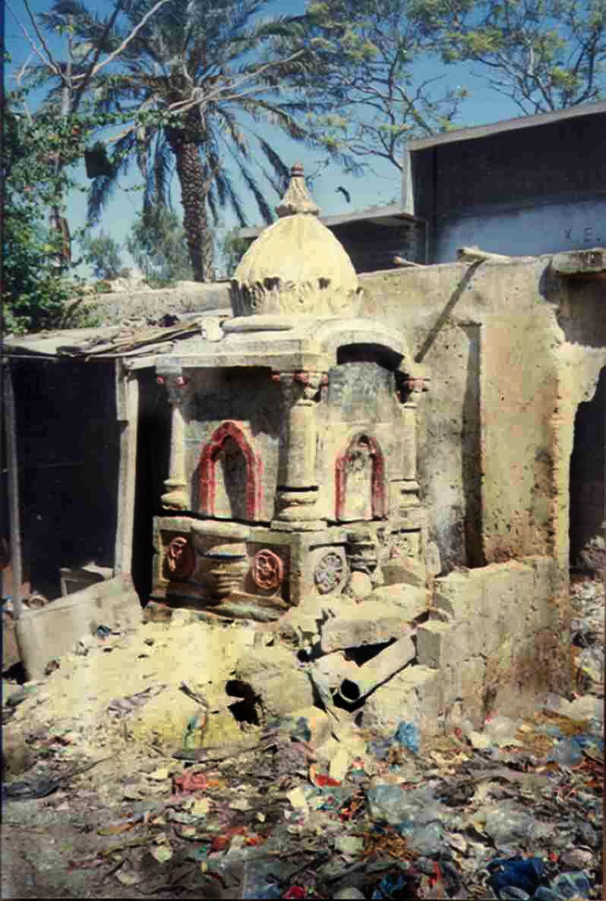
Karachi Water Trough

Slide 31
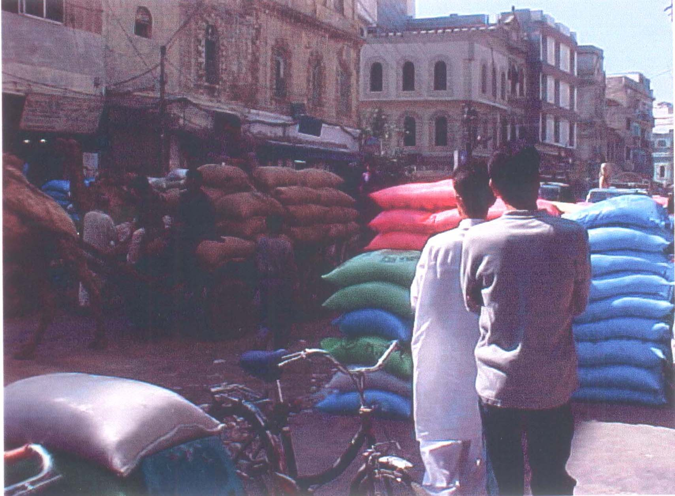
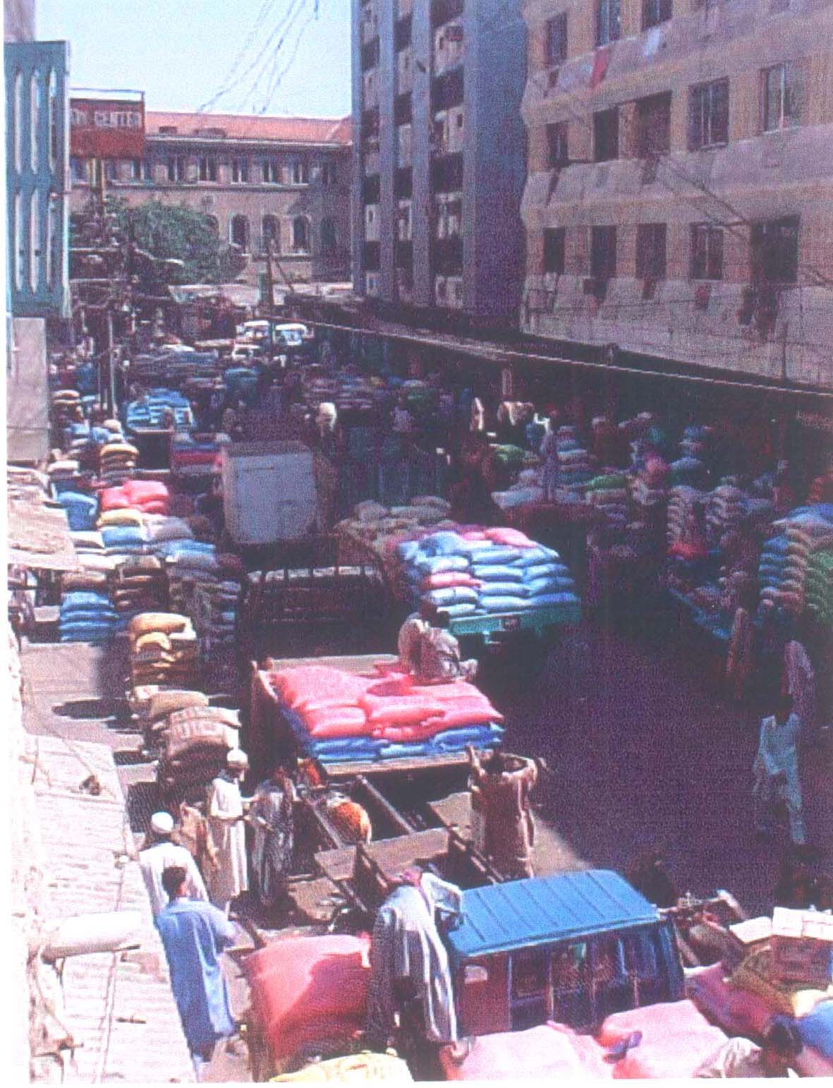

Slide 32
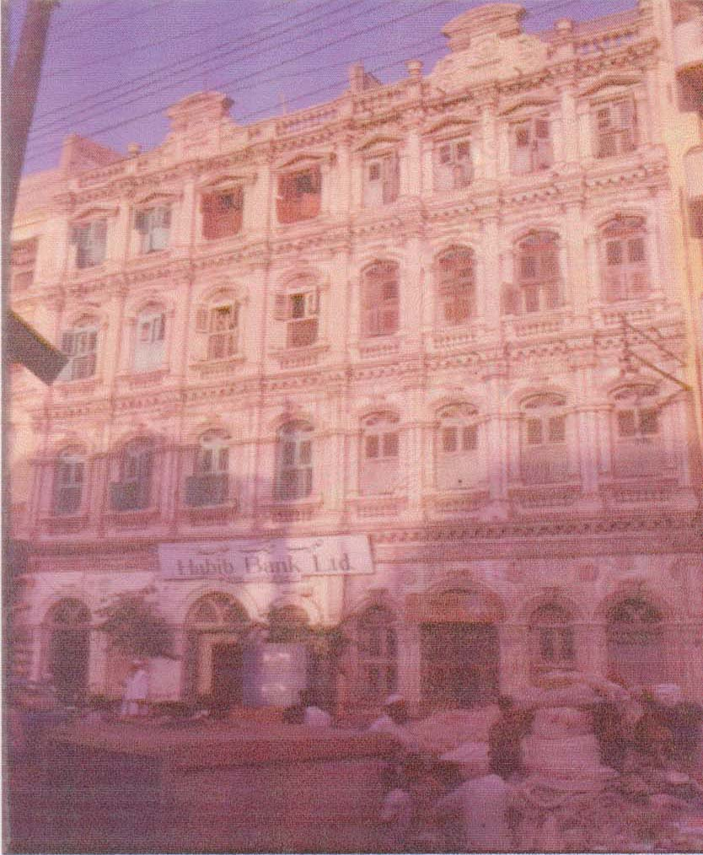
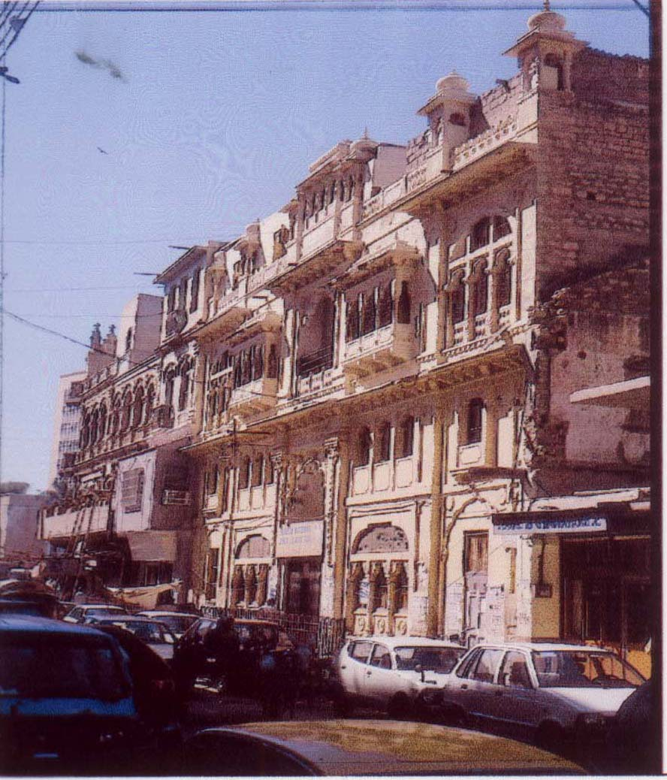
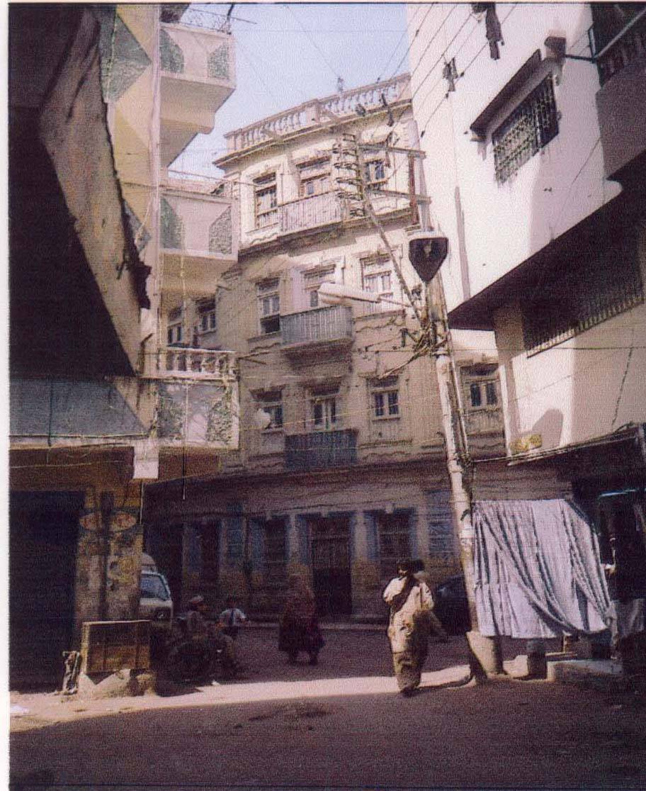
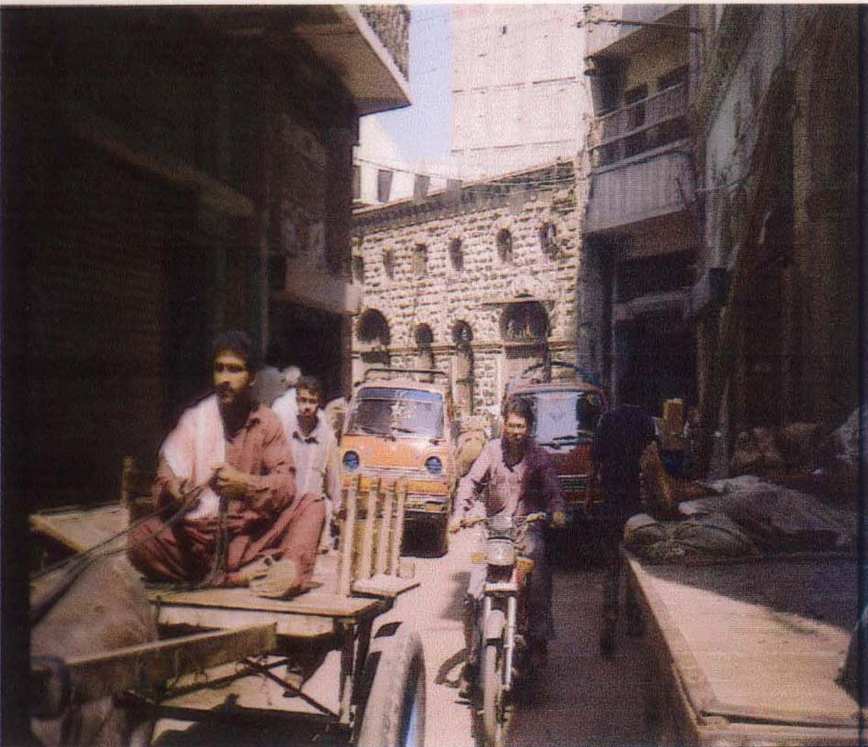

Slide 33
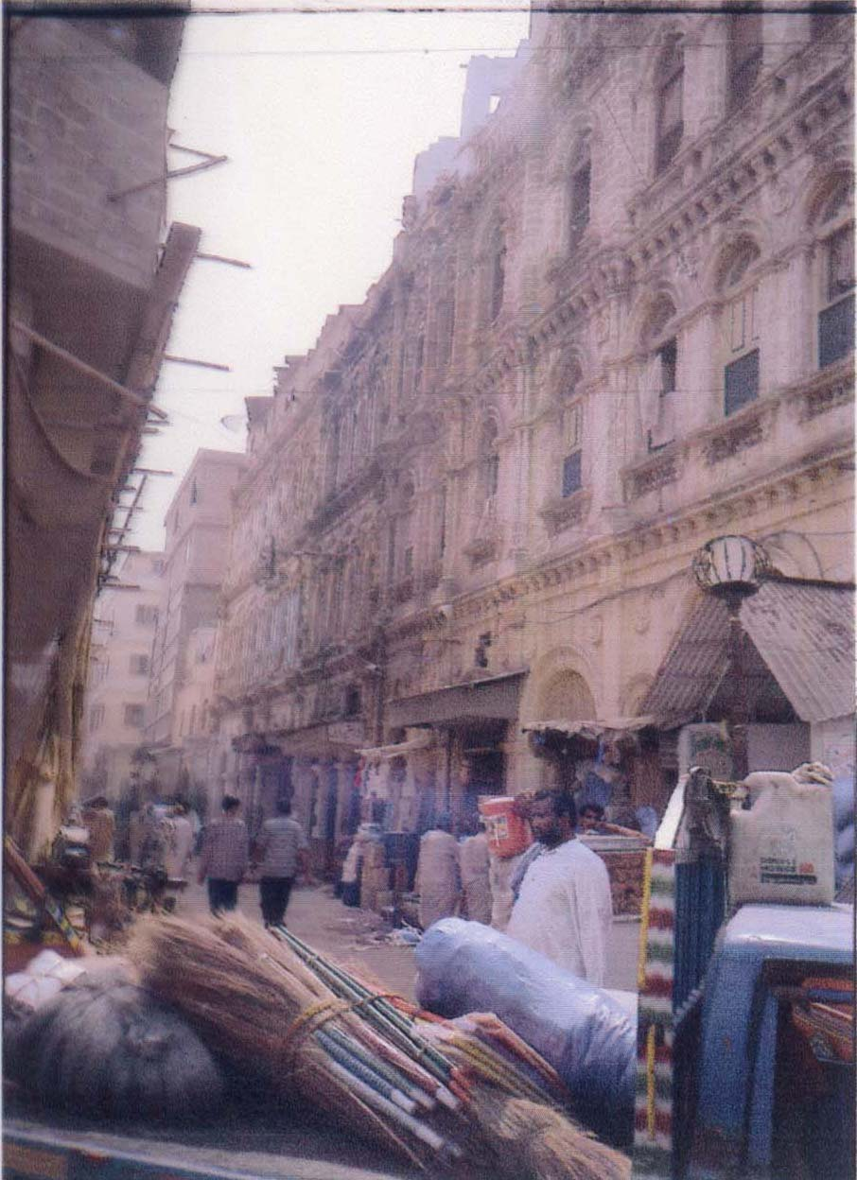
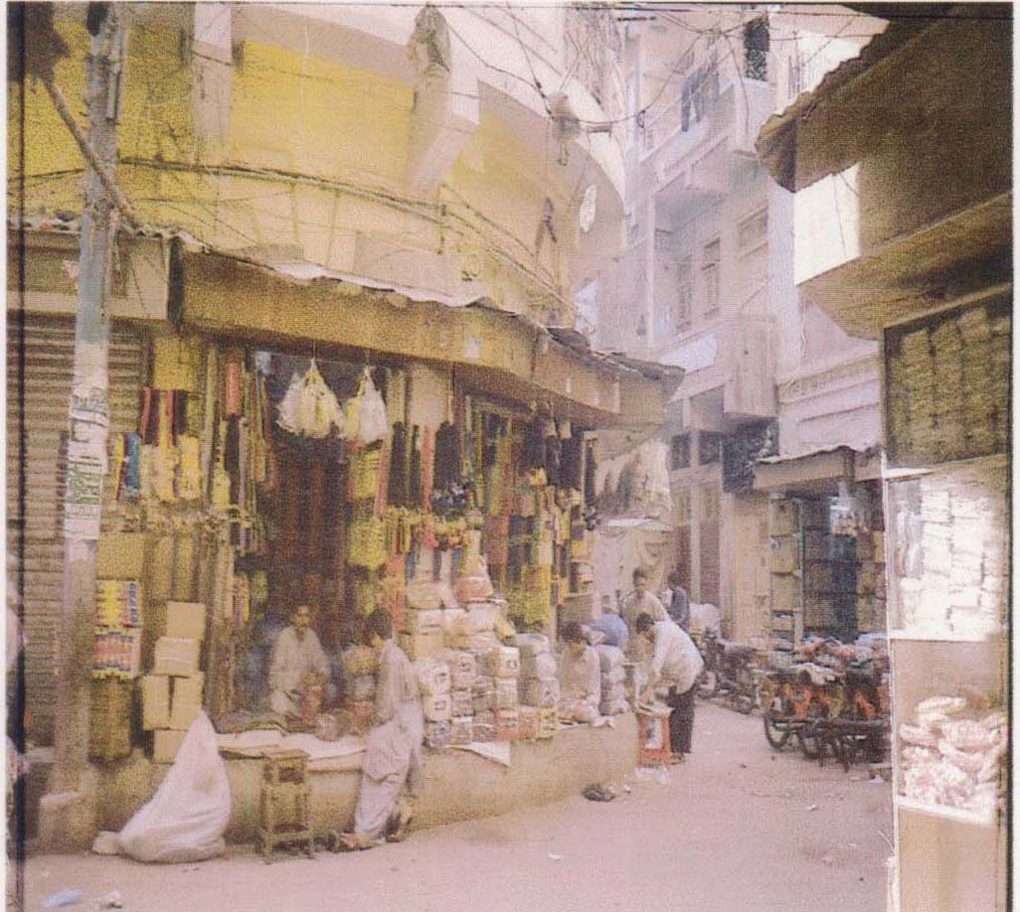

Slide 35
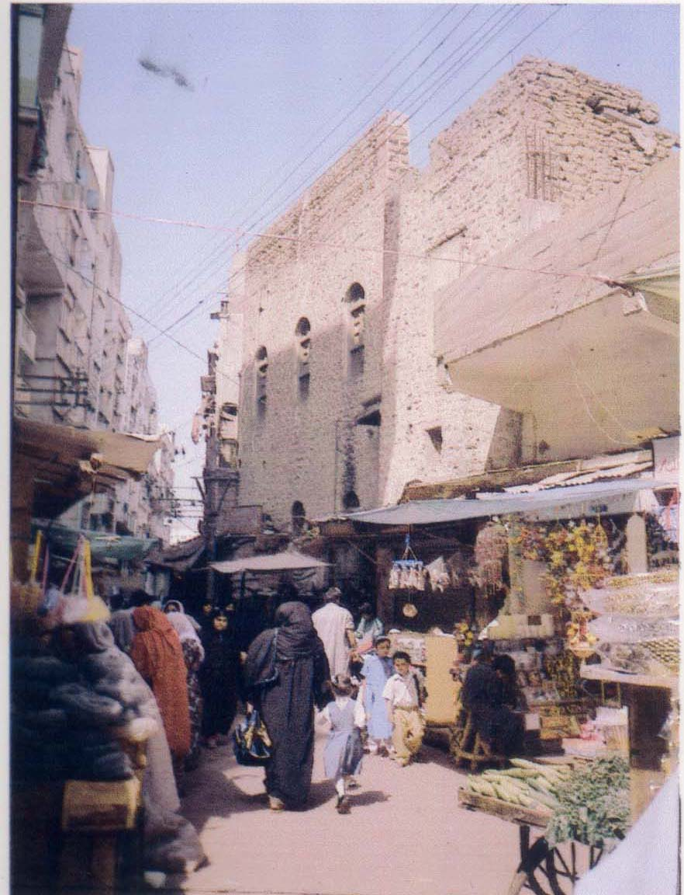
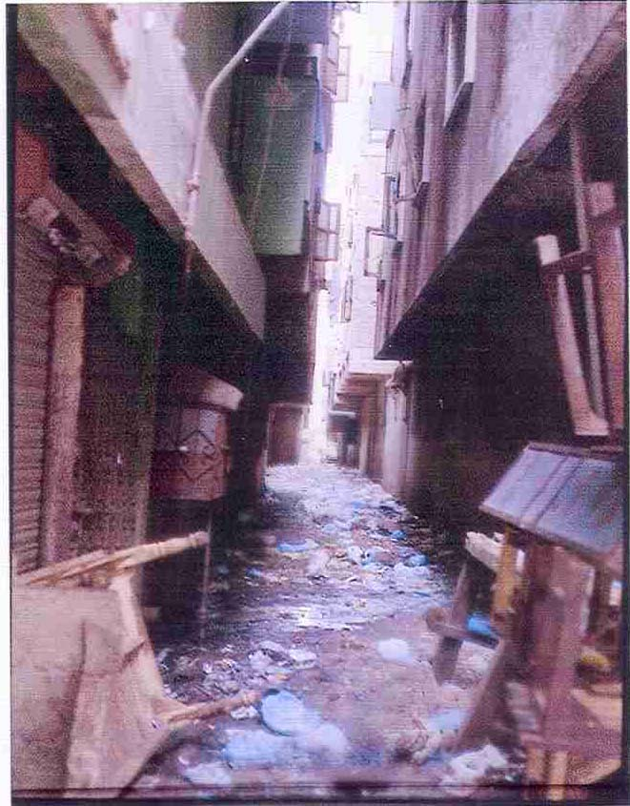

Slide 36
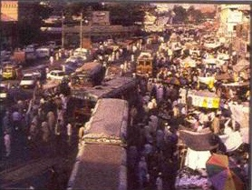
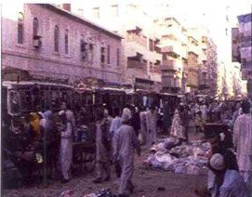
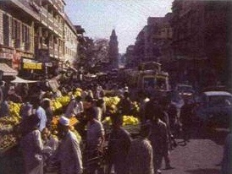
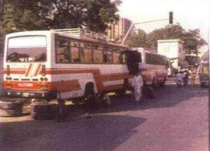

Slide 37
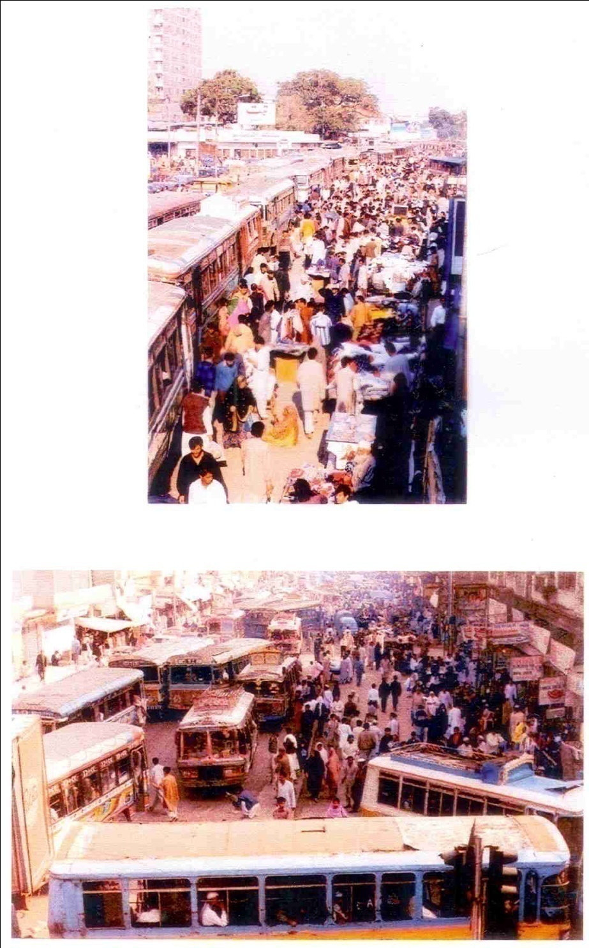

Slide 39
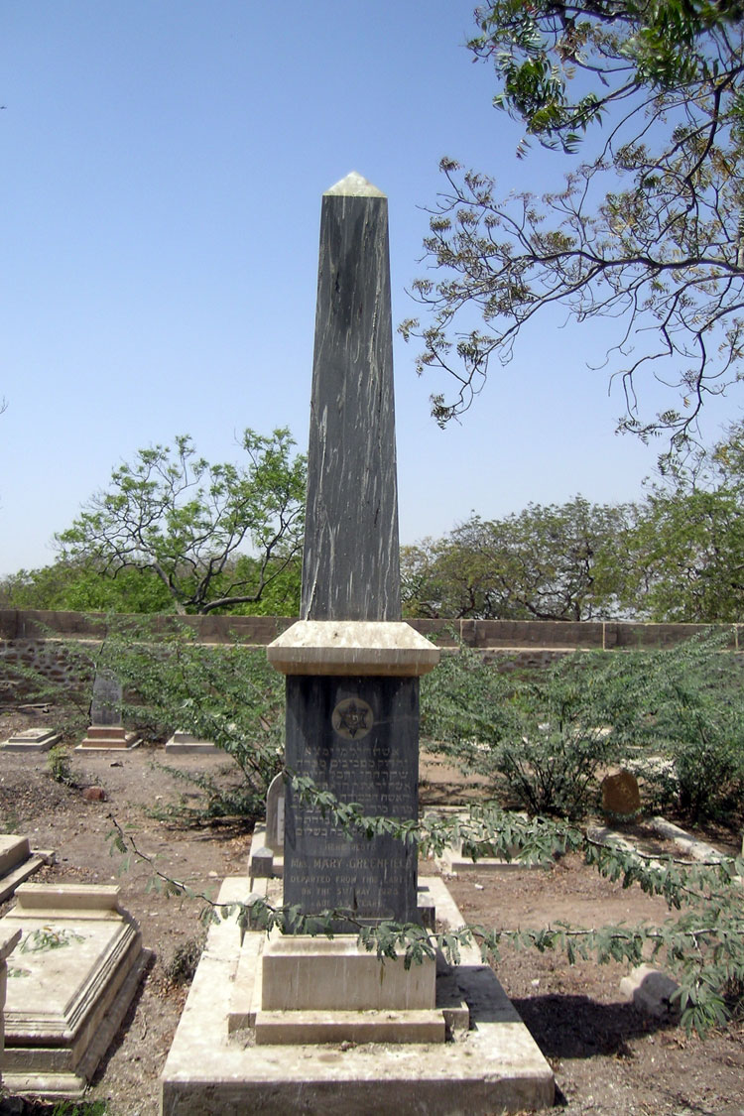

Slide 40
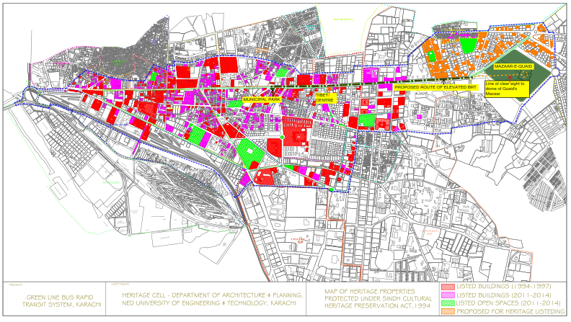

Slide 48
The Lane Was Transformed
Before
After

Slide 49
The Lane Was Transformed
Before
After

Slide 50
HARYANA COLONY NALA
Before
After

Slide 52
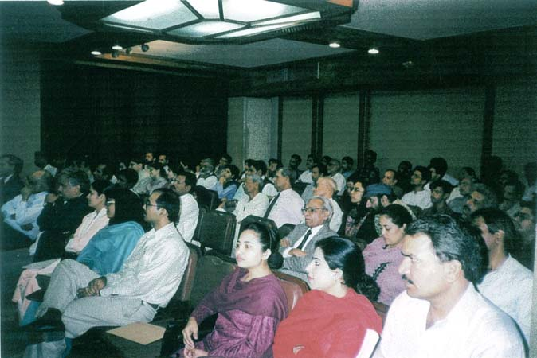

Slide 53
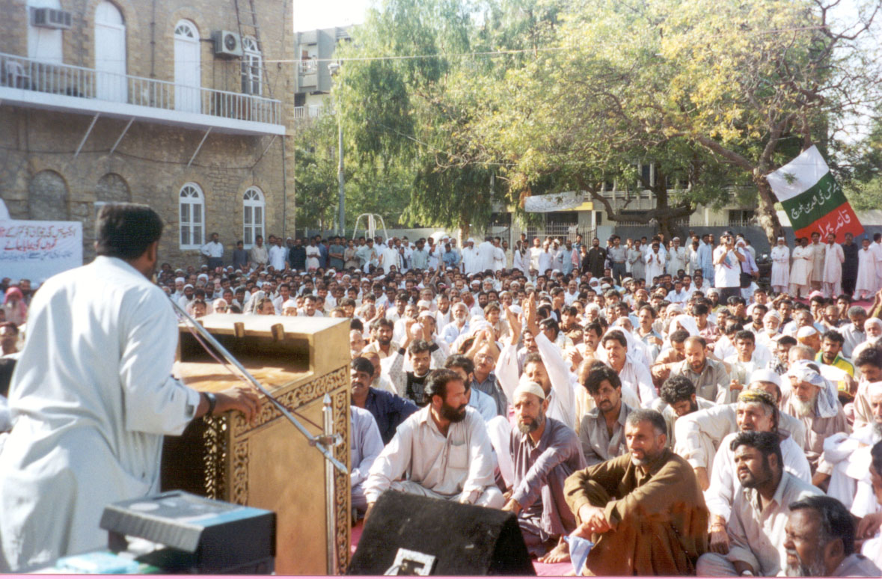

Slide 54
History of informal settlements in Karachi
1947-1951: Unorganized invasions
1951-1958: Bulldozing and relocation
1958-1962: Social housing in satellite towns
Discontinued after four years
1962-1968: Plot townships with no services
1955 onwards: Informal subdivisions (ISD or katchi abadis) on public land
1979 onwards: Regularization
62% of Karachiites live in ISDs
72% of ISDs have either been regularized or marked for regularization

Slide 55
Changing demography
In 1947, at Independence, Karachi had a population of 450,000
Today, it has an estimated population of about 22 million on the basis of the 2011 house count.
This makes it the fastest growing city in the world. In numerical terms no other city in history has grown faster.
The increase in population has been due predominately because of migration from India at the time of Partition and subsequent migration from other parts of Pakistan including migrations from Bangladesh, Burma, Afghanistan, Iran
A large but undocumented increase has taken place due to conflict in the KP and due to natural disasters (earthquake, floods and drought) since 2000
The migration created housing demand has not been met with the result that over 6o% of the households in Karachi live in informally created settlements (katchi abadis) which have changed over time

Slide 56
Housing Demand-Supply Gap
Housing demand : 120,000 per year
Formal sector housing supply : 42,000 per year
(Average over last 5 years)
Accommodated in katchi abadis : 32,000 per year
Rest accommodated through densification of existing settlements.
In the last two years, 90,000 plots have been developed informally for low and lower-middle income groups in the north and west of Karachi.
The issue of densification and its societal repercussions.

Slide 57
The emerging katchi abadis are different from the earlier ones
Because
Before the city was small, land was cheap, there was no middle class demand and the city periphery was near the city work places
Now the city periphery, where cheap land is available, is far away from work areas.
Hence living on the periphery has serious problems of travel, time and social costs in addition to absence of jobs and social amenities
Middle income housing and elite gated communities are occupying the immediate periphery pushing new katchi abadis further away from work areas
As a result, it is now cheaper to rent or get an apartment on pugri in a settlement nearer to the city than living in ones’ own house on the periphery

Slide 58
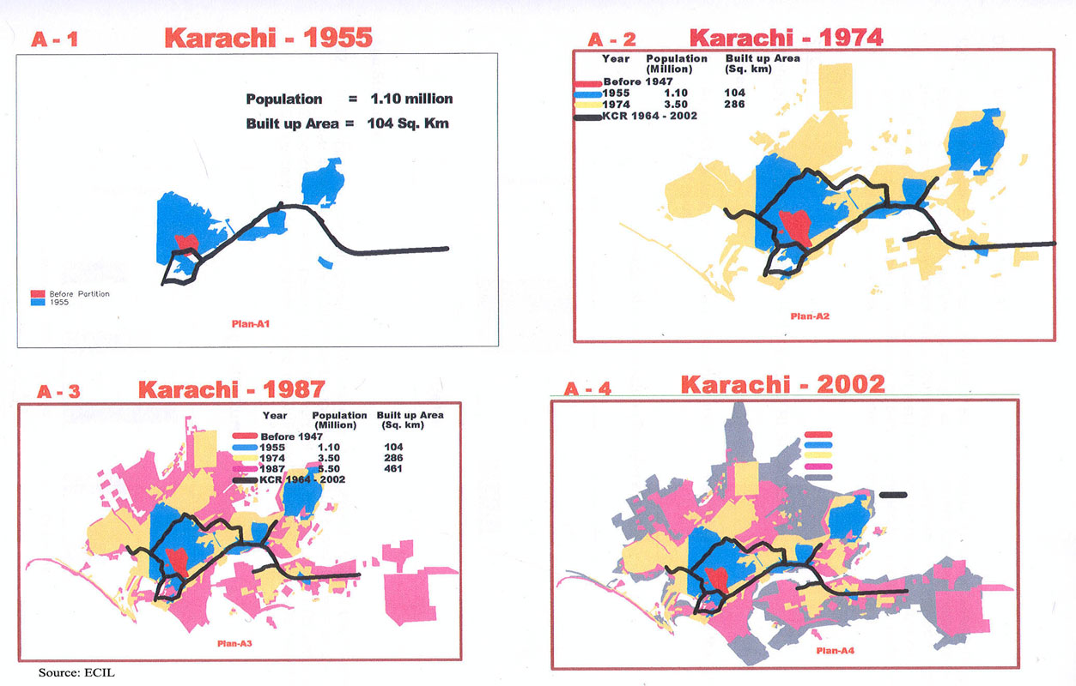
The changing locations of low income settlements

Slide 59
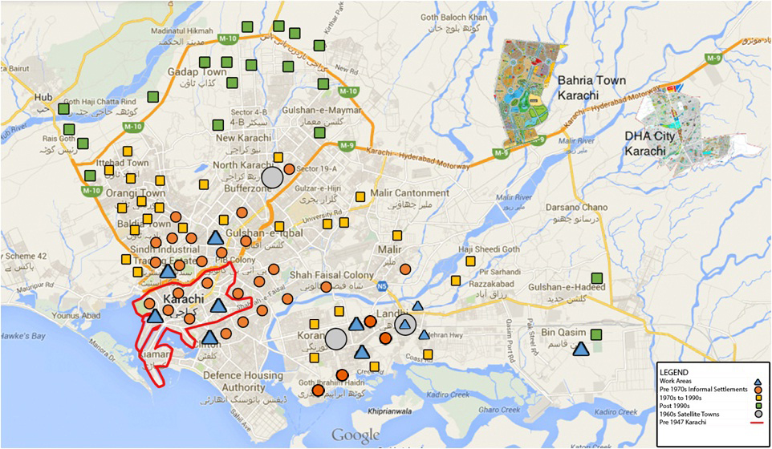

Slide 60
How people house themselves today: Government response
Post-liberalization de facto government policy
Access the market
Liberalization of credit terms
Collateral required: poor do not have it
Formal sector job required : 72% work informally
No credit for purchase of land
High rate of markup
The developers do not cater

Slide 61
Informal sector market response to the issue
Densification of existing katchi abadis by changing one or two storey informally built homes into multi-storey buildings in three ways
House owners building upwards to accommodate the expanding family
House owners building upwards to create rentals for additional income
Informal developers purchasing land from house owners and paying them in cash plus two apartments on the top floor

Slide 62
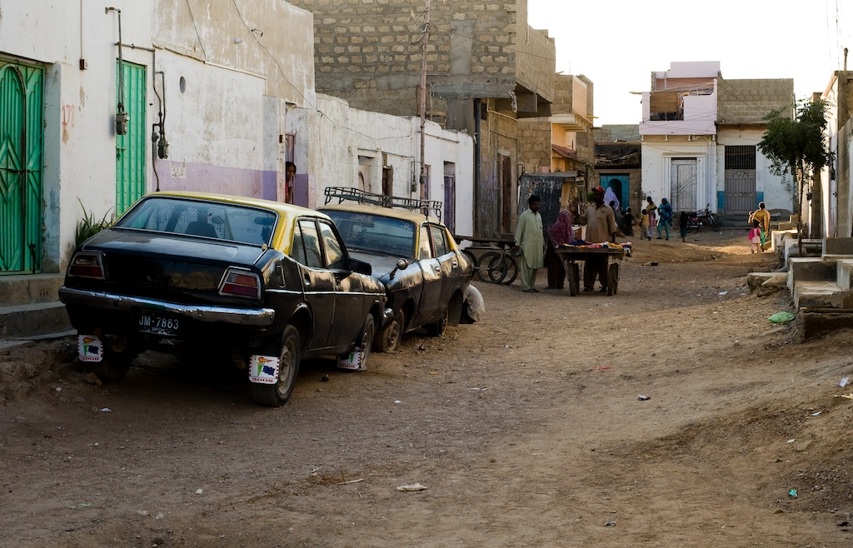
Old Katchi Abadis

Slide 64
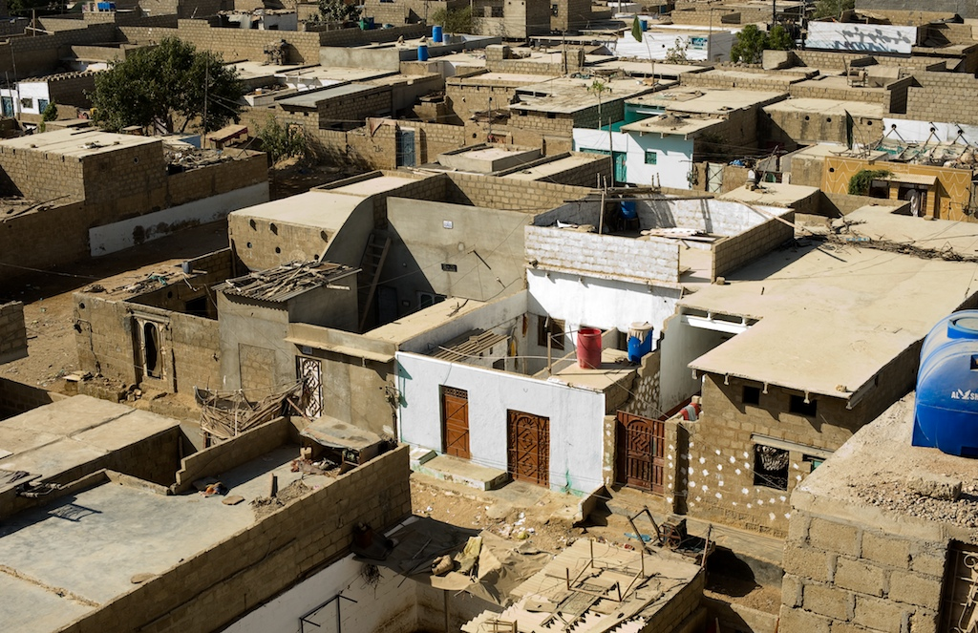
Old Katchi Abadis

Slide 65
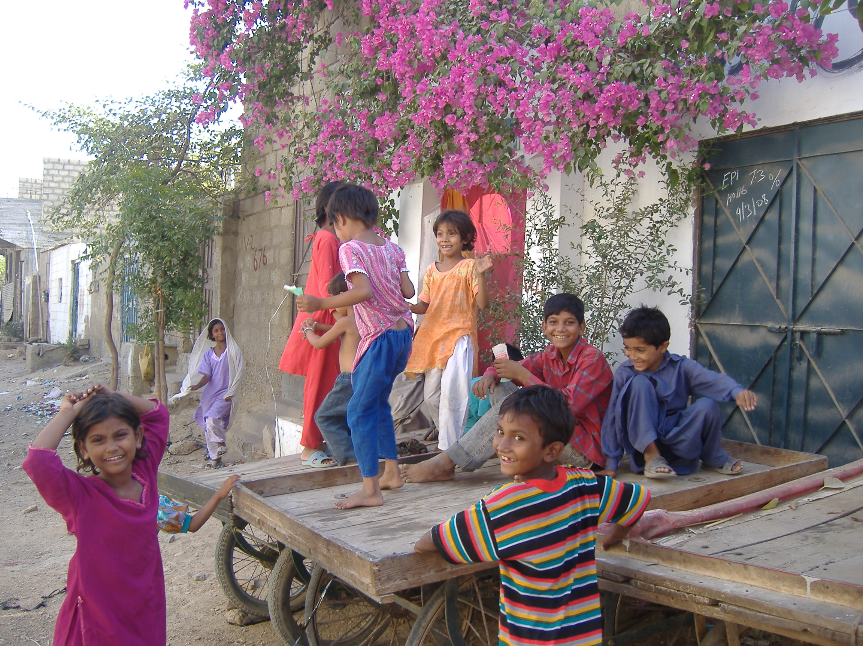

Slide 66
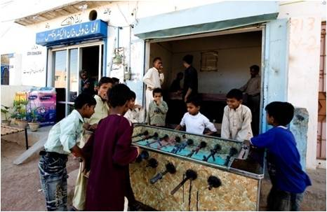

Slide 67
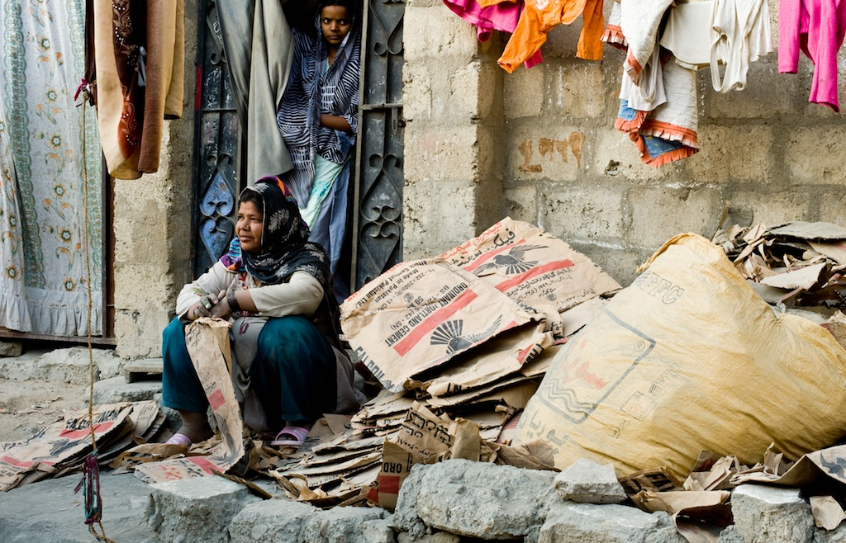

Slide 68
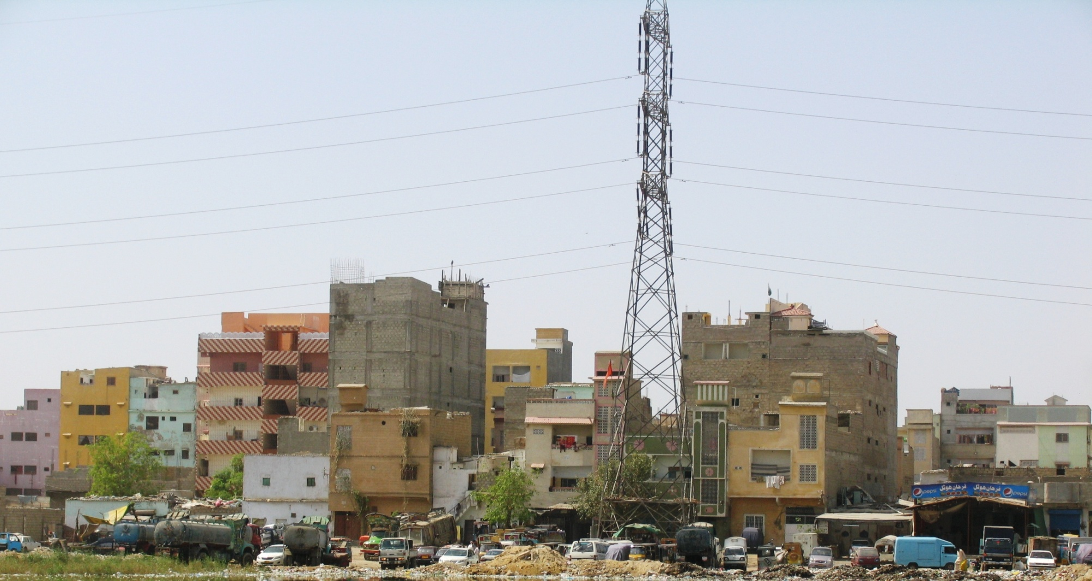
Katchi Abadis High-rises near City Centre

Slide 69
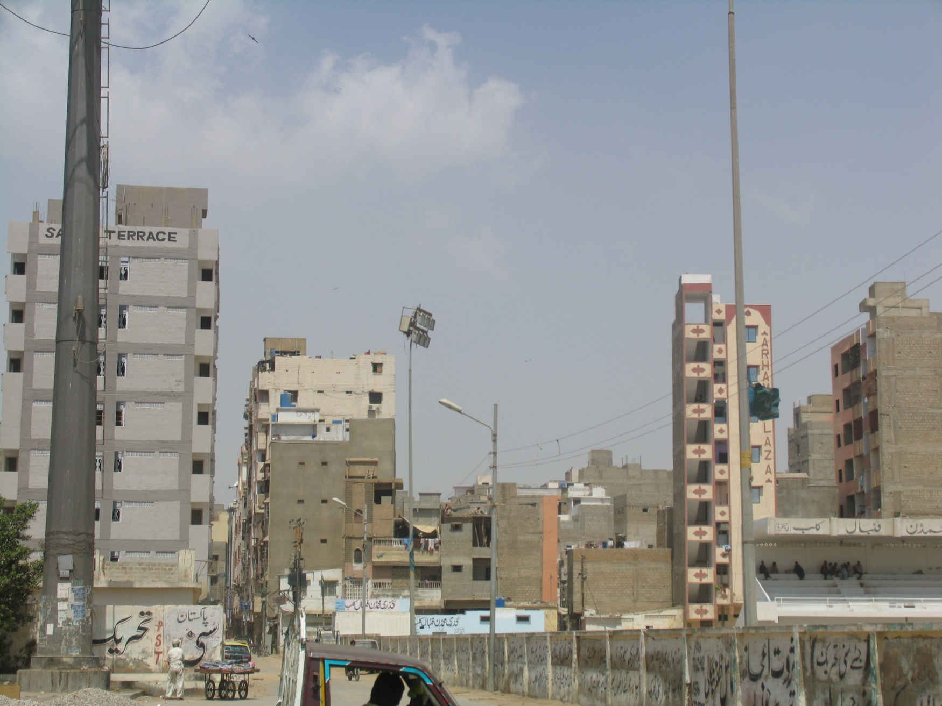

Slide 70
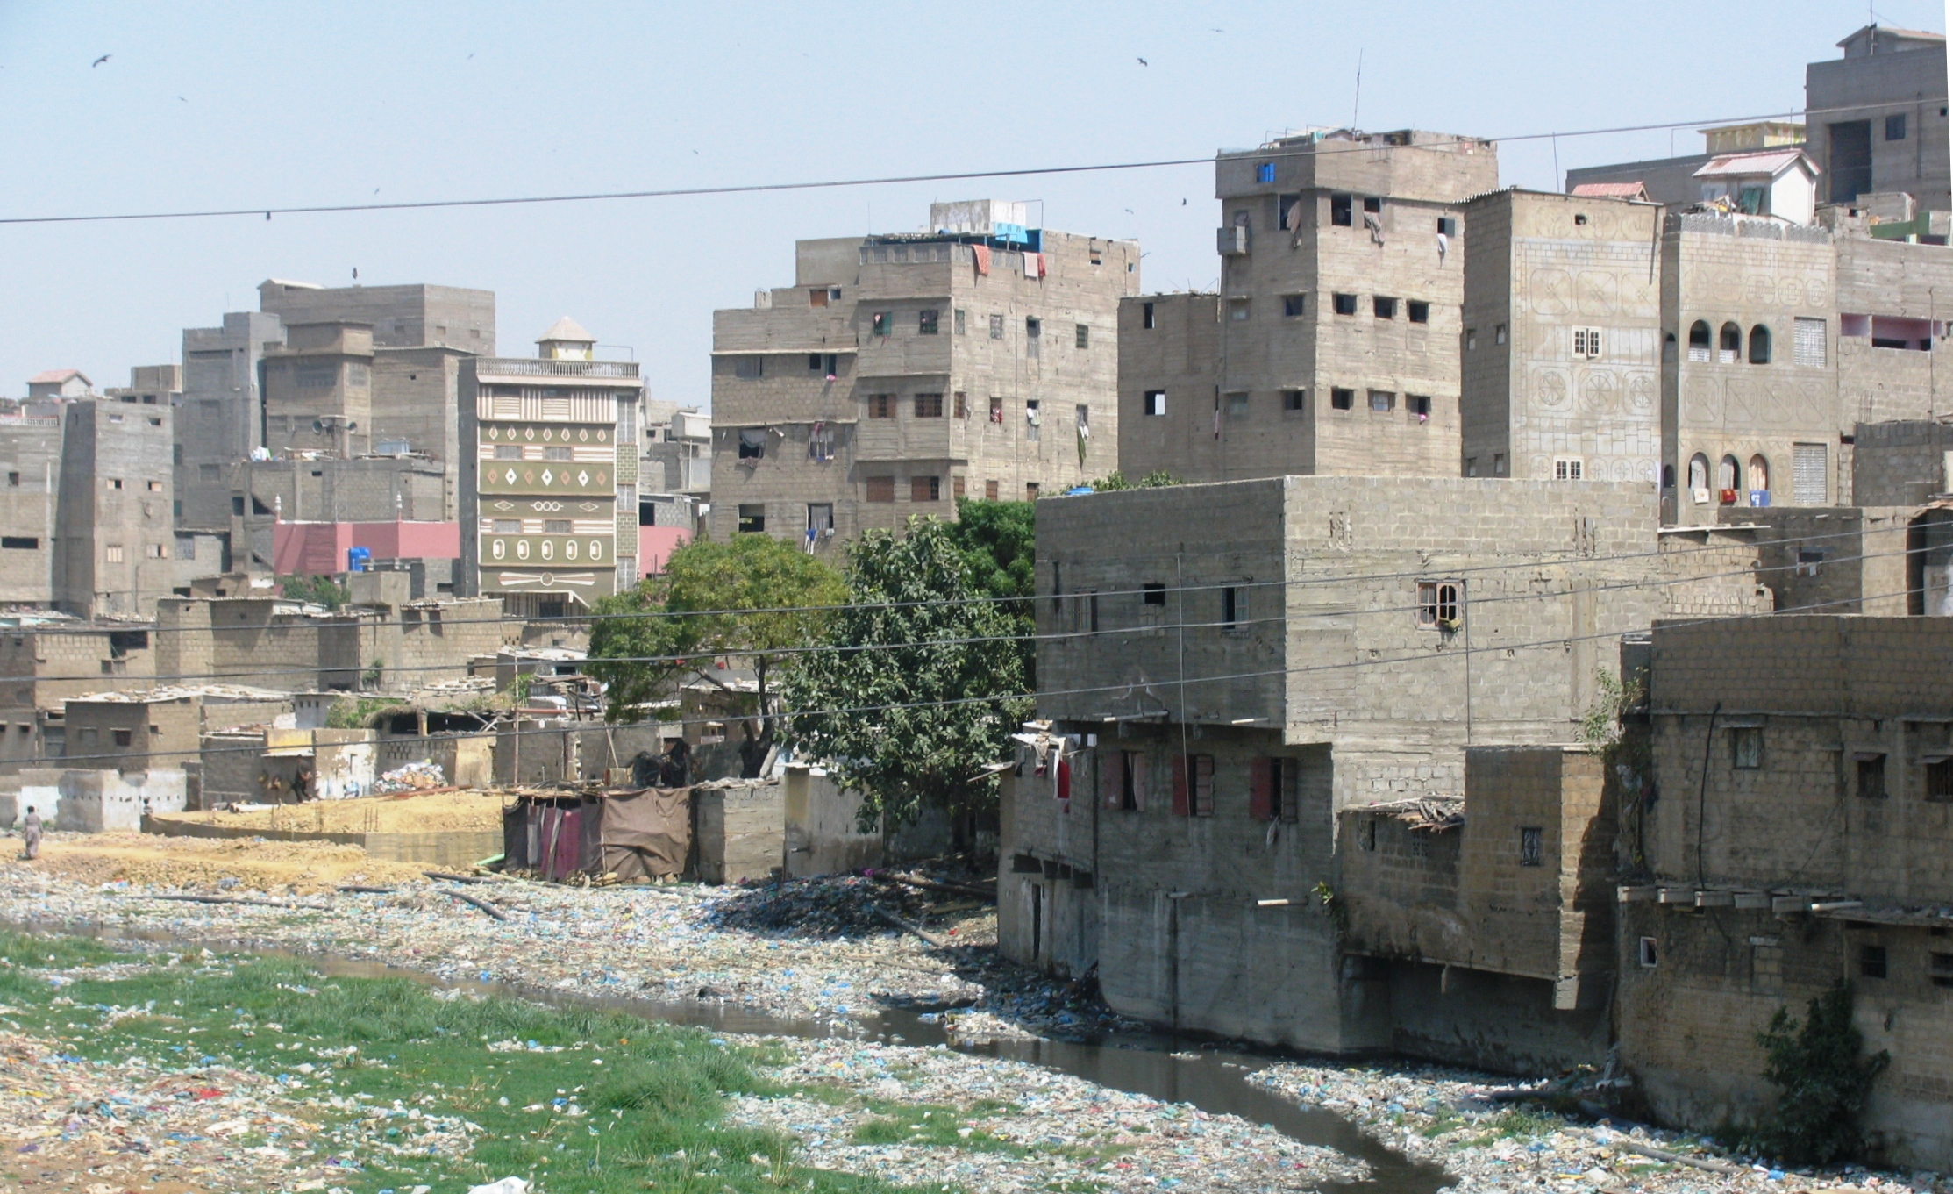

Slide 72
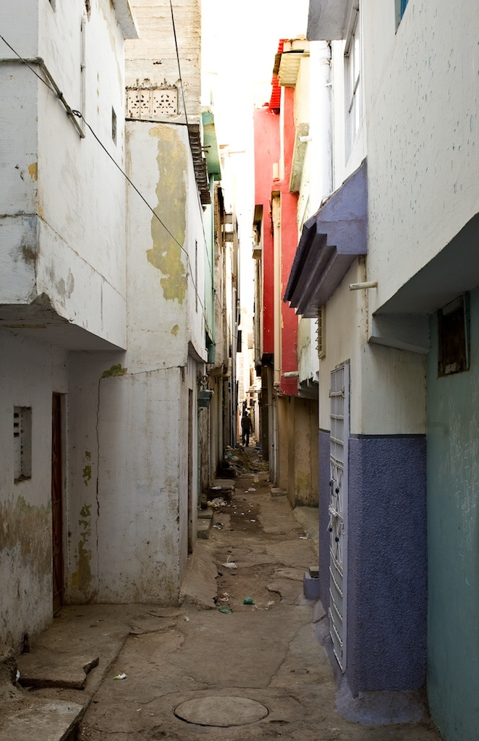
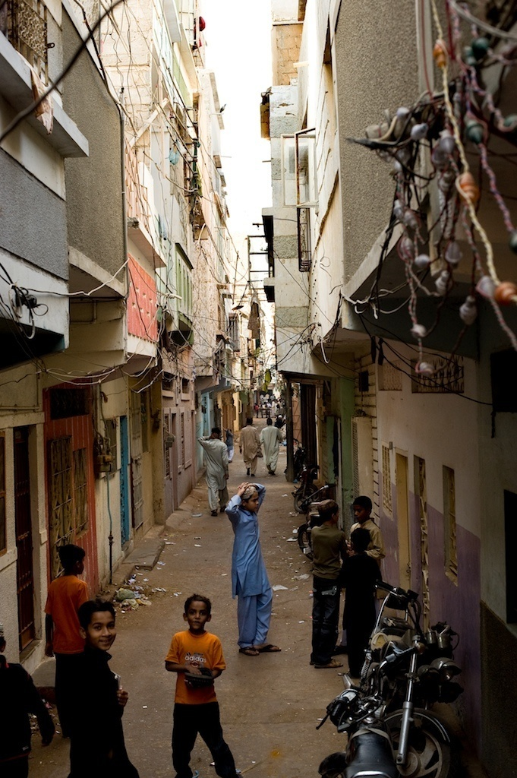

Slide 73
Densification Issues - 1
Smaller and smaller units to make them affordable : 6-10 persons per room
No lifts : Effect on women, children and old persons
No SBCA rules and regulations followed
Freedom to stay away from home
Formation of gangs
The issue of toilets
The growth of rentals : their vulnerability
Political control easier in apartment complexes.
Increase in household size by 10% between 1998 to 2011 though fertility rates have dropped.

Slide 74
We are told to densify
Yet, the three most dense cities in the world are in South-Asia
Actual Density Maximum Permissible
as per regulations
Dhaka 4,400 1,200
Mumbai 3,230 900 ?
Karachi 2,280 1,625

Slide 75
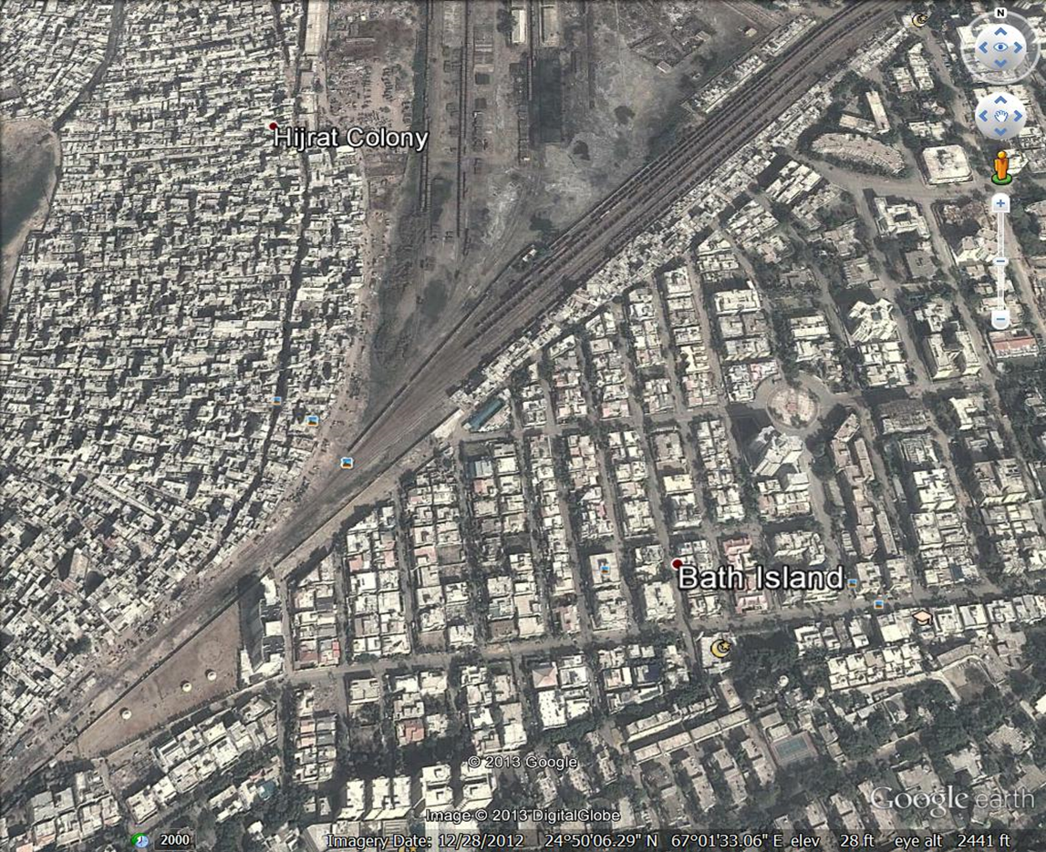

Slide 76
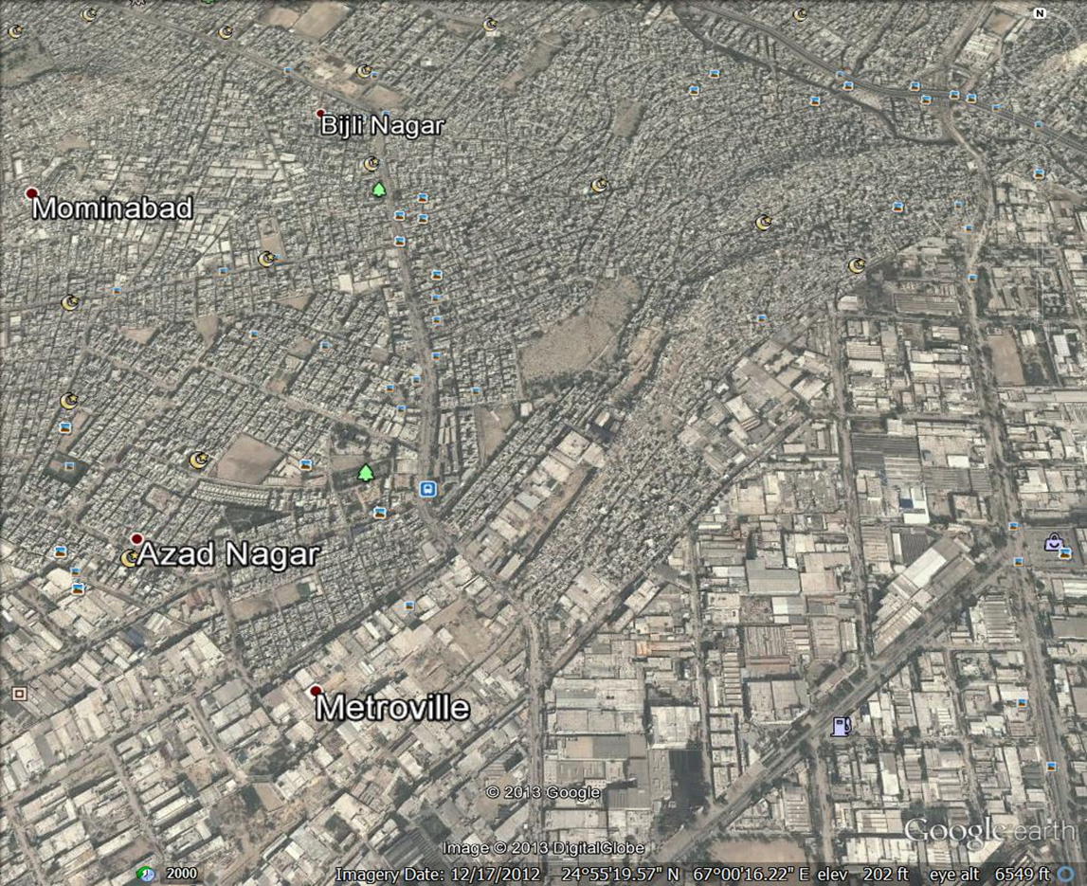

Slide 77
Karachi Residential Land-use
62% (about 13 million) of Karachi’s citizens live in informal settlements on 23% of the city’s residential lands.
Densities in these settlements are between 1,500 – 4,500 persons per ha and continues to increase
Persons per room: 6 – 10
The issue of toilets: 20 persons per wc
36% (about 7.5 million) of Karachiites live in “planned” settlements on 77% of the city’s residential lands.
Densities can be as low as 80 persons per ha and continue to decrease in new settlements

Slide 78
Houses / Plot Sizes
71.32% live on les than 100 square yard plots
24.27% live on 100 – 120 square yard plots
3% live on 120 – 240 square yard plot
1.47% above 240 square yard plots

Slide 79
Study of Four Sites
Labour Square Apartments
Built 1976
No. of persons per apartment in 1976: 5.8
No. of persons per apartment in 2010: 10
Nawalane Inner City Informal Settlement
Density in 1973: 450 p/ha
Density in 2010: 3,500 p/ha
Paposhnagar: Formal Sector Lower Middle Income Settlement
Density in 1955: 250 p/ha
Density in 2010: 1,180 p/ha
4. Fahad Square Apartments
Built in 1999
No. of persons per apartment in 2010: 5.72
Density: 942 p/ha
The process of densification
The negative aspects of unplanned densification

Slide 80
Criteria for Evaluating Projects
Accepted that for the foreseeable future there will be only projects. Four criteria must apply for judging projects.
Projects should not damage the ecology of the region in which Karachi is located
Projects must determine land-use on the basis of social and environmental
consideration and not on the basis of land value alone
Projects should serve the interests of the majority which are low and lower middle income groups
Projects should respect and enhance the tangible and intangible culture of the communities that live in Karachi

Slide 81
Emerging Trends in Government Policy
Support to developers for creating large gated elite/middle income settlements on the city’s periphery.
The Sindh High Density Board Act 2014
The Sindh Development Board Act 2014
The Creation of utilities Companies.
Liberalization of finance for house building
Promotion of long term unaffordable transport projects
These laws help the developers control and shape the form and land use of the city

Slide 82
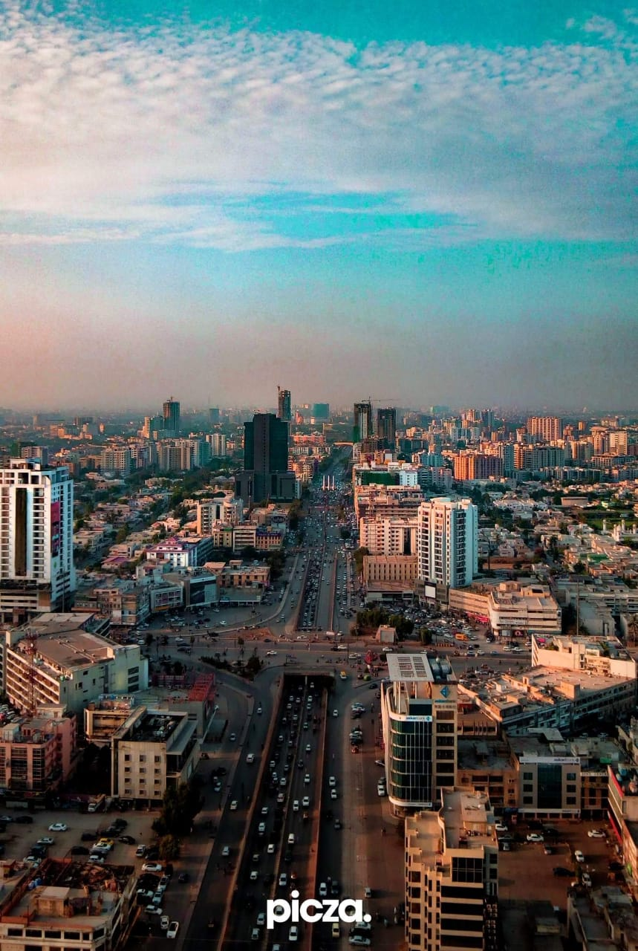

Slide 83
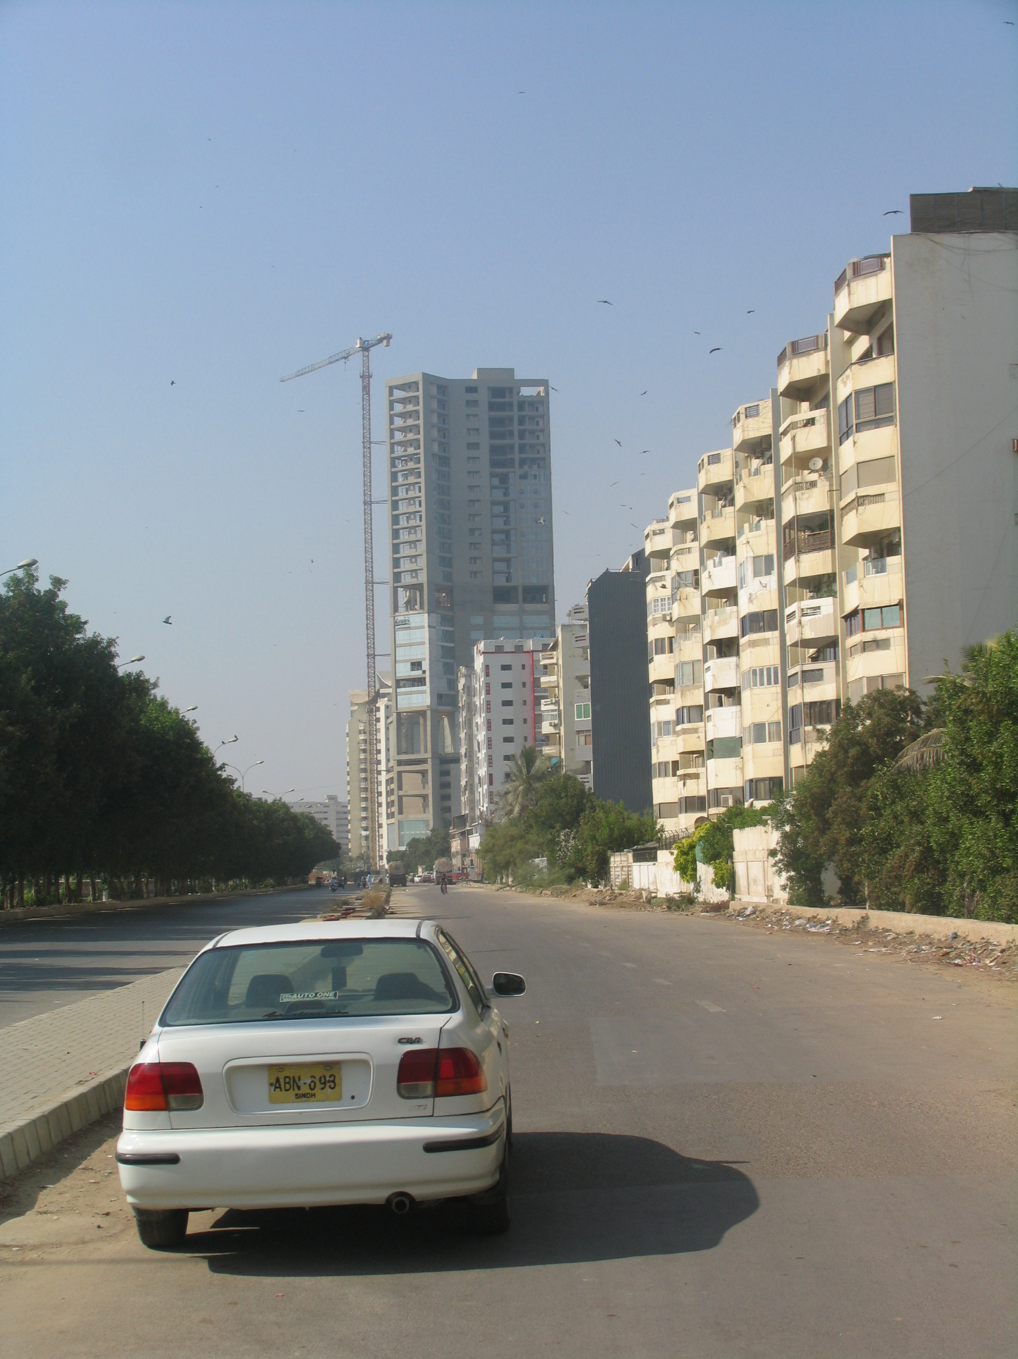

Slide 91
New Developments
30,000 hectares of gated housing for the elite and middle classes out of the city
Density: 98 p/ha
Population: 3,000,000
The case of Bahria Town
Heritage sites
Speculation
200,000 developed plots are lying vacant
62,000 apartments are unoccupied
Over 120 buildings of between 20 to 50 floors under construction
200,000 housing units being developed formally

Slide 92
The impact on ecology
The city floods because of encroachment on the outfalls to the sea by elite housing projects and land reclamation for informal settlements. Will flood more
Reclamation from mangroves (about 15,000 hectares) has damaged flora and fauna
The city expansion evicted 2,800 plus villages destroying the rural economy and impoverishing the rural population
In 1985, 70% of Karachi’s vegetable/fruit requirements came from its rural areas. In 2013, this was reduced to 10%.
60 billion cubic feet of sand and gravel has been illegally lifted for construction from the seasonal rivers making recharging of the aquifer impossible and depleting the rainwater aquifer.
Early turnover from the sand and gravel business is US$ 45 million

Slide 96
Motor Bikes
Motor bikes in 1990: 450,000
2004: 500,000
2010: 1,000,000
2013: 1,350,000
2016: 2,000,000 plus
2018: 2,400,000 plus
Preferred to public transport apart from capital expense cheaper, faster and flexible.
82% men at bus stops want them.
56% women want permission to ride them.
They will keep increasing.
Increase in fatal accidents.
Should they be promoted?

Slide 98
QINGQI
Over 62,000
Cheaper, faster, more comfortable
No subsidy
Ideal for families
Creates congestion
Should they be promoted?

Slide 101
Social Change
Age Group 15 – 24:
Married percentage 1981 2006
Men 13.39 7 (extrapolated from the 1998 Census)
Women 37.45 17 (extrapolated from the 1998 Census)
Literacy percentage 1981 2006
Men 68.08 85 (extrapolated from the 1998 Census)
Women 64.01 81 (extrapolated from the 1998 Census)
Nuclear Family Formation: 1987 2006
Percentage of nuclear families 57.00 84.54
Court Marriages:
Data shows an increase in geometric progression
Women Students in Public Sector Universities:
Karachi University 68 %
Medical students 87 %
Engineering University 50 % (about)
Architecture and planning 92 %
Repercussions of social change
Changes in gender relations
Changes in use of public space
Conflict between tradition and social reality

Slide 103
Required an urban land reform
A Land Ceiling Act: No one person should own more than 500 square meters of urban land
Minimum density for any urban development project should be 450 p/ha
There should be a large enough non-utilization fee on developed urban land so as to discourage speculative investment
No loans should be offered for housing to those who have already received loans previously
The development of a land inventory and its yearly updating and publication
Technical and financial support to communities and the informal sector in housing for the densification process

Slide 116
“I will not do projects that will irreparably damage the ecology and environment of the area in which they are located; I will not do projects that increase poverty, dislocate people and destroy the tangible and intangible cultural heritage of communities that live in the city; I will not do projects that destroy multi-class public space and violate environment friendly bylaws and zoning regulations; and I will always object to insensitive projects that do all this, provided I can offer viable alternatives.”
Arif Hasan, 1983

