Slide 1
The Inadequacy of Existing Heritage Related Laws and Institutions for Karachi
Seminar on Preserving Karachi’s Heritage: Challenges and Opportunities
IAP Karachi, 24 October 2017
By
Arif Hasan
Email: arifhasan37@gmail.com
Web: www.arifhasan.org

Slide 2
Existing Laws
Land Acquisition Act 1894
Karachi Development Authority Order, 1957
The Antiquities Act, 1975
The Sindh Building Control Ordinance, 1979
The Sindh Cultural Heritage (Preservation) Act, 1994
The Sindh High Density Board Act, 1994

Slide 3
The Land Acquisition Act, 1894:
Under this Act the state can acquire land from any owner, private or public for public good. (“Public purpose”)
There are well defined processes for acquiring the land and for providing compensation to the original owners
There has been considerable misuse of these laws that has increased poverty and homelessness
The Antiquities Act, 1975:
The Act deals with the preservation and protection of antiquities (moveable or immoveable), historic, ethnograpic, anthropological, military or scientific interest, and/or national monuments
The Director of Archealogy, government of Pakistan is empowered for custody, preservation and protection of an antiquity
The Act contains procedures, rules and regulations including those related to causing harm to protected antiquity and punishments for doing so
After the 18th Amendment , the powers under this Act have been transferred to the province

Slide 4
The Sindh Building Control Ordinance, 1979:
The Ordinance deals with building and town planning issues for the whole of Sindh including Karachi
A committee of experts is supposed to develop building byelaws and zoning regulations for the city and is empowered to make necessary modifications to the regulations as and when required
The Ordinance envisaged a Master Plan and Environment Control Department (MP&ECD) which would prepare a master or strategic plan for the city and oversee its implementation for every decade
There is also a regulation related to cultural heritage, defined as “special architectural or historic interest premises” and its surrounding area. The MP&ECD is empowered to list, protect and/or conserve such heritage
Under the Law, a Karachi Building Control Authority was established which was upgraded to the Sindh Building Control Authority to encompass the entire province

Slide 5
The Sindh Cultural Heritage Preservation Act, 1994:
The Act aims to preserve “protected heritage” which has been defined as premises or objects of archeological, architectural, historical, cultural or national value
The procedure for protection entails notification by the government and the establishment of committees to declare the heritage “protected”
Once declared heritage the owner is to enter into an agreement with the relevant government department to maintain the building and/or site and prevent its destruction and order the owner to carry out necessary preservation measures at his own cost
If the owner refuses, the Committee can take appropriate measures and/or to carry out the work at the owner’s expense or take legal action against him/her in a court of law
The government has the first right to acquire protected heritage in case of its sale at market value

Slide 6
The Sindh High Density Board Act, 2014:
The Board consists of nine members who are politicians and/or bureaucrats
The Board can declare any area, road or plot high density thus increasing its FAR without any urban design exercise having taken place
As a result, there are approximately 120 buildings of between 20-50 floors under construction, many in the heritage areas
The Sindh Special Development Board Act, 2014:
Under this Act, the government can demolish any katchi abadi that it identifies and build high-rise apartments on it for the house owners thus freeing more than half of the settlement.
The freed land can be used by a developer for middle income housing. This land is given to him free of cost
There are a number of katchi abadis in the heritage zones

Slide 7
Institutions Empowered to Implement the Laws
Karachi Development Authority:
Prepares Karachi’s master/strategic development plans and oversees its implementation
Land-use and environmental control, housing, transport planning and support to other planning agencies in Karachi
Sindh Building Control Authority:
Its function is to monitor development and construction activities in Karachi, and implement byelaws and zoning regulations
It is also tasked to support the heritage committees in supporting their work by monitoring heritage buildings and approving / rejecting building plans submitted by heritage owners after heritage related approval by the Heritage Committee

Slide 8
The Advisory Committees of the Sindh Cultural Heritage:
There are two committees: The Technical Committee and the Advisory Committee
The Technical Committee identifies and prepares lists of heritage buildings and sites and recommends their listings or subsequent delisting after negotiations with the owner.
The Advisory Committee is headed by the Chief Secretary and approves/ modifies/rejects the recommendations of the Technical Committee
The members of the committees are prominent citizens, architects, planners and secretaries of relevant departments such as those of cultural and communications
The Advisory Committee has the power to enact all the provisions of the Sindh Cultural Heritage Act.
The Committees have developed listing criteria to and related rules, regulations and prosedures

Slide 9
Heritage Relevant Institutions
Many areas where heritage is located are under the jurisdiction of different agencies who are responsible for the planning of those areas and in-charge of preparing and implementing master/strategic/area development plans.
Utility agencies provide infrastructure to the heritage areas and as such determine their physical and social environment. This in turn determines their value and use
These agencies include:
Karachi Port Trust
The Military Estate Office
The Railways Department
The deputy commissioner’s office
The Karachi Water & Sewerage Board
Karachi Electric
ABAD and other real state developers
Numerous local interest groups including neighbourhood, shopkeepers and transporters associations

Slide 10
Constraints
The laws give the government immense powers to design and implement heritage, conservation and protection
However, the institutions created for implementing conservation lack capacity, capability and financial sustainability
There is very little government will or support to the existing processes or for supporting the creation of viable institutions
Karachi’s heritage areas are constantly undergoing major land-use and social changes leading both to degradation and increasing interest in heritage buildings by neighbourhood individuals
The laws do not envisage a role of communities, corporate sector institutions, trade organisations, shopkeeper’s associations and other interest groups in the heritage process although they exist in large numbers guarding their gains and promoting their claims
The various institutions that impact on heritage conservation are not aware of each others’ work and responsibilities with the result that they often work in cross purposes to each other
Most of the heritage is in areas where property prices are high and where building byelaws promote high-rise construction. Preserving heritage means loss of earnings from real estate development for the owner.
A politically powerful developers’ lobby
Listing of buildings and technical advise to the owners is currently given by the NED University’s heritage cell. Attempts at creating a cell for monitoring and implementation of the decisions of the Advisory Committee has not been made functional in spite of 22

Slide 11
Major Planning Related Issues
Traffic: Absence of management, planning, increase in volume, bad roads and vehicles
Problems created by the proposed BRTs
The view of Quaid’s Mazar
Expanding and markets but without planning
The large hawker economy and its links with commuters
Community activities:
Religious activities
Entertainment/recreation activities
Sports activities
Specialised markets (books, pets and items from the afghan transit trade)
Sunday markets
A degraded physical environment and an increasingly aware community
Car and motorbike parking issues
Inappropriate high rise construction

Slide 16
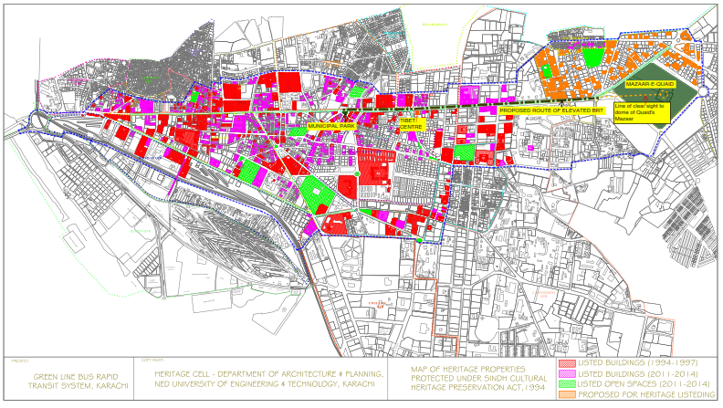

Slide 18
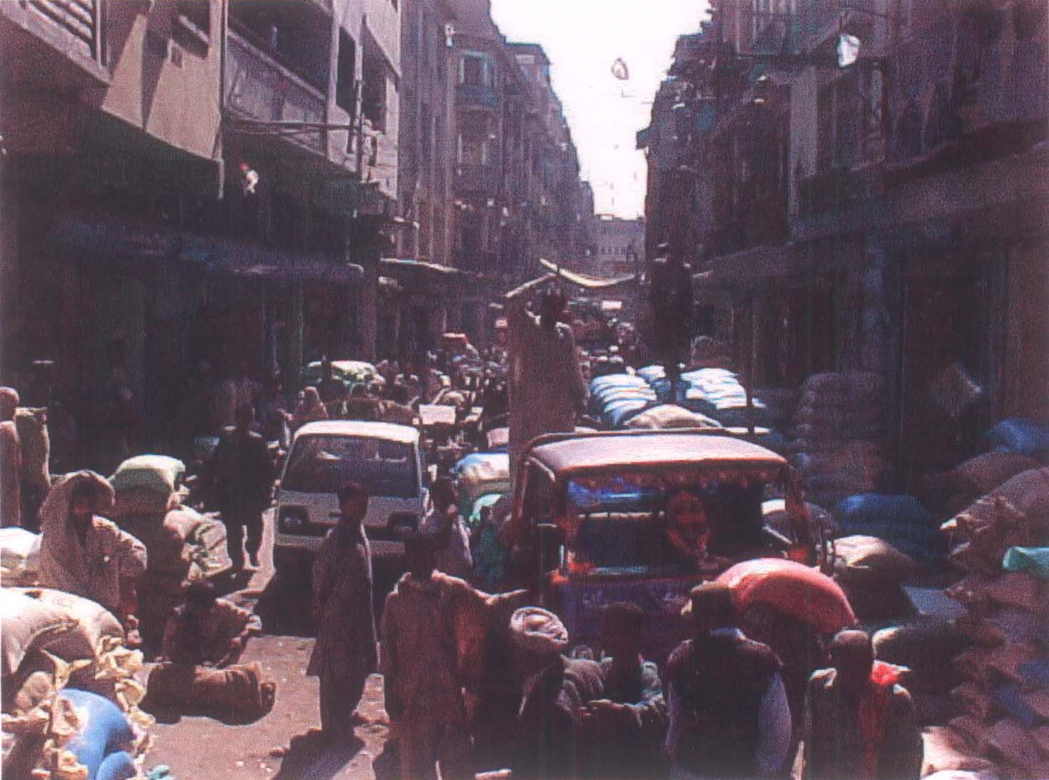
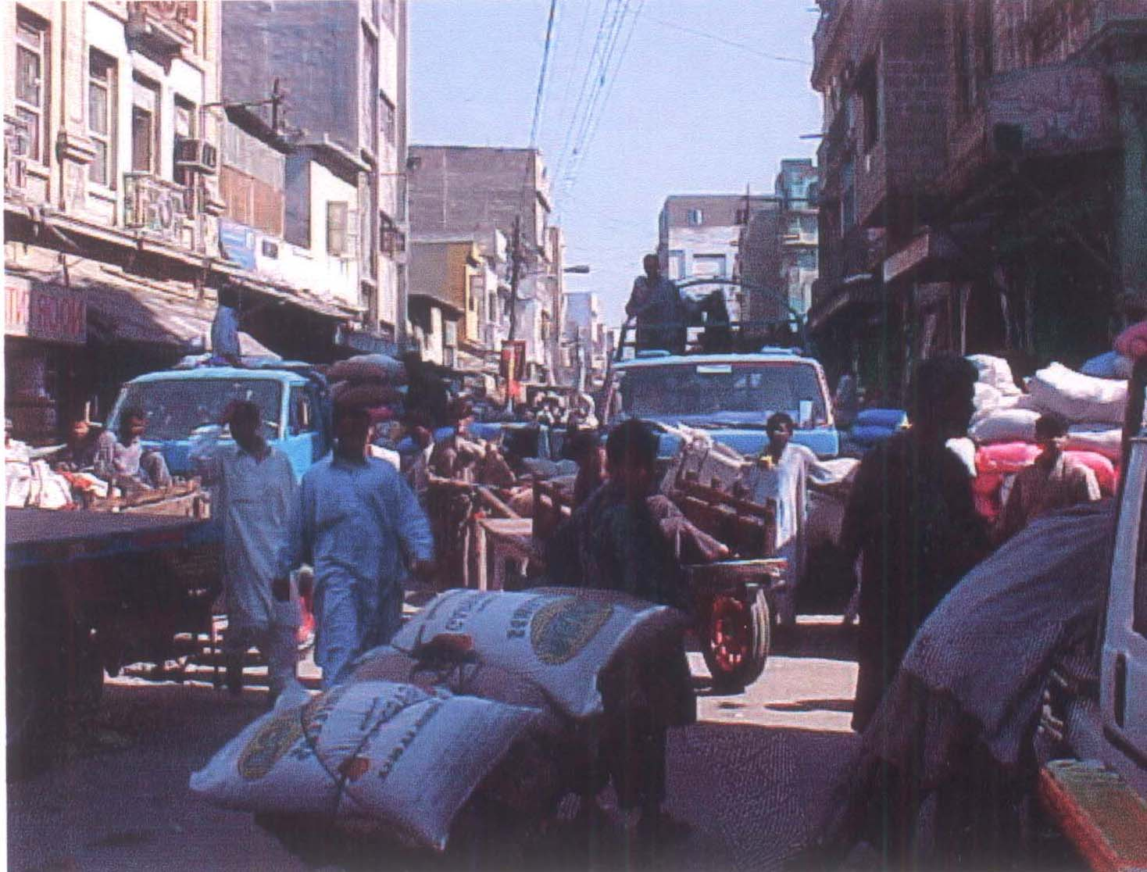

Slide 19
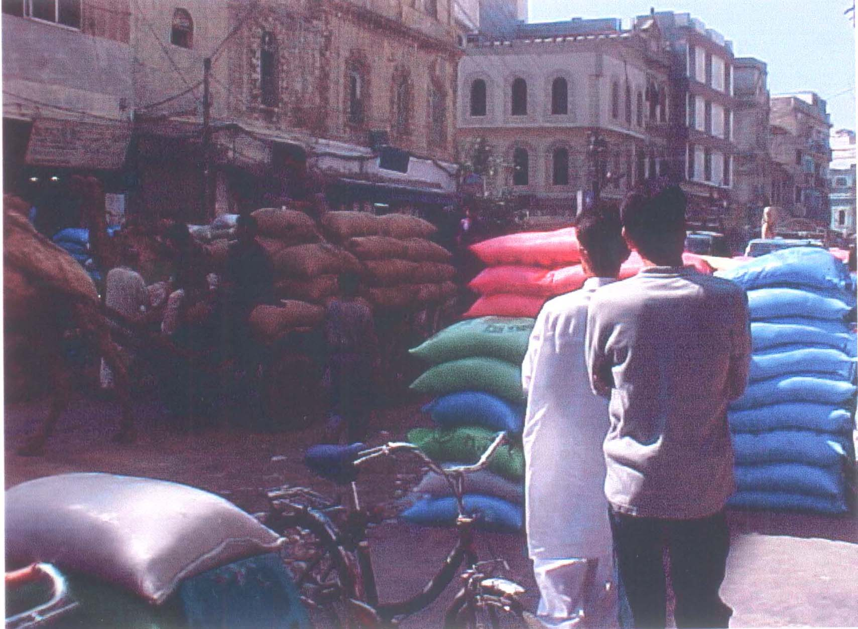
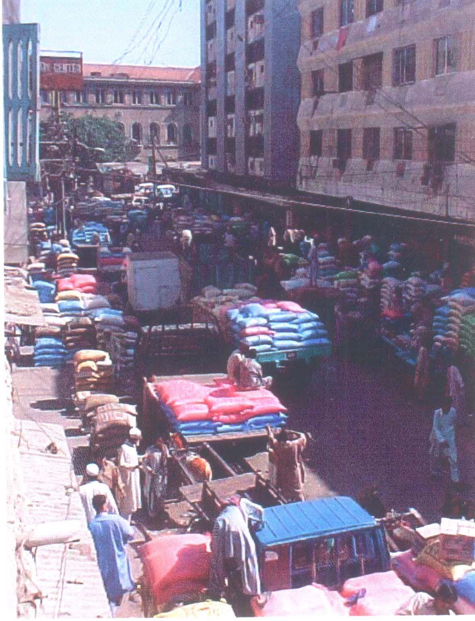

Slide 20
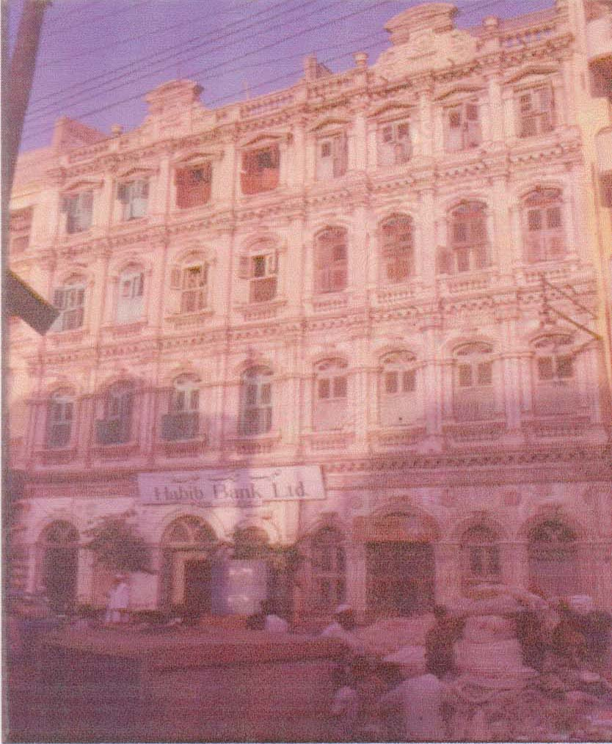
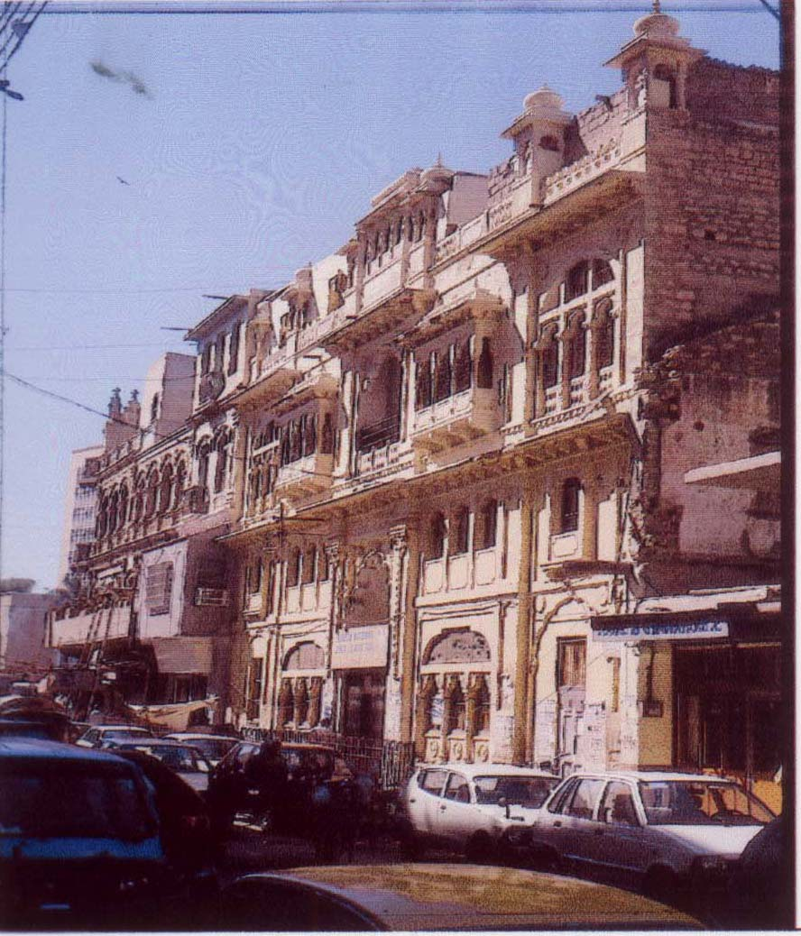
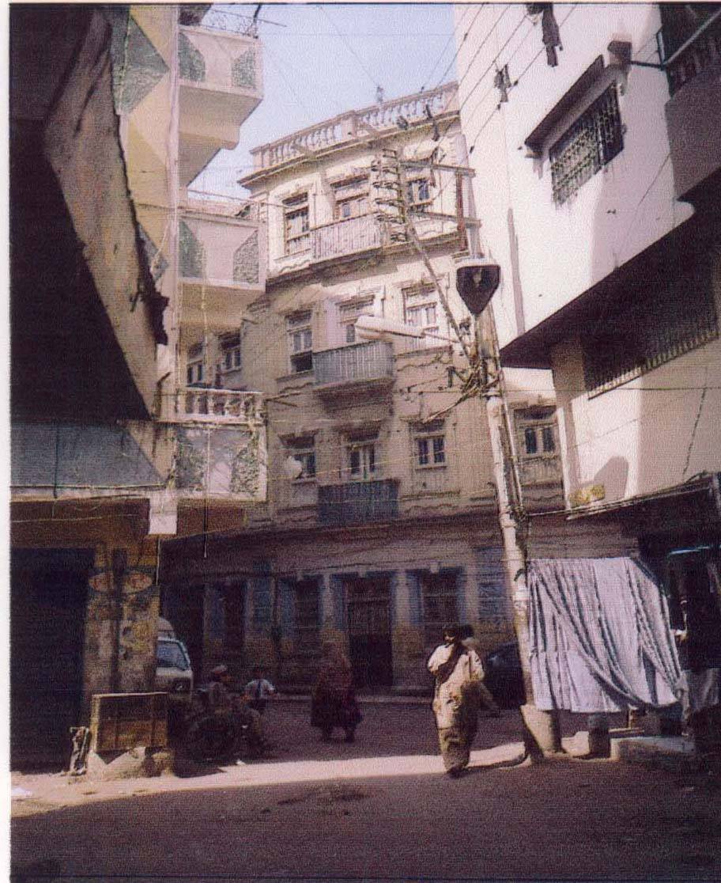
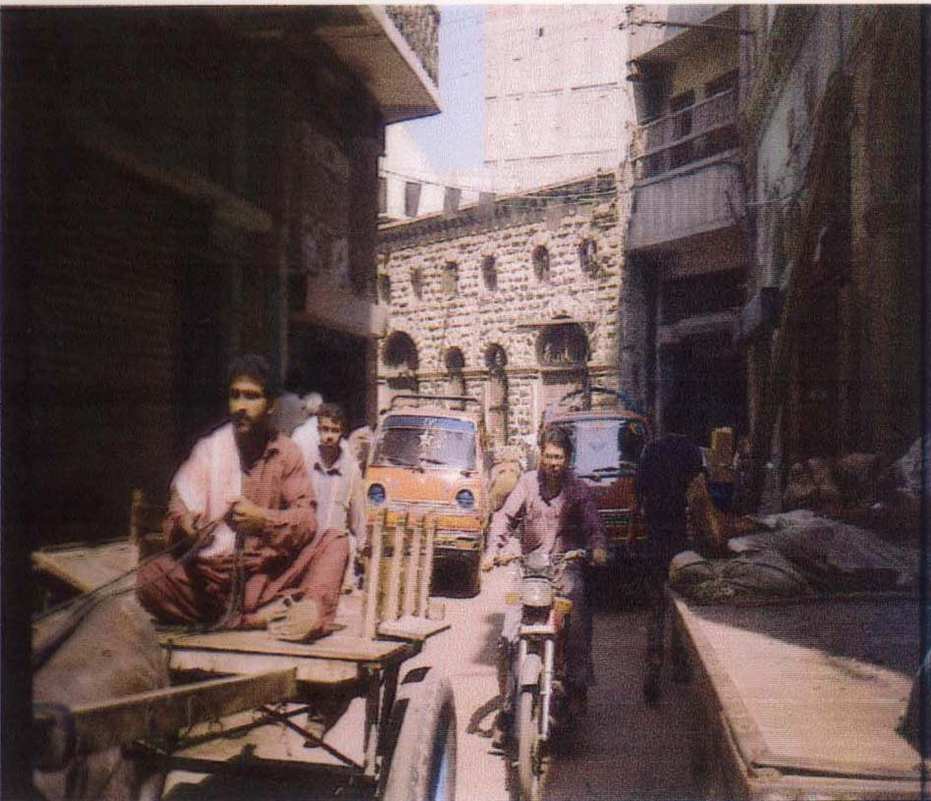

Slide 21
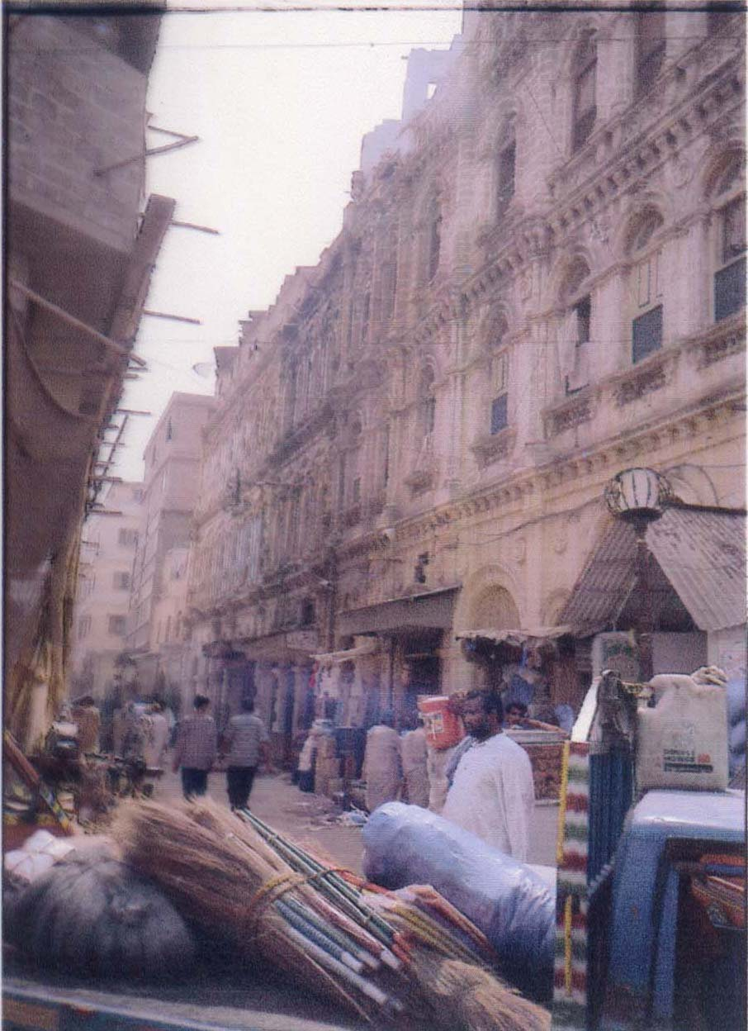
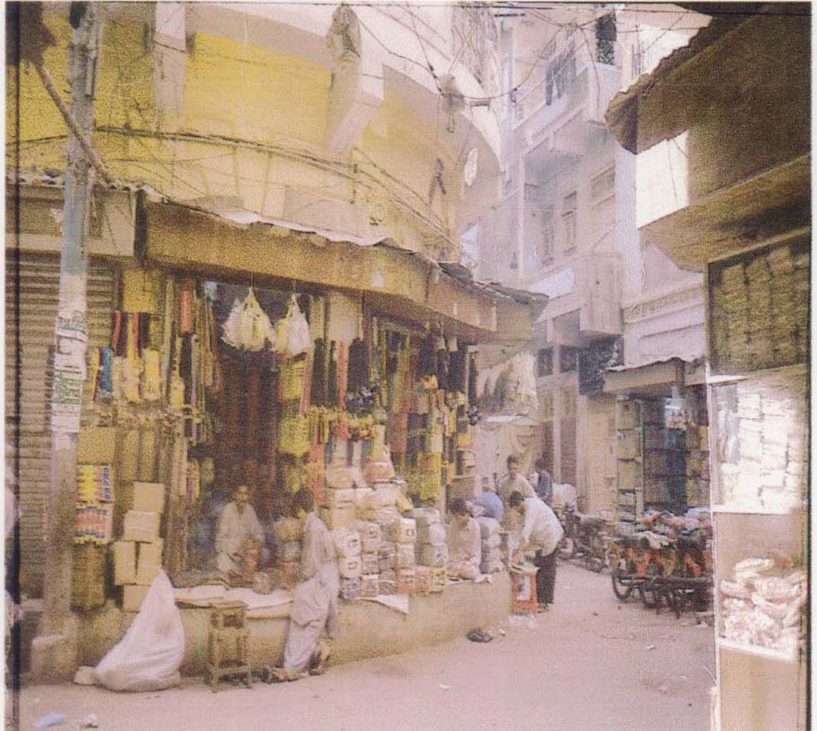

Slide 22
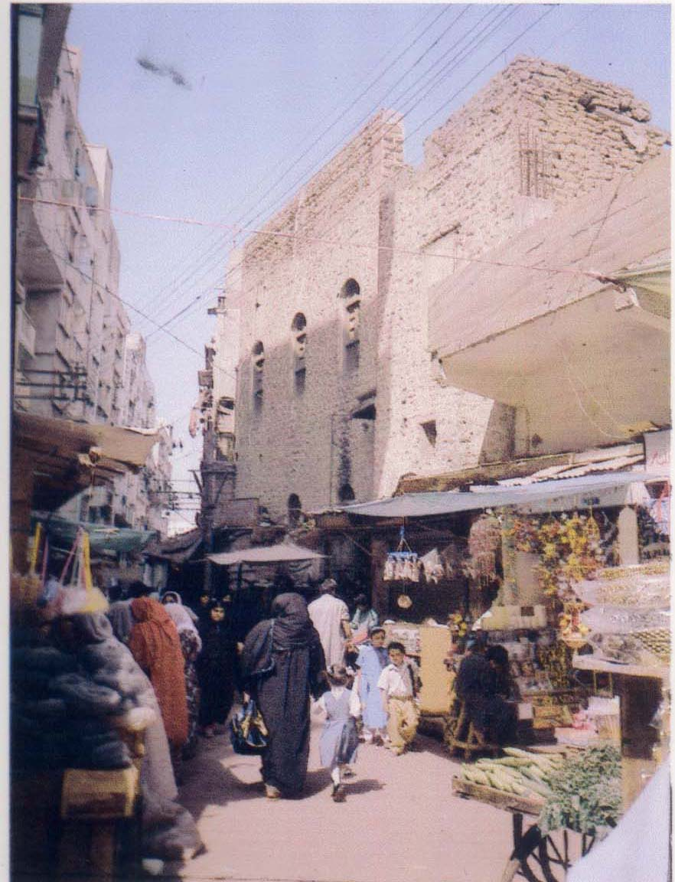
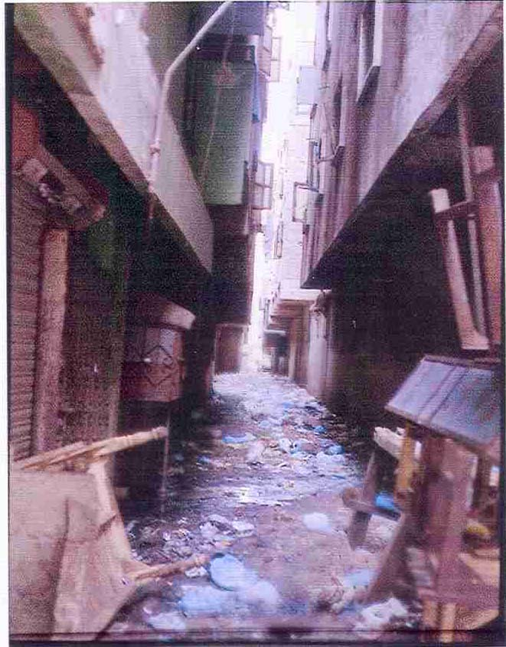

Slide 24
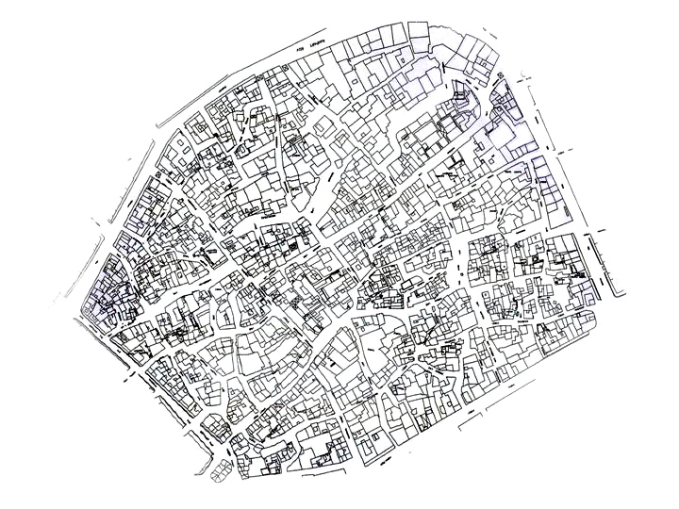

Slide 28
2008 Recent Karachi Photographs

Slide 29
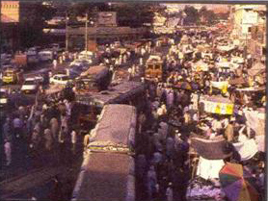
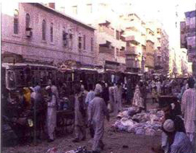
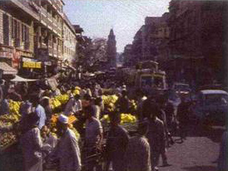
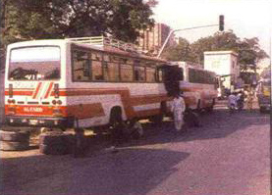

Slide 40
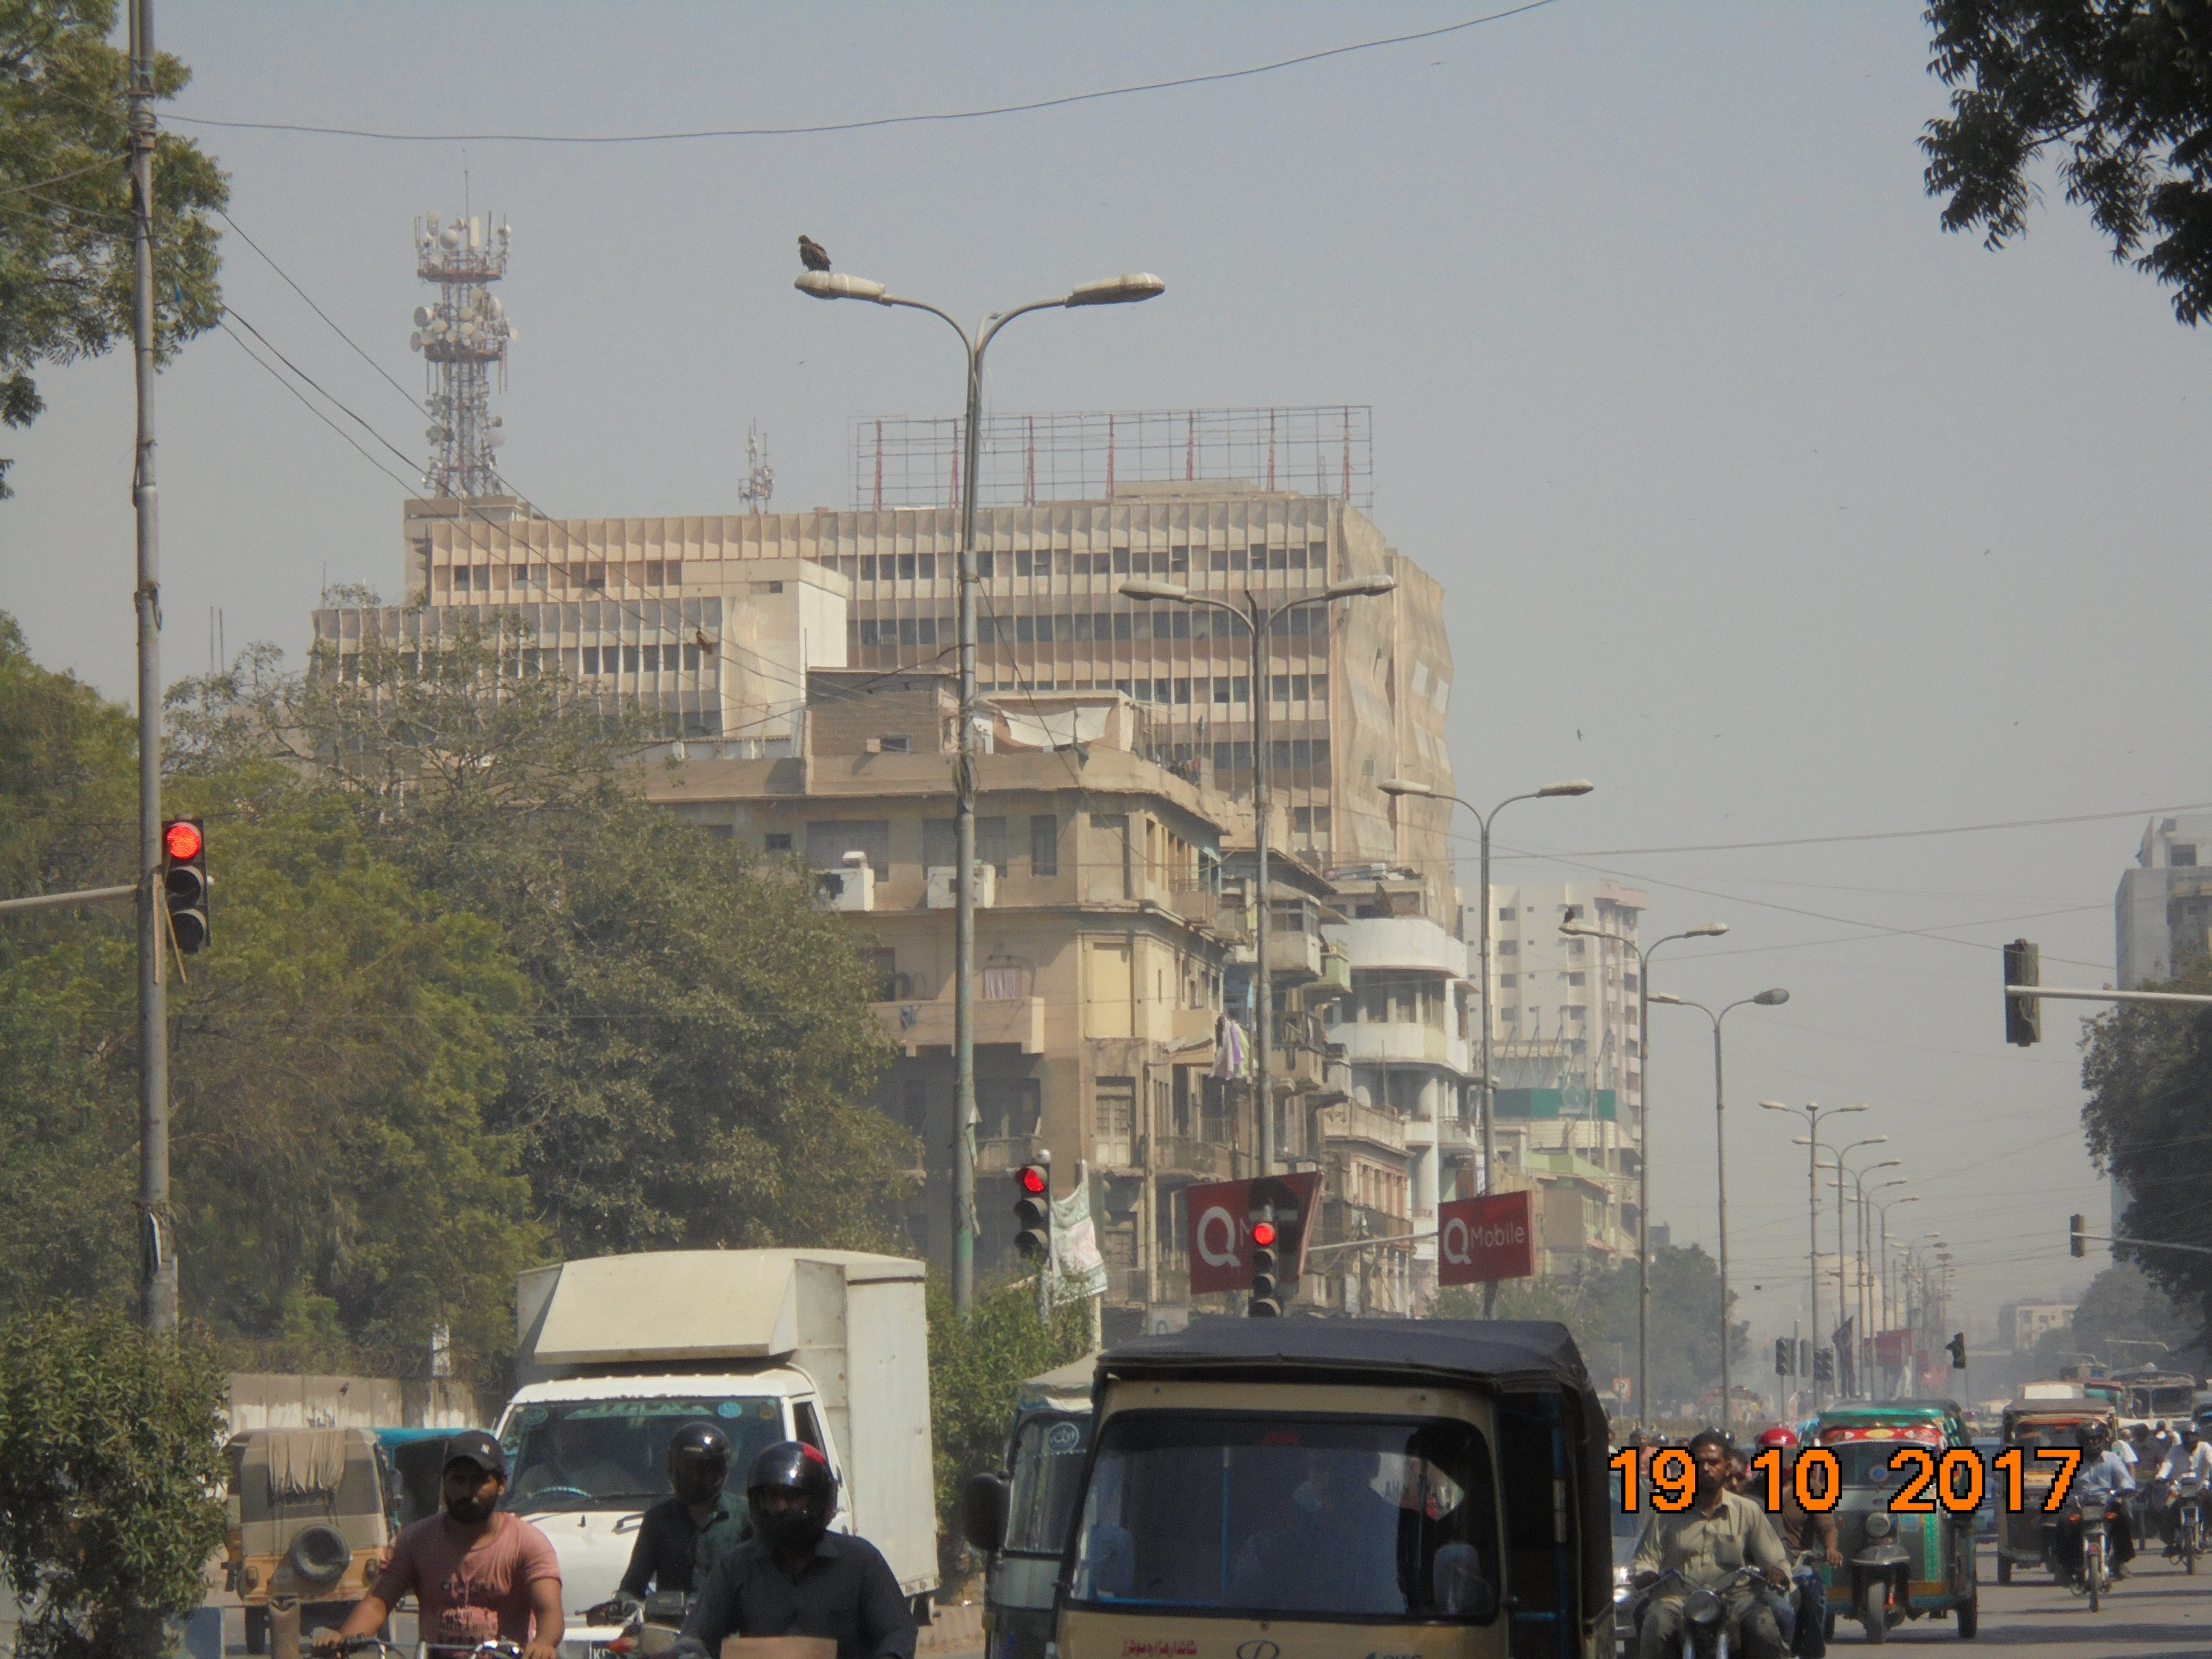

Slide 46
Karachi Traffic

Slide 49
Karachi Water Trough

Slide 55
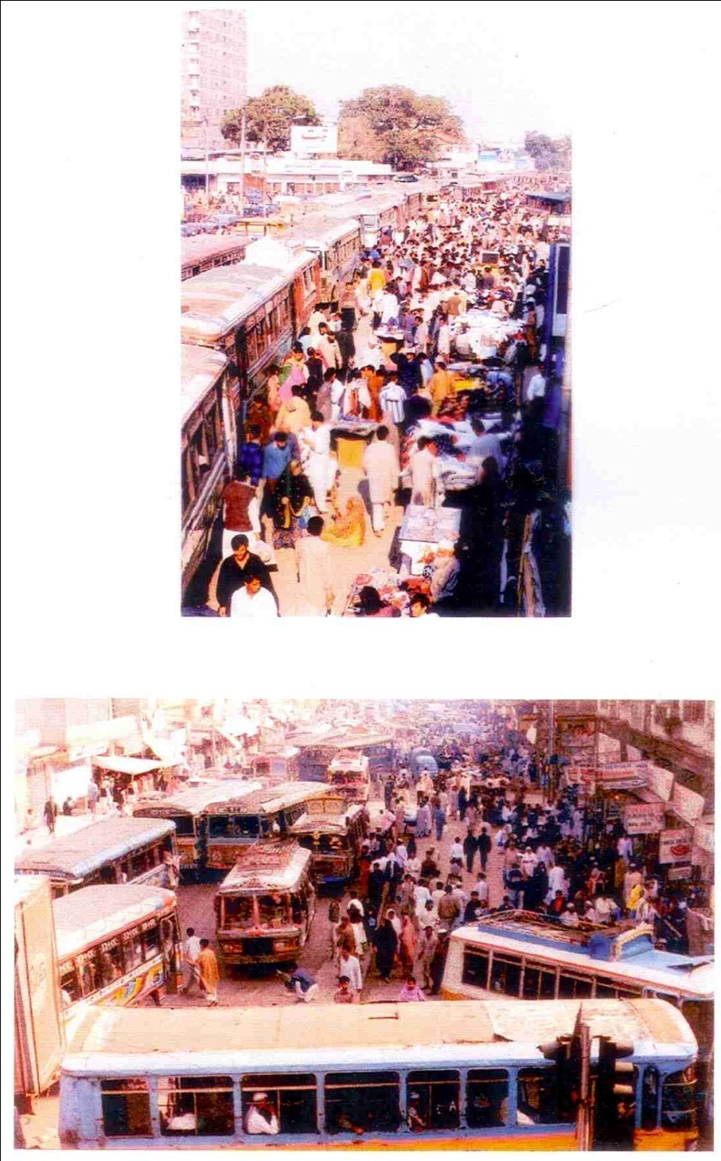

Slide 63
1998 Granada

Slide 81
IM08- Karachi

