Slide 1
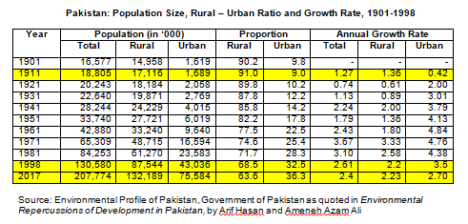
In Pakistan’s Vision 2030 the urban population is predicted to increase by an additional 80 million people
Notes:
Highlight cells

Slide 2
How urban is Pakistan
Before 1981, urban meant settlements of 5,000 and above which had urban characteristics related to density and occupation.
1981 and after, the definition was changed to those settlements which had an urban governance structure.
As a result, in the 1981 census 1,483 settlements of over 5,000 were not considered for being declared urban.
Cities between 500,000 and 2.5 million populations have municipal corporations. Towns between 25,000 and 500,000 have municipal committees. Towns less than 25,000 have town committees.
Special case of Karachi.
Administrative boundaries of many urban areas do not include their peri-urban settlements which in socio-economic and physical terms have urban characteristics.

Slide 3
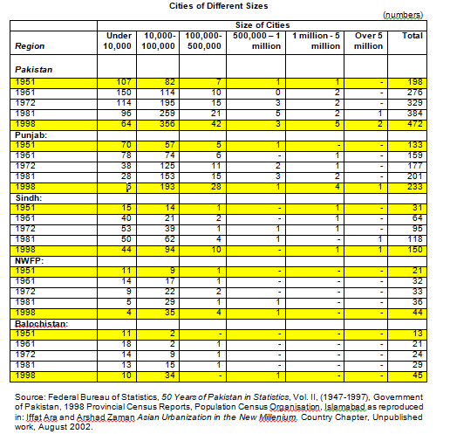
Notes:
Highlight cells

Slide 4
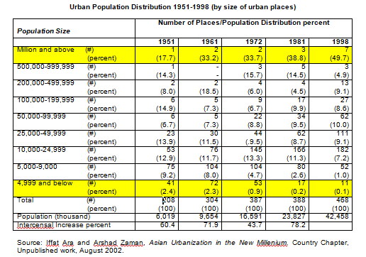
Notes:
4,999 and below. Million and above.

Slide 5
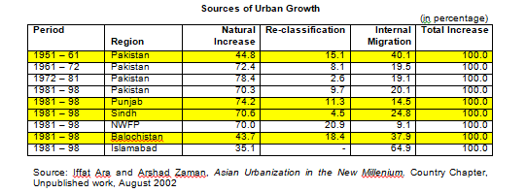
Notes:
Highlight cells

Slide 6
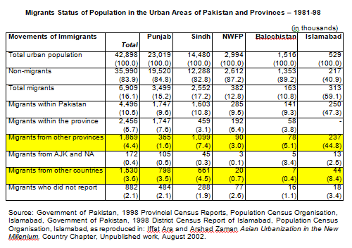
Notes:
Highlight cells

Slide 7
Major Provincial Differences
Balochistan: area 39.3% of Pakistan, population 6.5 million, 4% of country’s population, density 18.8 ppsqkm, urban population 3.5% of pakistan’s total urban population 1998
Punjab: area 25.8% of Pakistan, population 55.58% of country population, density 353.5 ppsqkm, urban population 53.48% of pakistan’s total urban population 1998
The other two provinces fall in between these two.
Sindh and Punjab constitute 88% of the country’s urban population. 80% of cultivated land in Pakistan is in these two provinces.

Slide 8
Demography
Indicator | Pakistan | India | Bangladesh
Population | 207,774,520 | 1,326,093,247 | 161,376,708
Growth Rate | 2.4 | 1.1% | 1%
Birth Rate | 25.6/1,000 | 18.2/1,000 | 18.8/1,000
Death Rate | 6.7/1,000 | 7.3/1,000 | 5.4/1,000
Male Life Expectancy | 65.8 years | 68.4 years | 71.1
Female Life Expectancy | 69.8 years | 71.2 years | 74.4
Fertility Rate | 3.1/woman | 2.35/woman | 2.17/woman
Infant Mortality Rate | 66/1,000 live births | 35.4/1,000 live births | 31.7/1,000 live births
Age 0-14 years | 35.4% | 28.6% | 27.76%
Age 15-64 years | 60.4% | 63.6% | 66.02%
Age 65 and over | 4.2% | 5.3% | 6.23%

Slide 10
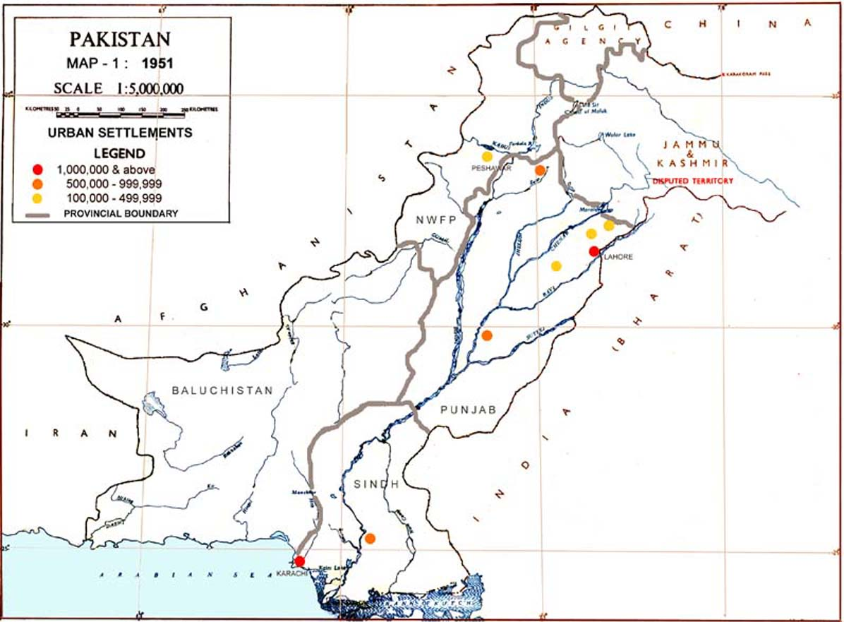

Slide 11
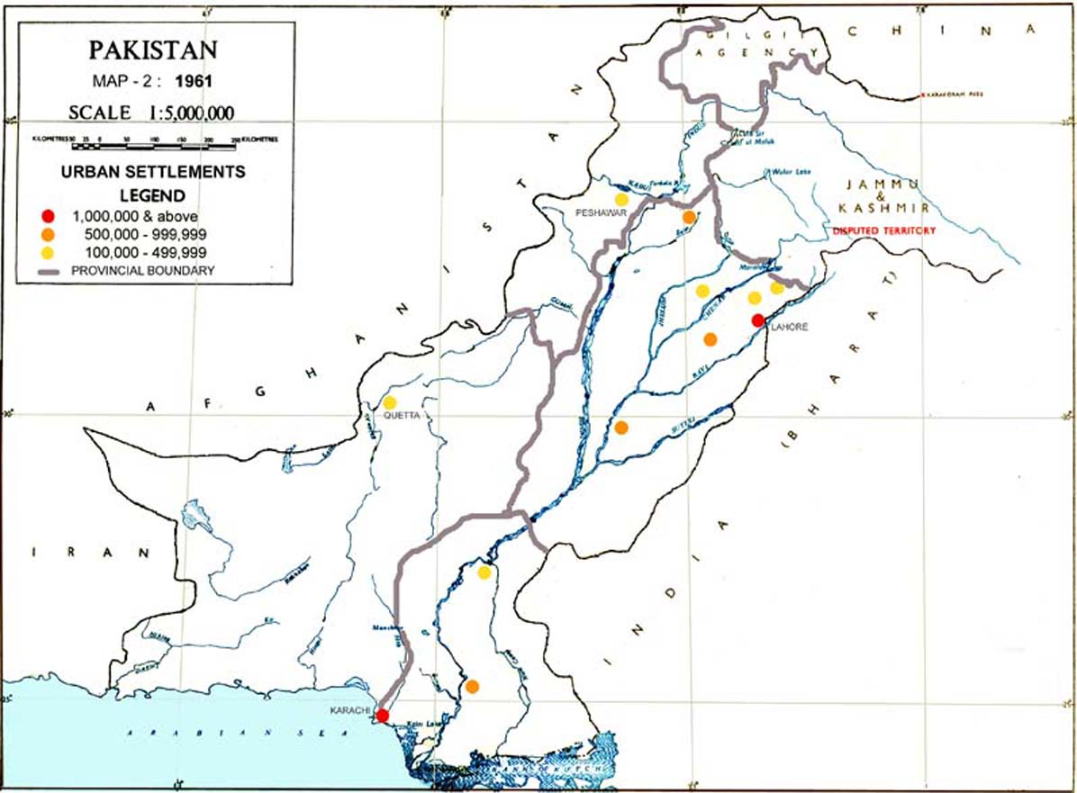

Slide 12
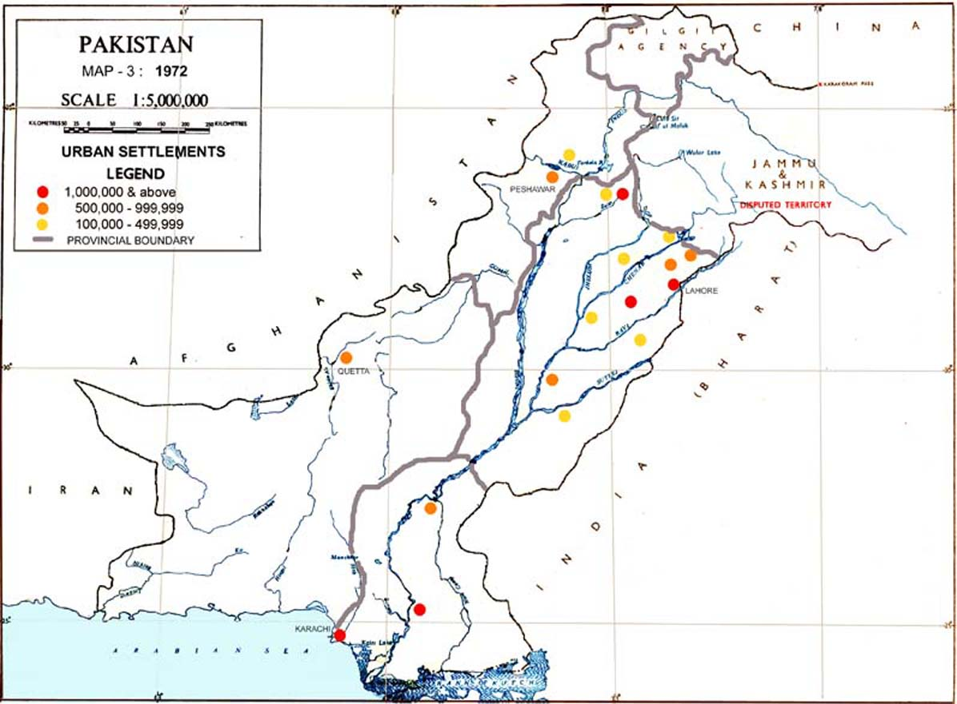

Slide 13
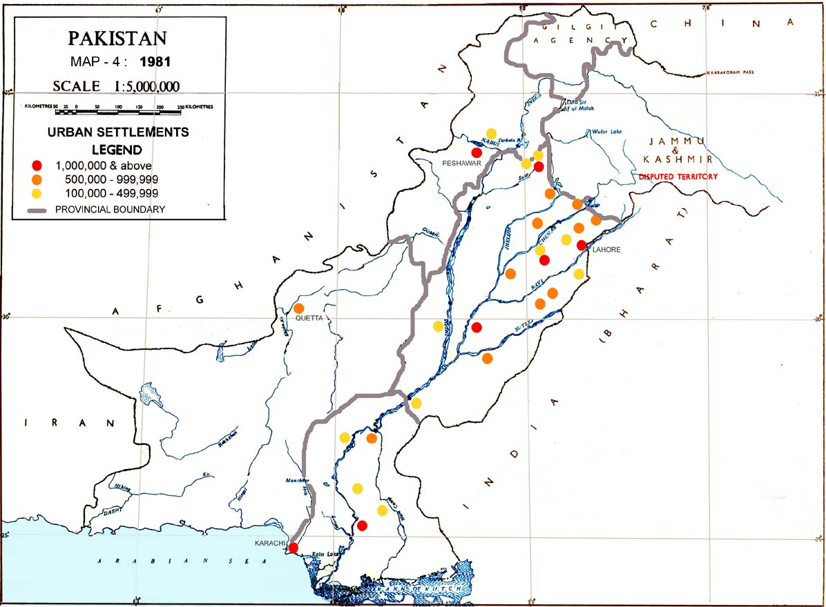

Slide 14
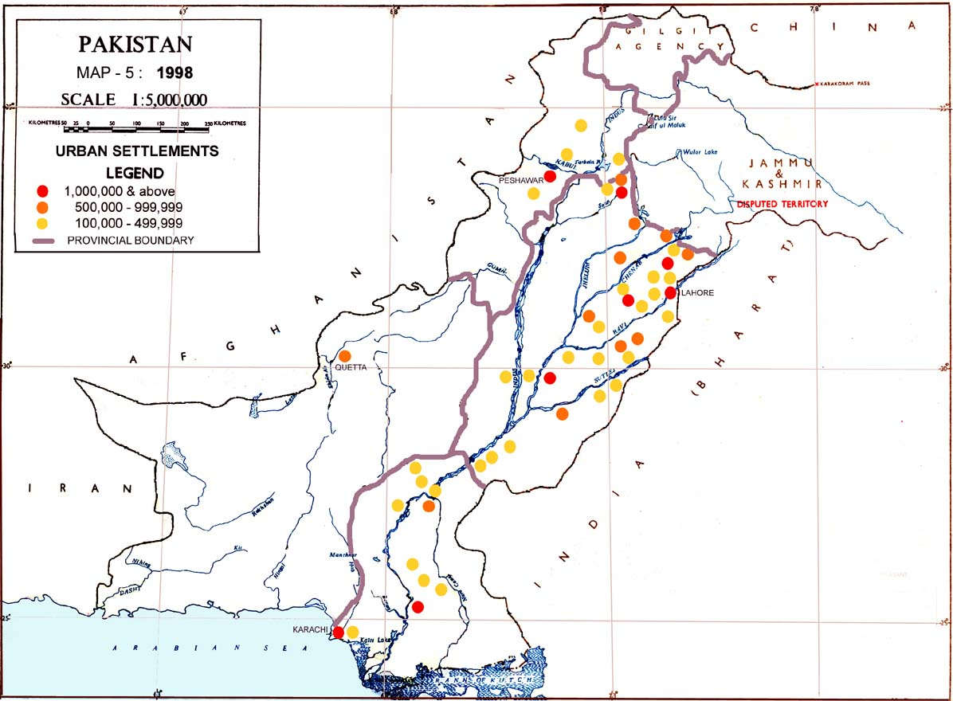

Slide 15
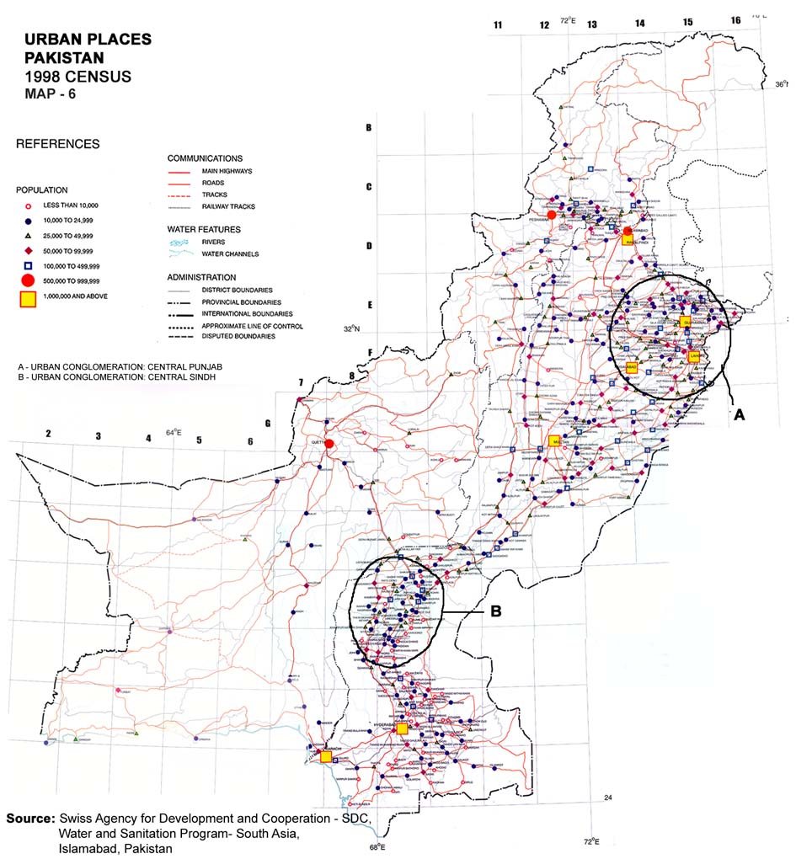

Slide 16
Land: Change in Urbanized Area in Pakistan

Slide 17
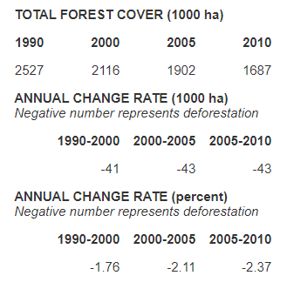
Forest Area: Pakistan, Punjab, and Faisalabad
Pakistan
Forest Area, Punjab and Faisalabad (Hectares)
Area | Punjab | Faisalabad
Year | Total Compact | Total Compact
2002-03 | 3,255,208 | 1,672
2015-16 | 741,025 | 1,202
Notes:
Add pakistan

Slide 19
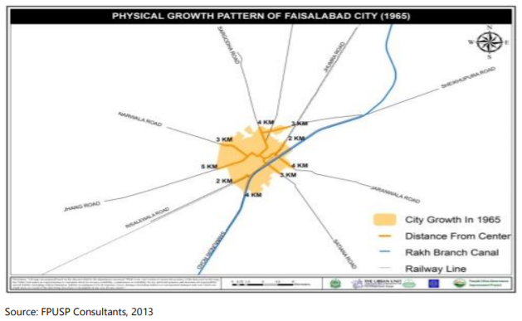

Slide 20
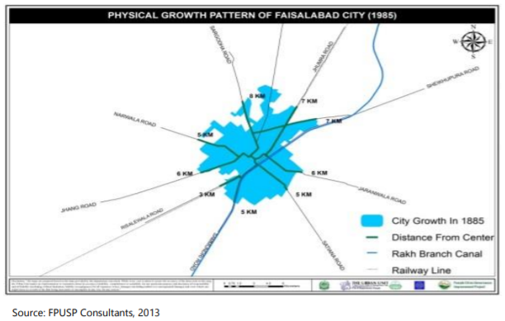

Slide 21
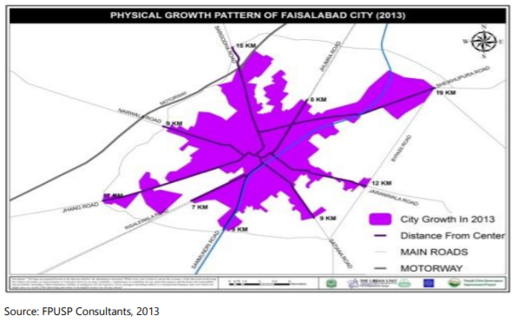

Slide 22
Urbanization in Sindh
Area | 1998 |  | 2017 |  | Actual Difference |  | % Difference
 | Urban | Total | Urban | Total | Urban | Total | Urban | Total
Sindh | 14,839,862 | 30,439,893 | 24,910,458 | 47,886,051 | 10,070,596 | 17,446,158 | 67.8 | 57.3
Karachi | 8,875,941 | 9,856,318 | 14,910,352 | 16,051,521 | 6,034,4111 | 6,195,203 | 67.9 | 62.8
Hyderabad | 1,261,298 | 1,494,866 | 1,832,755 | 2,199,463 | 571,457 | 704,597 | 45.3 | 47.1
Mirpurkhas | 322,453 | 1,006,329 | 425,752 | 1,505,876 | 103,299 | 499,547 | 32 | 49.6
Sukkur | 462,105 | 931,694 | 720,115 | 1,487,903 | 258,010 | 556,209 | 55.8 | 59.6
Larkana | 405,479 | 1,001,608 | 701,637 | 1,524,391 | 296,158 | 522,783 | 73 | 52.1
Sindh Urban Footprint (Total Area of Sindh: 140,914 sq.km.)
Year | 1951 | 1961 | 1972 | 1981 | 1998 | 2018
% of footprint | 29.2% | 37.85% | 40.4% | 43.3% | 48.8% | 52.02%
Area (sq. km) | 41,147 | 53,336 | 56,929 | 61,016 | 68,766 | 73,303

Slide 23
Karachi – Land Loss
15,000 hectares has been reclaimed from mangroves, damaging flora and fauna.
City’s expansion evicted more than 2,800 villages destroying the rural economy and impoverishing the rural population.
In 1985, 75% of Karachi’s vegetable/fruit requirements came from its rural areas.
In 2013, this was reduced to 10%.
Since 1947, an estimated 60 billion cubic metres of sand and gravel has been illegally lifted from construction from the seasonal rivers preventing water run off, thus making recharging of the aquifer impossible and depleting the rainwater aquifer on which agriculture depends.

Slide 24
Multan – Land Loss
Multan Mango orchards 44,000 acres.
Around 48 large housing schemes have been developed on 7,817 acres of land of which 2,043 acres (26%) was previously orchards.
There are 460 legal and illegal housing societies in Multan, the majority of which have been built over agricultural land.
The proposed DHA scheme plans to build on over 9,000 acres, most of which is currently mango orchards.
All of this has added to the climate concerns Mango growers already face.

Slide 25
Comparison of Karachi and Lahore

Slide 26
Houses or Housing?
Building certain number of houses in a given period of time without a long range process.
Building housing through an institutional arrangement.
Private or Public
Land at appropriate places with laws to make that possible
Affordable loans
Mechanisms to raise funds
Maximum use of available land (density)
Minimum standards for decent living
Controlling speculation
Technical advice for house building and purchase
Training institutions to create Human Resources to make the above possible

Slide 27
Official Figures
Messy statistics (major difference in government figures)
Urban housing demand: 350,000 units/year. 62% lower income, 25% lower-middle income, 10% upper-middle and higher income.
Formal supply: 150,000 units/year.
Annual backlog: 250,000 units.
To maintain backlog at this level: Rs. 1 bn. annually required for 10 years.
Last budget allocation for housing 2.329 bn.

Slide 28
Government Policy
De jure: provide social housing and upgrading of katchi abadis as per housing policy 2001.
De facto: access the market. To make that possible, credit for housing related purposes has been liberalized by government policies.
Problems of accessing the market.

Slide 29
Government Housing Attempts
PPP: Affordable homes and plots under Shaheed Benazir Bhutto Housing Cell for 1500 underprivileged families: did not materialize, officials arrested under NAB for irregularities.
PML-N: Apna Ghar housing scheme 2013, 1,000 clusters of 500 each, housing ministry asks for Rs. 350 million and gets 10 million: no housing developed.
PTI: In KP, fourth government which failed to complete Regi model town, launched 26 years ago. Of 26,000 plots, only 1,000 built.

Slide 30
How is housing accessed?
By lower income and lower-middle income groups
Katchi abadis on government land
(receding availability and increasing costs, location issues, regularization and improvement processes, evictions)
Informal subdivisions of agricultural land
(location issues, rapidly increasing scale and cost, speculative trends, no government policy for upgradation, secure tenure)
Densification of existing settlements and of old city centers abandoned by the rich.
Middle-income groups: HBFC/Bank Loans: increasingly purchased from developers, often for speculation.
Higher-income groups: increasingly in gated settlements on the city fringe in speculative developments.

Slide 31
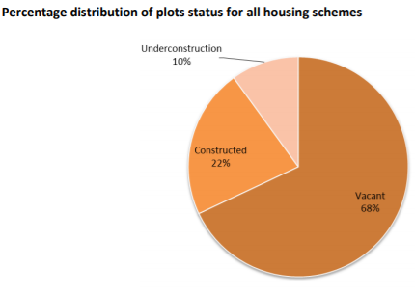
Punjab
In Lahore:
Households at the bottom 68% of the income distribution can afford only 1% of all available housing.
Households at the top 12% can afford 56% of all available housing.
More than 47% of urban households live in low quality/substandard housing often in katchi abadis without security of tenure.
Punjab in 2017:
Housing Demand: 17,103,835
Housing Supply: 15,564,838
Housing Replacement: 778,242
Housing Shortage: 2,317,239
Punjab in 2047:
Housing Demand: 37,461,577
Housing Supply: 27,592,686
Housing Replacement: 1,440, 027
Housing Shortage: 11,308,919
Source: Urban Unit, Lahore
Notes:
https://spearheadresearch.org/?p=37264
https://www.urbanunit.gov.pk/Upload/forest/11%20housing.pdf

Slide 32
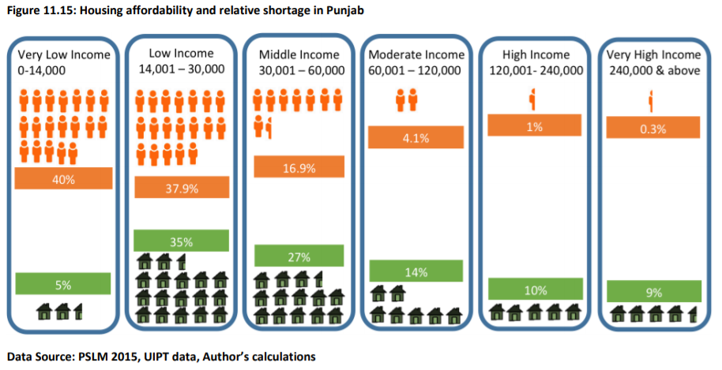
Lahore Urban Unit
Source: Urban Unit, Lahore

Slide 33
Faisalabad
Housing demand: 1947-98: 200,000 units
Formal Supply 1947-98: 37,785 units
Informal Supply (ISALs): 7,000 units annually
Sanctioned housing schemes: 121
Under process housing schemes: 169
Illegal housing schemes: 245
Projected increase in household demand keeping district household size constant (6.4) 2017-47: 250,001 – 700,000
Projected increase in household demand while factoring in the projected decrease in district household size (5.8) 2017-47: 700,001 – 5,371,030
Source: Urban Unit, Lahore

Slide 34
Colonies
The schemes described above are known as colonies.
Almost all the colonies are empty, even those that began 10-15 years ago.
With the advent of the motorbike, colonies are now developing in the villages as well, far away from the cities since people can travel long distances from their villages to their places of work.
This is increasing the population of the urban centers during the day.
This is also increasing the number of dormitory villages.

Slide 35
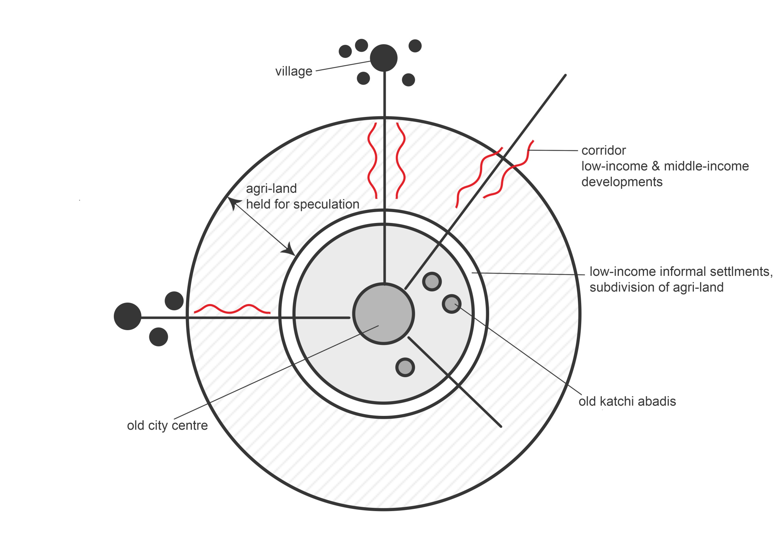
Villages
Existing
Notes:
Mohsin’s email

Slide 36
HBFC Loans

Slide 37
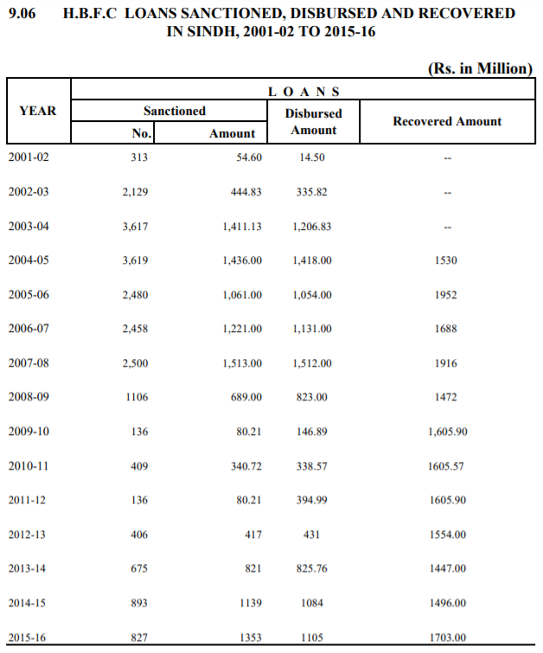

Slide 38
Karachi Housing Demand-Supply Gap
Housing demand : 120,000 per year
Formal sector housing supply : 42,000 per year
(Average over last 5 years)
Accommodated in katchi abadis : 32,000 per year
Rest accommodated through densification of existing settlements.
The issue of densification and its societal repercussions.
This was when we had a population of 22 million.
But now we have lost 6 million population so it needs to be reworked.

Slide 39
Karachi – Some 1998 Census Statistics
Population: 9,856,318.
Households: 1,471,092.
Housing Units: 1,457,096.
Backlog: 13,966.
Demand at 3.5% per year. Population increase 53,370
Inadequate housing means
One room house: 451,700 units.
Without piped water: 373,360 units.
Without electricity: 90,450.
Katcha houses: 62,900.
Need to redefine adequate housing.

Slide 40
History of Informal Settlements in Karachi
1947-1951: Unorganized invasions
1951-1958: Bulldozing and relocation
1958-1962: Social housing in satellite towns
Discontinued after four years
1962-1968: Plot townships with no services
1955 onwards: Informal subdivisions (ISD or katchi abadis) on public land
1979 onwards: Regularization
62% of Karachiites live in ISDs
72% of ISDs have either been regularized or marked for regularization

Slide 41
New katchi abadis are becoming history
Because
Before the city was small, land was cheap, there was no middle class demand and the city periphery was near the city work places.
Now the city periphery, where cheap land is available, is far away from work areas.
Living on the periphery has serious problems of travel, time and social costs in addition to absence of jobs and social amenities.
Middle income housing and elite gated communities are occupying the immediate periphery pushing new ISDs further away from work areas.
Previously, katchi abadi land was arranged through partnership with government officials and patronage. Today, it is purchased illegally from government departments. Capitalism?

Slide 42
Other reasons for katchi abadis becoming history
Increase in housing cost 1991- 2007
 | Cost per Square Yard
 | 1991 | 2007
Land in new peri-urban katchi abadis | Rs 176 (US$ 2.35) or 1.7 times daily wage for unskilled labour | Rs 2,500 (US$ 33.33) or 10 times daily wage for unskilled labour
Construction cost of semi-permanent house in katchi abadis | Rs 660 (US$ 8.8) | Rs 5,000 (US$ 66.66)
Rent for semi-permanent house in katchi abadis | Rs 350 (US$ 4.66) or 2.5 times the daily wage for unskilled labour | Rs 2,500 (US$ 33.33) or 10 times the daily wage for unskilled labour

Slide 43
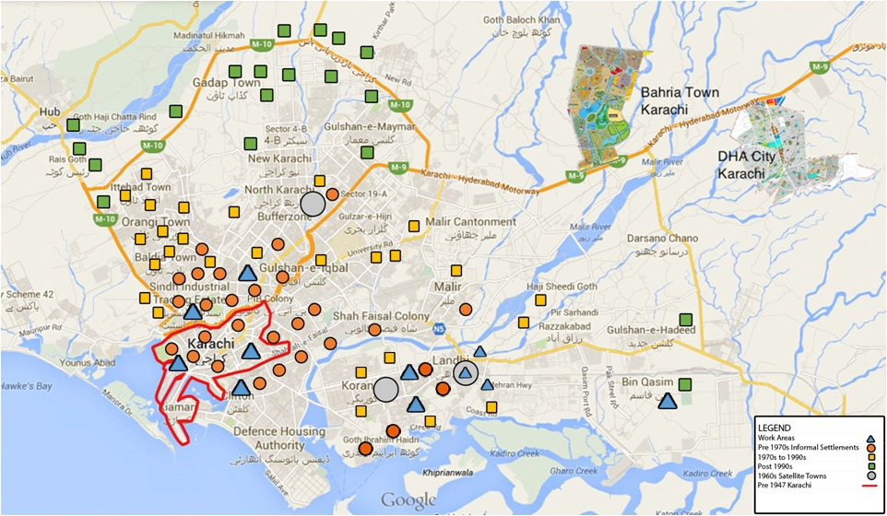

Slide 44
The Density Issue
New Urbanism theory recommends densification for South Asian cities. Yet, the three most dense cities in the world are in South-Asia. Why?
Actual Density Maximum Permissible
as per regulations
Dhaka 4,400 1,200
Mumbai 3,230 900 ?
Karachi 2,280 1,625

Slide 45
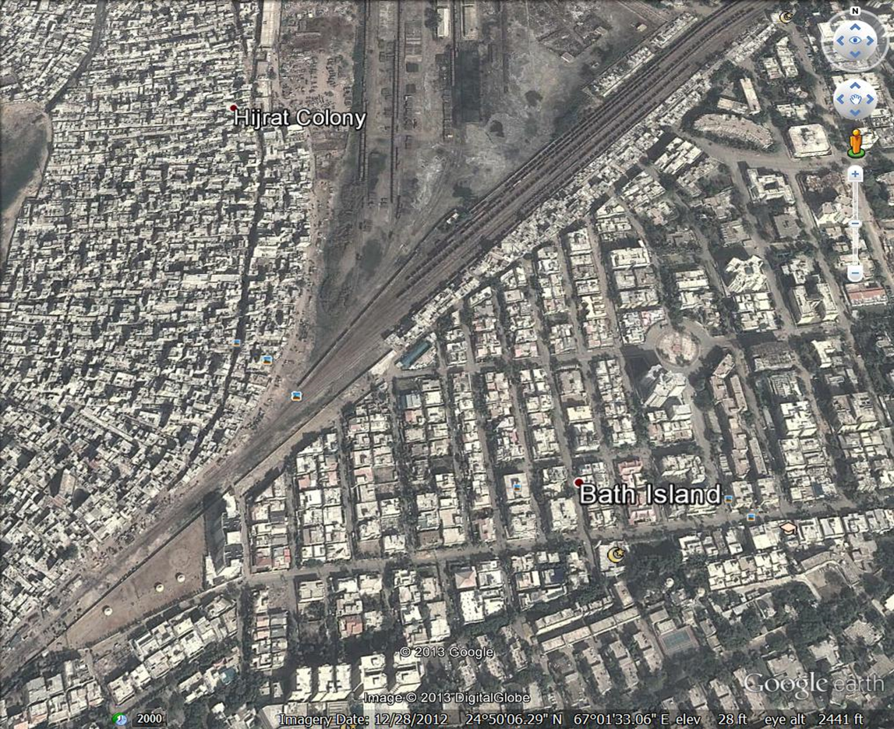

Slide 46
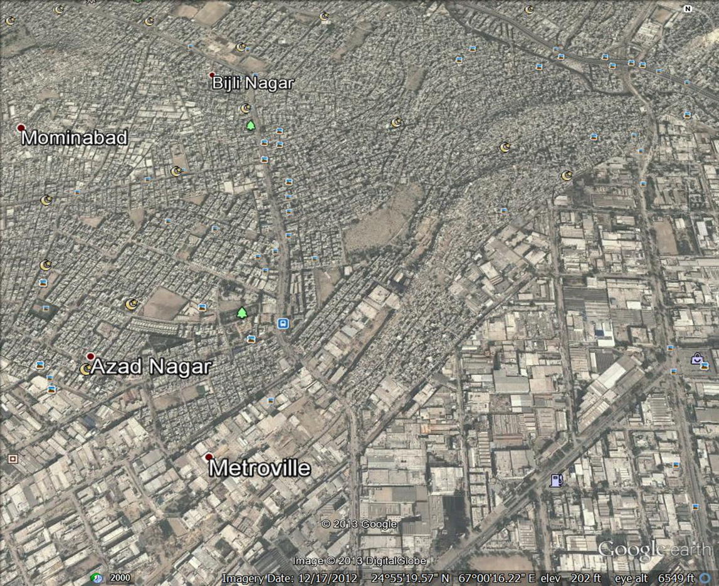

Slide 47
Karachi Residential Land-use
62% (about 13 million) of Karachi’s citizens live in informal settlements on 23% of the city’s residential lands.
Densities in these settlements are between 1,500 – 4,500 persons per ha and continue to increase
Persons per room: 6 – 10
The issue of toilets
36% (about 7.5 million) of Karachiites live in “planned” settlements on 77% of the city’s residential lands.
Densities can be as low as 80 persons per ha and continue to decrease in new settlements
Figures above are for when Karachi was 22 million. Now we have become 16 million.

Slide 48
How People House Themselves Today: Government Response
Post liberalization de facto Government Policy
Access the market
Liberalization of credit terms
Collateral required: poor do not have it
Formal sector job required : 72% work informally
No credit for purchase of land
High rate of markup
The developers do not cater

Slide 49
The Market Response
Densification of existing katchi abadis by changing one or two storey informally built homes into multi-storey buildings in three ways
House owners building upwards to accommodate the expanding family
House owners building upwards to create rentals for additional income
Informal developers purchasing land from house owners and paying them in cash plus two apartments on the top floor
(informal capitalism catering to the poor?)

Slide 50
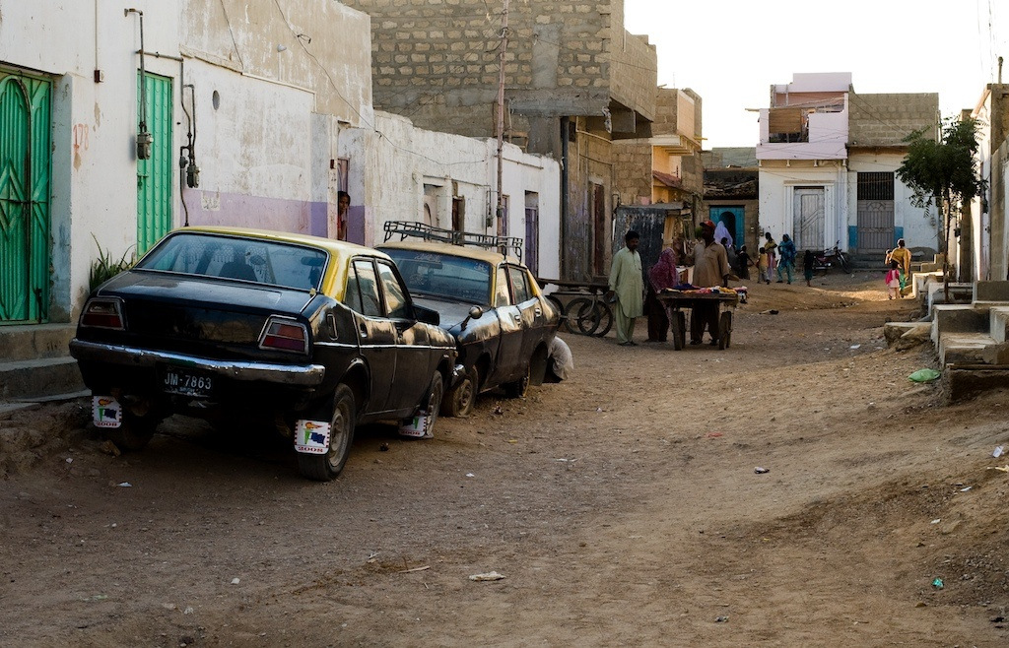
Old Katchi Abadis

Slide 52
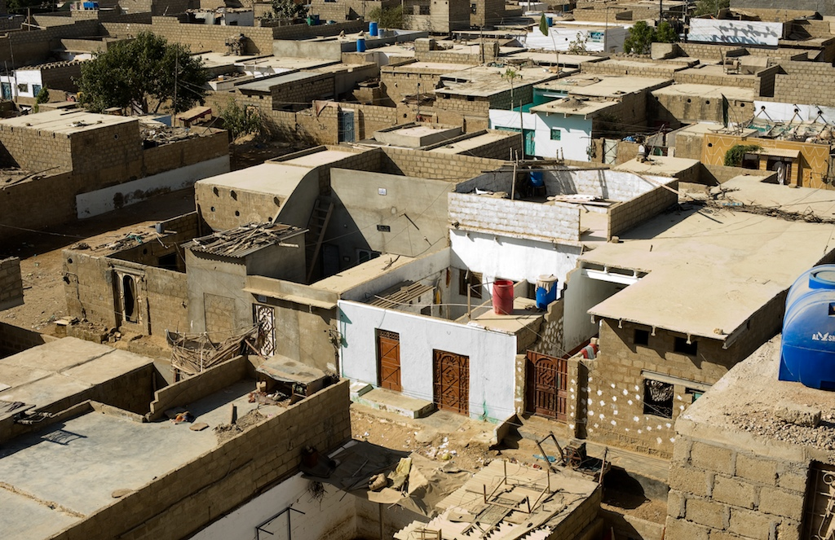
Old Katchi Abadis

Slide 53
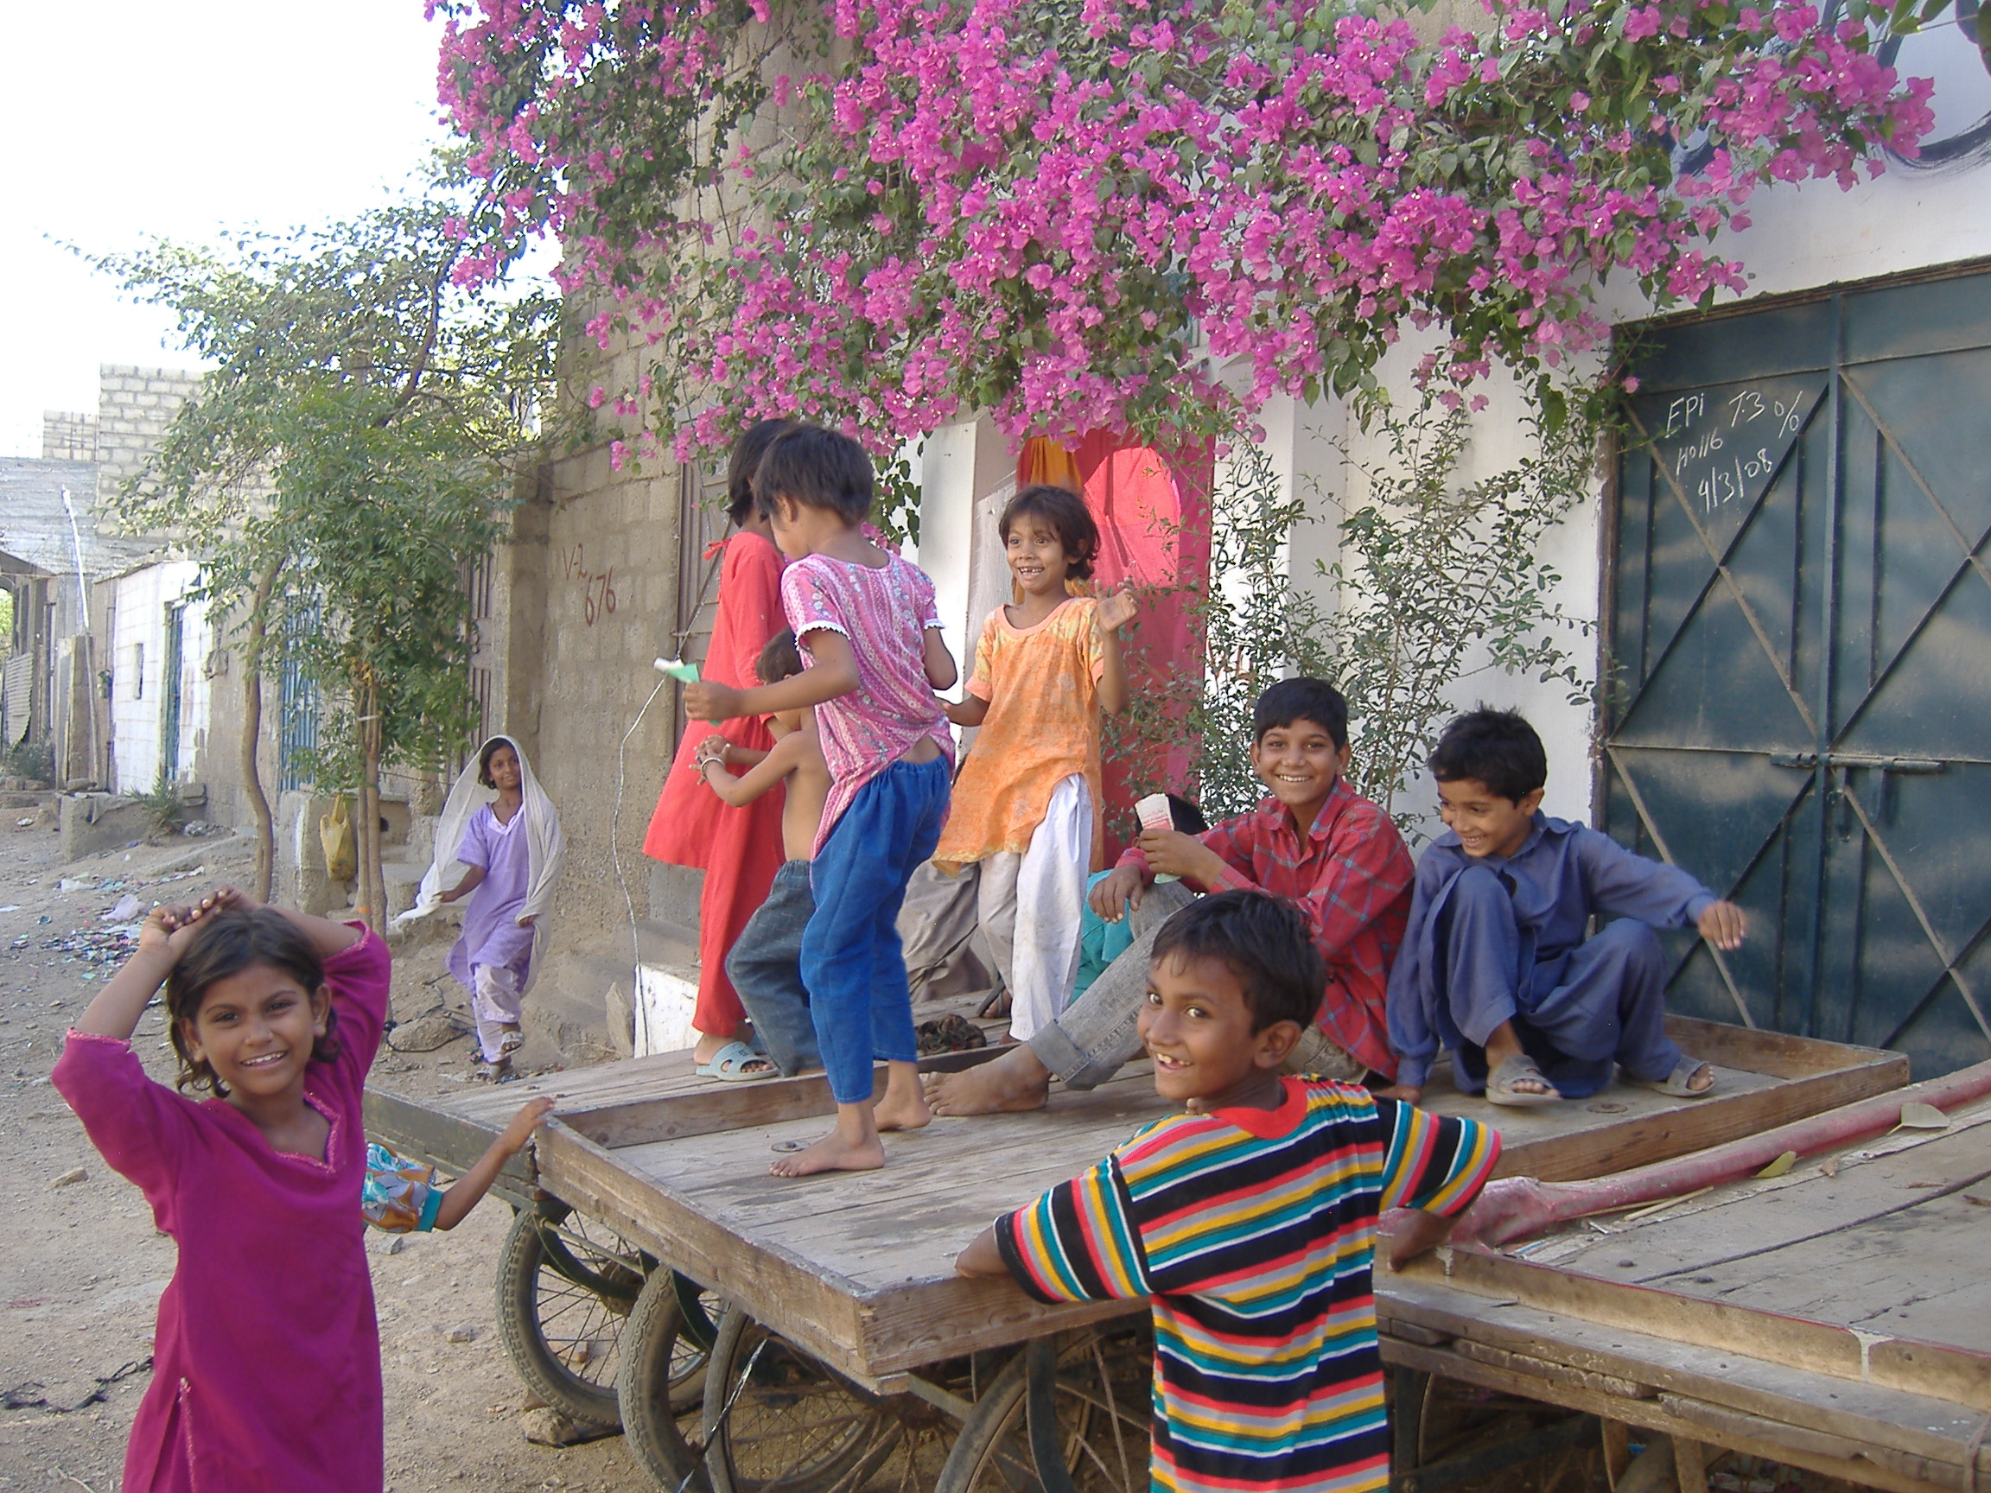

Slide 54
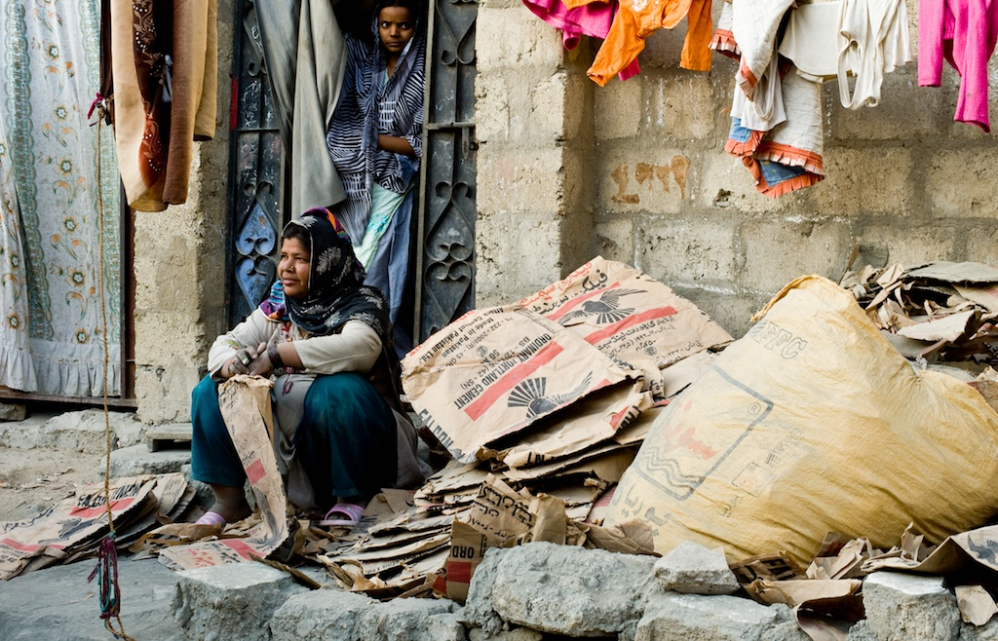

Slide 55
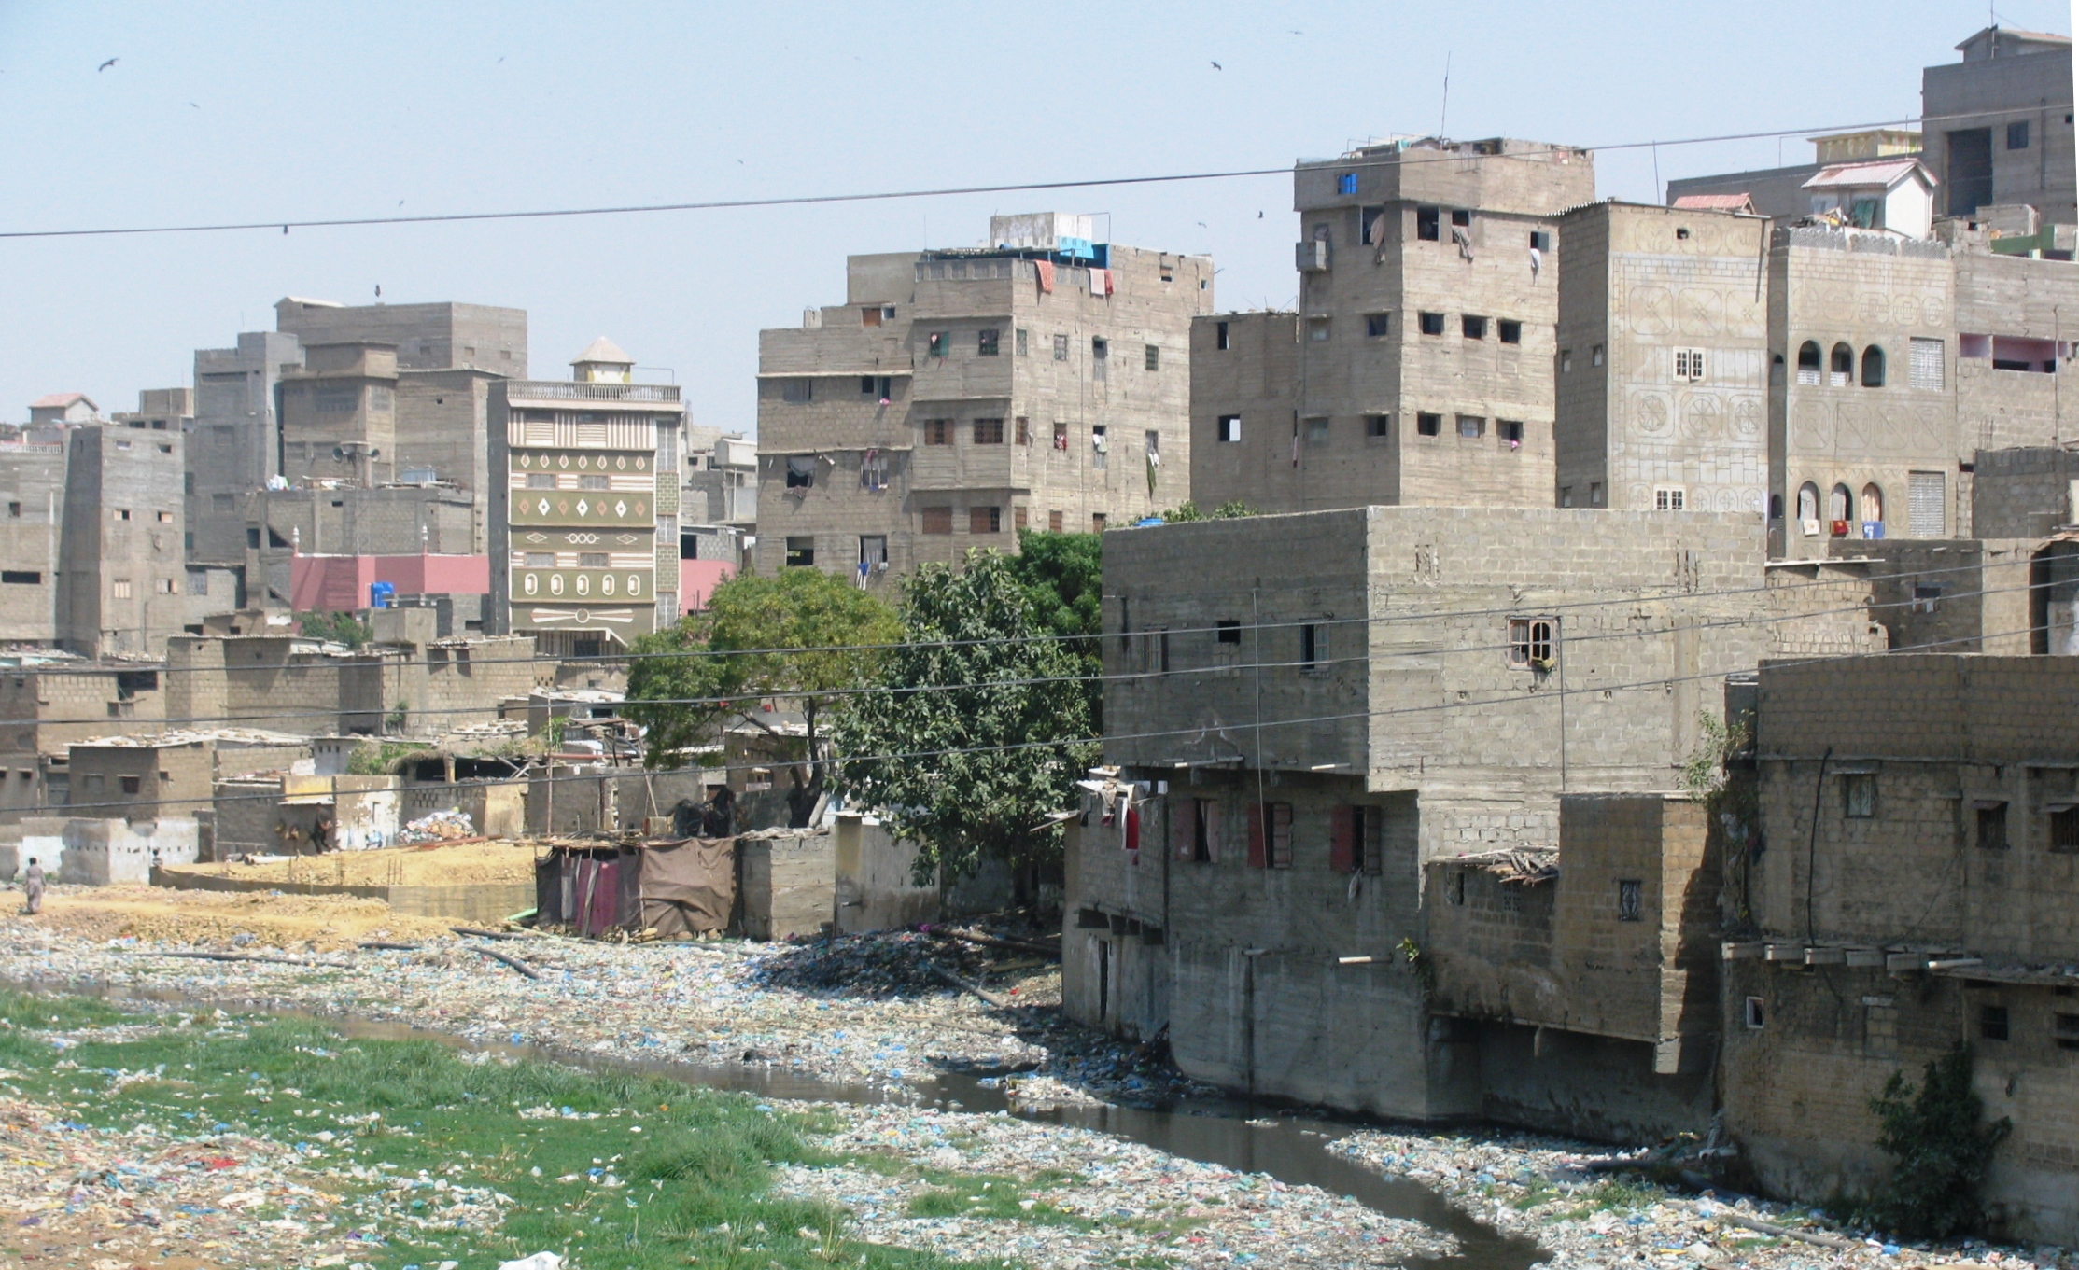

Slide 56
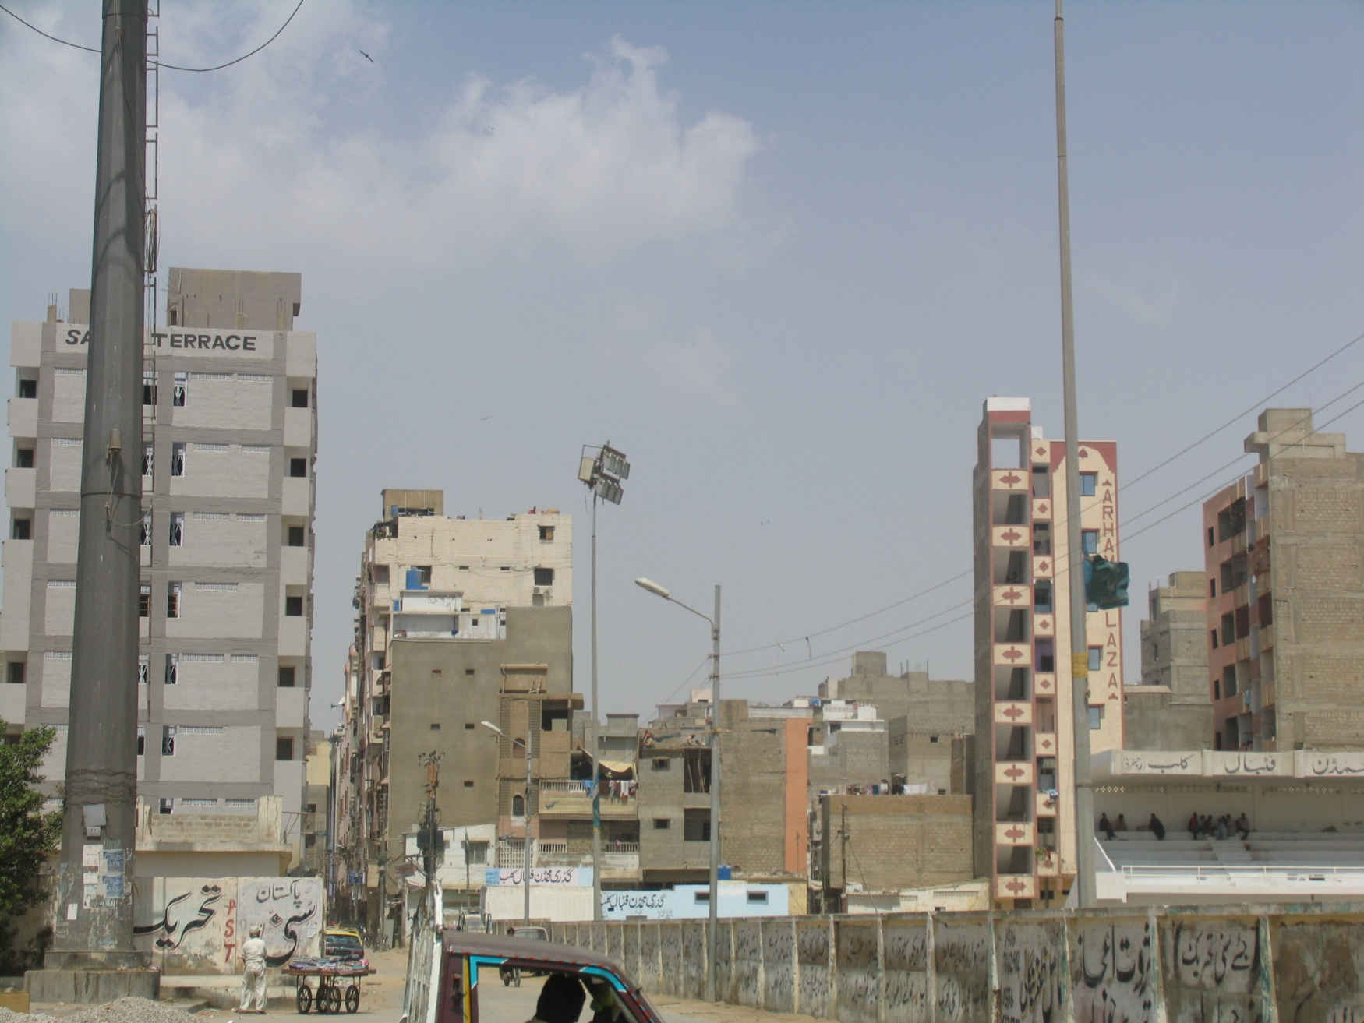

Slide 57
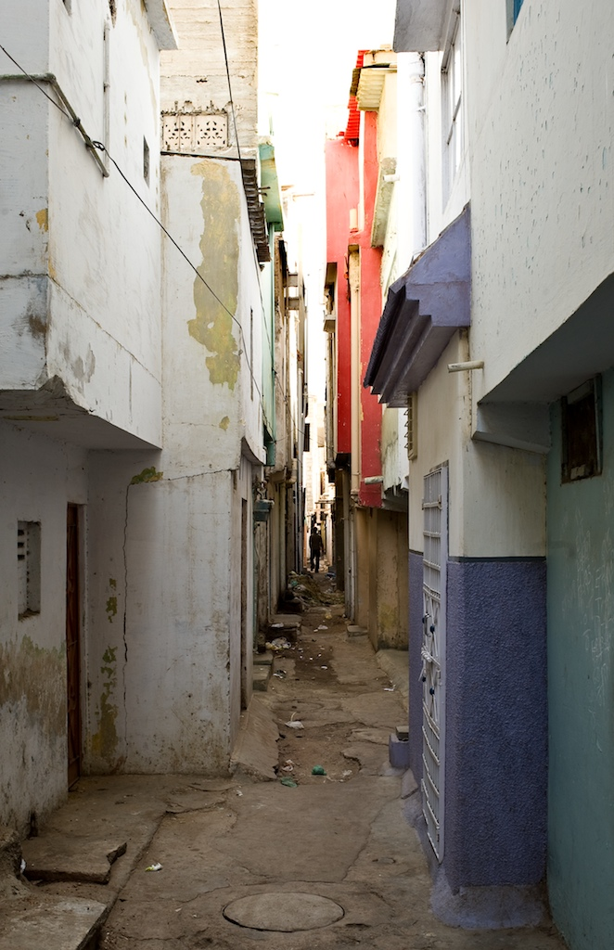
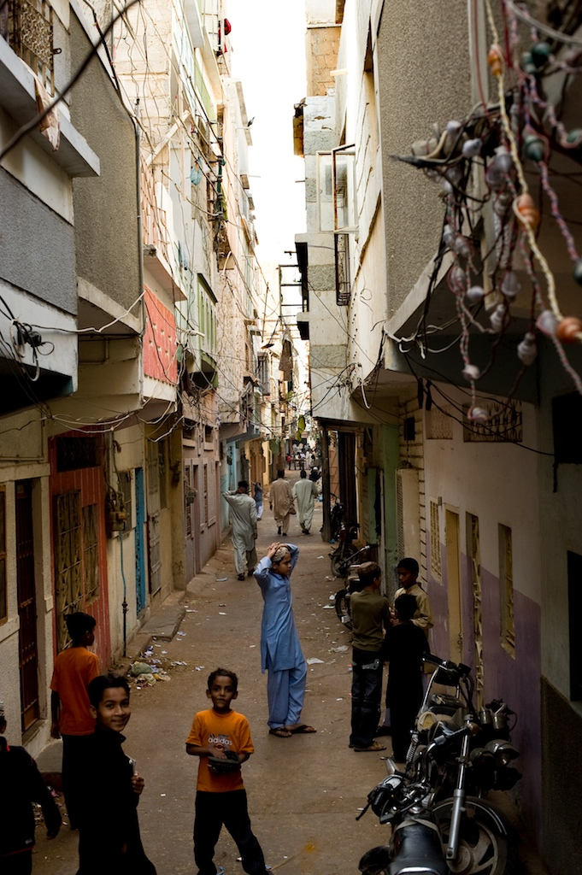

Slide 58
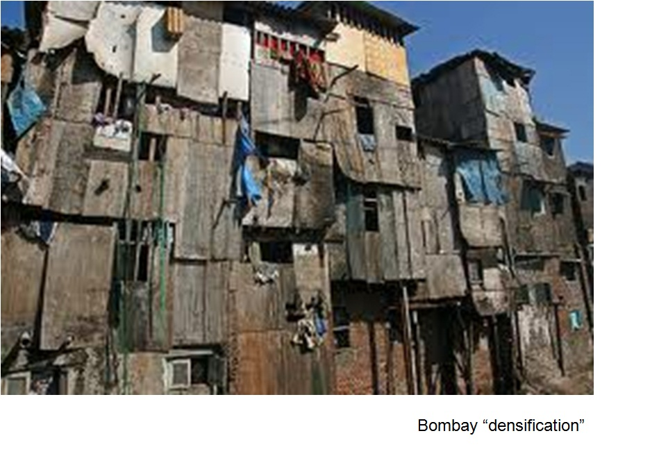

Slide 59
Densification Issues - 1
Smaller and smaller units to make them affordable : 6-10 persons per room
No lifts : Effect on women, children and old persons
No SBCA rules and regulations followed
Freedom to stay away from home
Formation of gangs
The issue of toilets
The growth of rentals : their vulnerability
Political control easier in apartment complexes.
Increase in household size by 10% between 1998 to 2011 though fertility rates have dropped.

Slide 60
Densification issues - 2
Karachi Physical Conditions
 | 1981 | 1998
No. of Housing Units | 858,000 | 1,457,000
Rental Housing | 26.40 % | 32.48 %
One room houses | 44.94 % | 30.09 %
Three room houses | 13.96 % | 21.12 %
Average persons per room | 3.1 % | 2.89 %
Electric Connections | 65.78 % | 93.79 %
Water Connections in house | 44.45 % | 74.38 %
Water Connections outside house | 45.39 % | 7.41 %
RCC roofs | 42.54 % | 56.04 %
Houses with separate latrines | 74 % | 47 %
Houses with separate kitchen | 65 % | 48 %
Houses with separate bathrooms | 69 % | 34 %
8 persons or more per room | 35 % | 34 %
Source: Housing Census Reports, Government of Pakistan
TV Ownership : 86% HH
Computers : 17.22% population

Slide 61
Study of Four Sites
Labour Square Apartments
Built 1976
No. of persons per apartment in 1976: 5.8
No. of persons per apartment in 2010: 10
Nawalane Inner City Informal Settlement
Density in 1973: 450 p/ha
Density in 2010: 3,500 p/ha
Paposhnagar: Formal Sector Lower Middle Income Settlement
Density in 1955: 250 p/ha
Density in 2010: 1,180 p/ha
4. Fahad Square Apartments
Built in 1999
No. of persons per apartment in 2010: 5.72
Density: 942 p/ha
THE PROCESS OF DENSIFICATION
THE NEGATIVE ASPECTS OF UNPLANNED DENSIFICATION

Slide 62
Trends (not issues): What is happening
Unprecedented Migration:
The village has become entirely dependent on urban produced goods which it cannot afford. This is because of a change from barter and caste relations to a cash economy and new cropping and marketing systems. Result Migration: Population increase from 9.8 million in 1998 to 16 million in 2017 . Will continue
Difference between old and new migration and hence between old and new informal settlements
City’s spatial expansion since 1998 more than 100%. See Perween Rahman’s work
New katchi abadis far from the city and work areas: Serious social and physical repercussions for the city
Subservience of the governance system to the developers and the real estate lobby due to neoliberalism and its repercussions
Social change and the consolidation of old katchi abadis
The division of the city on ethnic and class lines (4 cities)
The damage to the ecology of the region in which the city is located is inceasing due to these developments

Slide 63
The impact of the World Class City vision and liberalization
Officially Karachi wishes to be a World Class City. This has meant
Gentrification of public space and civil society struggle against this
Building “investment-friendly infrastructure”. Flyovers/signal-free roads causing extreme in convenience to pedestrians, children and the old
Direct foreign investment (DFI): This has replaced planning with projects
Housing has to be delivered by the market
Emergence of a land-hungry middle class, powerful developers and federal and provincial land-owning agencies hoarding 4,000 hectares of land within the city for speculation and commercial developments
Gated elite/middle income settlements being built on 32,000 hectares on the city outskirts causing ecological and cultural damage and the destruction of the rural economy
Under pressure from powerful developers the government of Sindh has enacted the “Sindh High Density Board Act” and the “Sindh Development Board Act” which give the boards powers to densify any plot or area without any urban design exercise or a larger city plan
The closure of informal industry and loss of jobs

Slide 64
New Developments
30,000 hectares of gated housing for the elite out of the city
Density: 98 p/ha
Population: 3,000,000
For whom: ?
Mass transit solutions to link sites up with the city
Heritage sites (Stone age, Buddhist, Islamic)
Speculation
300,000 developed plots are lying vacant
62,000 apartments are unoccupied
200,000 apartments are under construction
“Land has replaced gold”

Slide 65
The Changing Nature of Migration and its Repercussions
Earlier migration from settled societies to welcoming pro poor cities
Present migration from areas where community governance systems have no moral authority left and where cash has replaced barter
Old katchi abadis have consolidated physically and socially.
New katchi abadis are increasingly catering to circulating population
The changing voting patterns for older settlements
Older settlements do not support pro-poor causes like before

Slide 66
Older Lower Income Migrants
Migrants after two generations begin to loose links with the rural areas.
Also, their settlements change both physically and socially and so do their aspirations. Nature of change (Age group 15-24: Marriage, family structures)
Needs less about water, electricity, etc and more about schools, health, culture, jobs for upward mobility
Previously they voted for progressive parties who promised regularization of their settlements. Now they vote for the more conservative parties and unlike before are reluctant to join movements against evictions and/or pro-poor reform
Their relationship with officialdom has changed from protest to negotiation
They also constitute the largest group of voters in Karachi
They came to welcoming cities and since they came earlier they live nearer the city centre and work areas
Migrants change: The TV issue

Slide 67
The Newer Low Income Migrants
They are coming to an unwelcoming city where no social housing or regularization of new settlements is promoted unlike before
For the most part, this is forced migration due to the introduction of cash as a mean of exchange and the collapse of local community governance systems
Land is no longer available for informal settlements near the city and living far away is very costly in terms of cost, social issues and job opportunities. Result, densification of older settlements and the related problems of densification
Unskilled labour is becoming redundant due to mechanization and digital technology. Case of the building industry: A machine replaces 40 persons
The creation of circulating populations and the emergence of a new under class
Migrants from regional conflicts (weak political support) and natural disasters (positive features)

Slide 68
Density Issues
Population Densities 1972-2017 Selected Cities (Persons per hectare)
City | 1972 | 1981 | 1998 | 2017 | % Change 1972-2017
Old Town Lahore | - | - | - | 781.25 | -
Multan | 5.2 | 7.17 | 11.73 | 18.3 | 252%
Gujranwala | 1.0 | 1.9 | 3.5 | 6.3 | 530%
Faisalabad | 6.3 | 8.4 | 15.4 | 24.6 | 290%
Karachi | 9.3 | 13.7 | 24.7 | 42.3 | 359%

Slide 69
Informal Settlements
No actual figures are available.
There are two types of settlements: katchi abadis on government land (to be regulated and upgraded), informal subdivisions on agricultural land (schemes financed by councilor, MNA, and MPA funds). Estimated that 50% of all housing is provided in this manner.

Slide 70
Karachi’s Informal Economy
30-40% of the total economy.
Backbone is the street economy consisting of informal retail and wholesale selling and buying.
Hawkers at different locations where commuters have a presence.
Import of dry fruit from Afghanistan, tea from Kenya and Sri Lanka, Afghan transit trade coming back to Pakistan.
Manufacturing of items such as watches, small leather items, toys and kites of recycled plastics which are sold by street hawkers.
Informal recycling of inorganic waste.
The economy provides for over 1.3 million jobs/employment.

Slide 71
Court Judgments
Empress market
1,725 legally constructed shops demolished
6,000 plus hawkers around the market dislocated
Loss in earnings of shopkeepers and hawkers, 1.5 billion annually (does not include other aspects of the economy such as production of items, supply chains, wholesaling of retail items sold on the streets and in the markets.

Slide 72
Evictions
Major evictions have taken place due to development projects as a result of which those evicted have relocated and become poorer due to longer distances from their places of work, inability of women to work, difficulty in educating children.
Most of those evicted are now in debt.
The KCR case: 1,000 homes destroyed as a result of a mistake by the judges of the Supreme Court.
High Court judgment on removal of encroachments from all over Sindh is affecting lakhs of people in Karachi and when applied to Sindh, will be even larger.
Creation of a “nomad” urban population and its consequences.

Slide 73
Transport
Urban transport, how many persons per seat is available? Compared to bombay and delhi, compare pakistan, punjab, faisalabad, karachi

Slide 74
BRTs: Cost and Utility
Current Plan:
Cost of Karachi Circular Railway: Rs. 22 billion
Cost of Karachi BRTs (5 corridors): Rs. 170 billion
Number of trips served: 7% (of 2.5 million) or 175,000
Average cost per trip: Rs. 125 plus
Major subsidy required.
Alternative:
Purchase 2000 buses
Easy to expand fleet
Much larger surface area served
Cost per trip: Rs. 65 plus

Slide 75
Motor Vehicles Growth: Pakistan, Punjab, and Faisalabad
Motor Vehicles in Punjab and Pakistan
Year | All Motor Vehicles | Motor Cars, Jeeps, Station Wagons | Motorcycles and Scooters | Trucks | Delivery Vans | Buses | Taxis | Auto Rickshaws
2003 | 3,031,723 | 570,678 | 1,741,839 | 33,114 | 51,053 | 51,415 | 16,212 | 61,266
2016 | 16,742,882 | 1,867,363 | 13,144,241 | 61,394 | 238,346 | 94,629 | 64,917 | 415,764
2016 Pakistan | 20,237,570 | 2,779,652 | 14,595,722 | 269,853 | - | 232,552 | 167,067 | 648,066
Motor Vehicles in Faisalabad
Year | All Motor Vehicles | Motor Cars, Jeeps, Station Wagons | Motorcycles and Scooters | Trucks | Delivery Vans | Buses | Taxis | Auto Rickshaws
2003 | 253,188 | 42,946 | 172,073 | 3,664 | 95 | 4,956 | - | 7,478
2016 | 1,283,995 | 89,477 | 1,112,180 | 4,593 | 11,902 | 5,736 | 4,659 | 31,108
Notes:
Highlight motorcycles, buses, and rickshaws

Slide 76
Women and Motorbikes
Urban Resource Center surveys show:
Motorbikes reduce transportation costs of the home
Increase recreation and social activities
82% of men interviewed at bus stops want a motorbike but can’t afford it
56% women want permission to ride a motorbike
Women choose jobs in relation to transport available and not on the basis of their qualification or desire
Riding a motorbike changes dependency on transport as a job seeking criteria

Slide 77
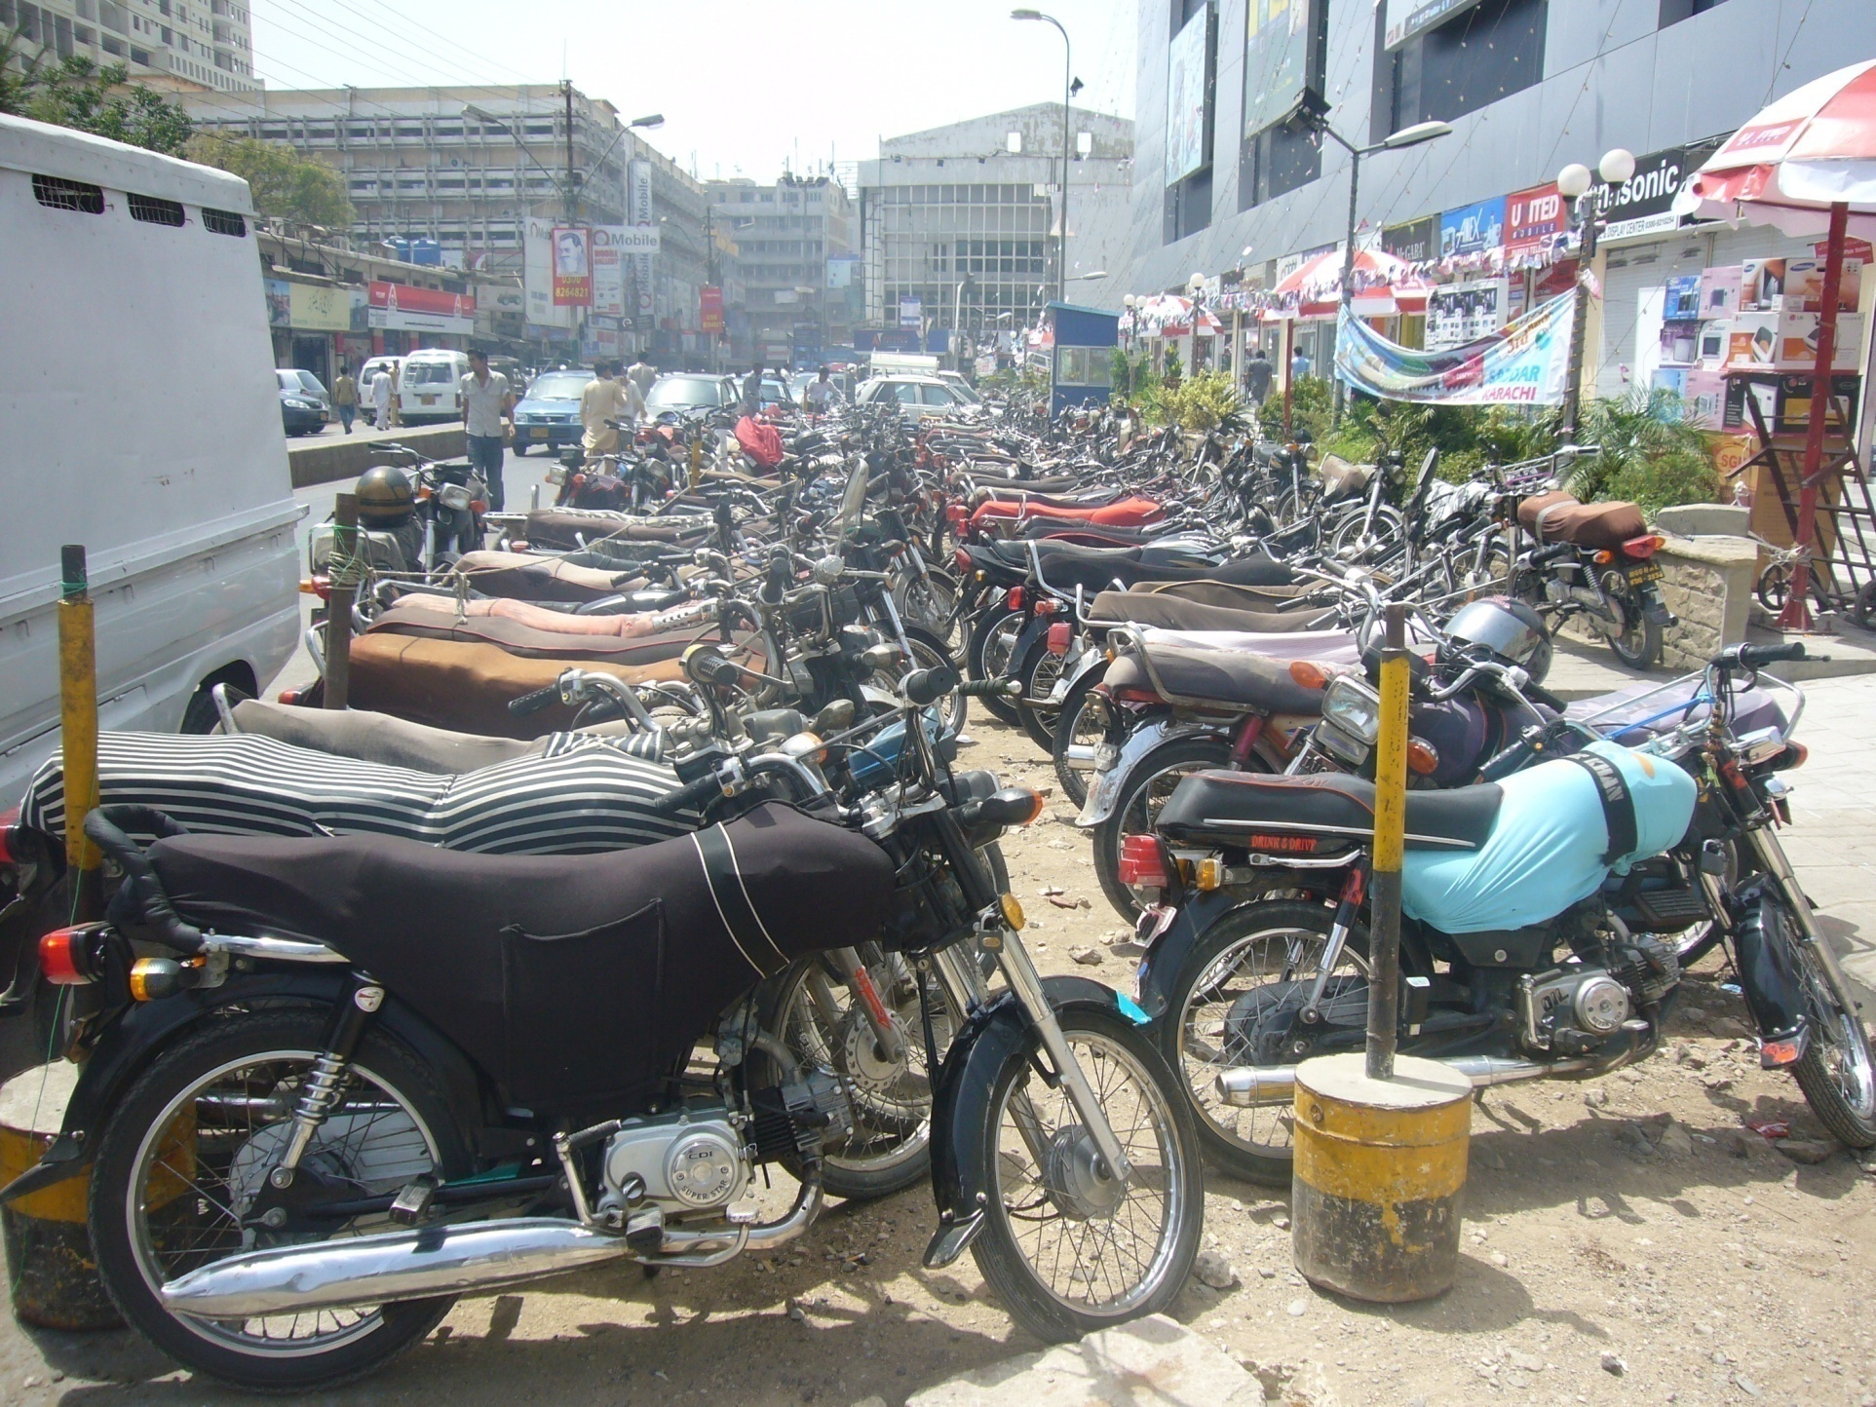

Slide 78
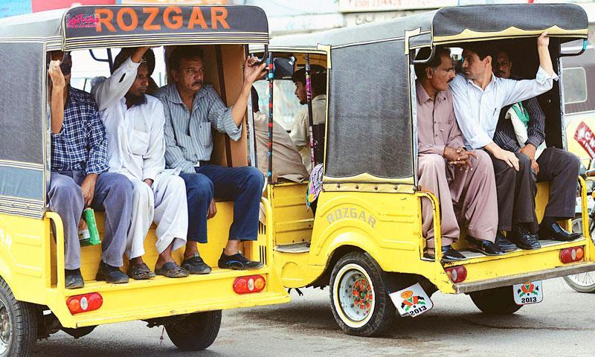
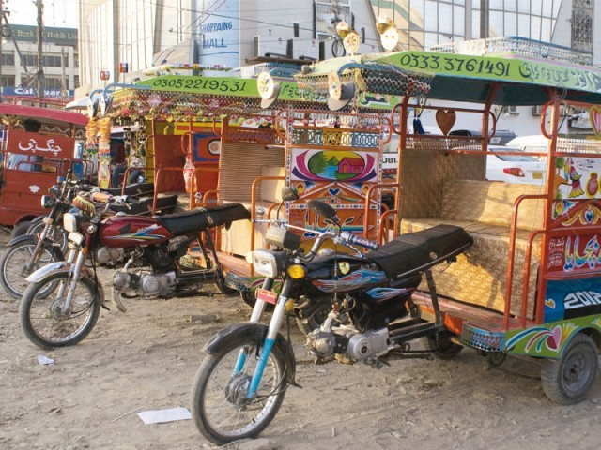
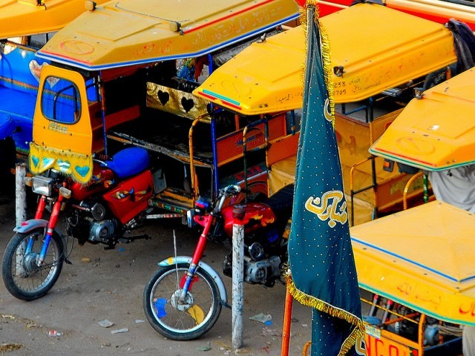
QINGQI
Over 62,000
Cheaper, faster, more comfortable
No subsidy
Ideal for families
Creates congestion
Should they be promoted?

Slide 80
Avoidable Deaths
Everyday, media reports death of a large number of persons which could be easily avoided.
The most common cause of these deaths is: road accidents (4,829 fatal accidents last year), collapse of buildings, factory fires, drowning during floods, electrocution, honor killings, aerial firing celebrations.

Slide 81
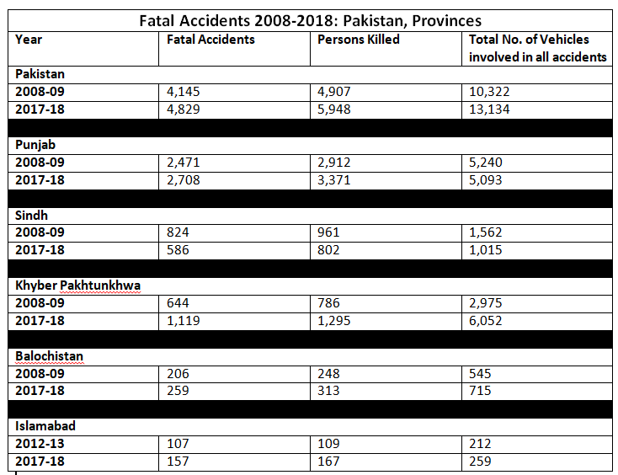

Slide 82
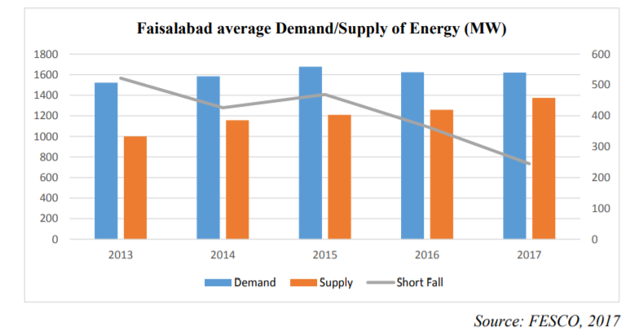

Slide 83
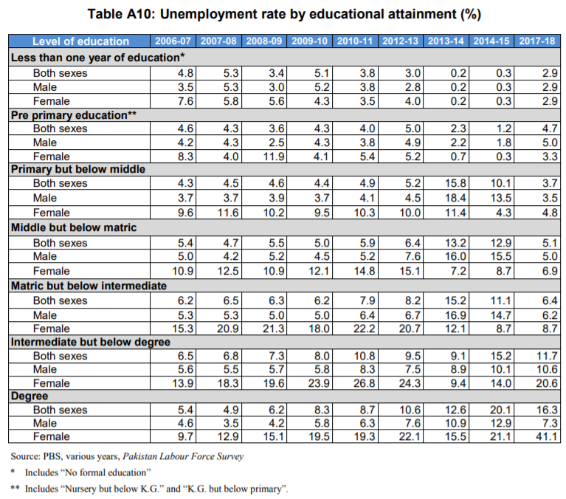
Number of Registered Factories and Their Employment Levels, Punjab and Faisalabad
 | Punjab |  | Faisalabad
 | 1998 | 2016 | 1998 | 2016
No. of Factories | 6,396 | 13,824 | 750 | 2,313
Employment Levels | 545,379 | 1,034,349 | 80,738 | 197,149

Slide 84
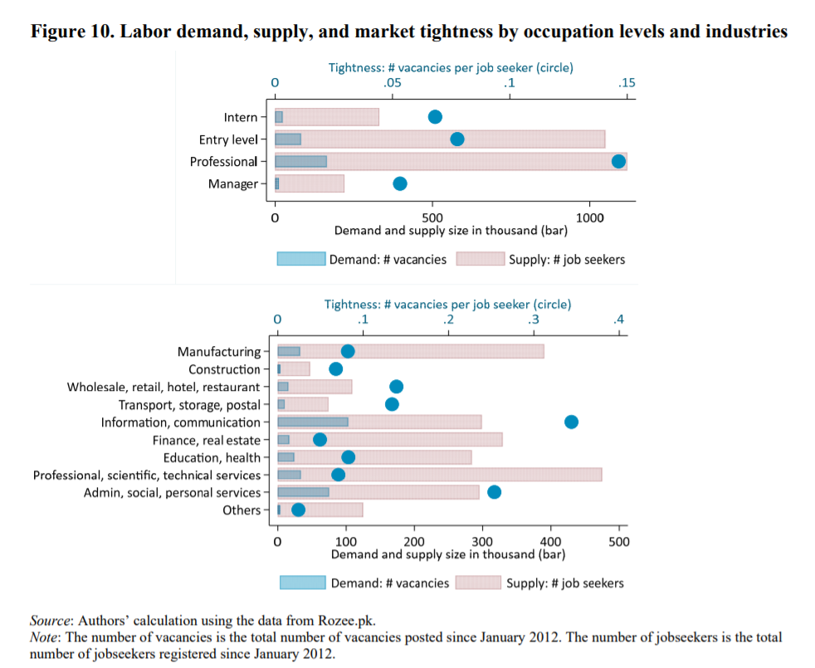

Slide 85
Employment is a key challenge in Pakistan. While its unemployment rate is low at 6.0%, the quality of employment is not high. Among the employed people, three-quarters work in informal sectors; 36% and 24% are self-employed and family workers, respectively; and only 12% are wage workers with a written contract (Pakistan Bureau of Statistics, 2015; Bossavie et al., 2018).
The youth, despite being more educated, face a three times higher unemployment rate and are more likely to work in informal sectors than older people (Bossavie et al., 2018).
Facing a youth bulge—a large influx of a young labor force—in coming years, the Pakistani economy needs to create more jobs by taking advantage of the relatively well-educated young labor force. However, the higher unemployment rate of the educated young labor force raises the concern that skill development in the current education and training system does not respond well to skill demands in industries.
Source: World Bank

Slide 86
Water Table Depths
Water Table Depths, Pakistan and Punjab
Water Table Depths | Area Occupied (Thousand Hectares)
 | 2001 |  |  | 2015
 | Pakistan | Punjab | % Share of Punjab | Pakistan | Punjab | % Share of Punjab
Total | 20,165 | 12,835 | 63.7 | 16,685 | 9,964 | 59.7
0-150 cms | 3052 | 293 | 19.1 | 1,548 | 298 | 19.3
150-300 cms | 3516 | 1,720 | 48.9 | 5,597 | 1,397 | 25.0
300-450 cms | 3924 | 2,999 | 76.4 | 2,437 | 1,864 | 76.5
450-600 cms | 3740 | 3,293 | 88.1 | 1,669 | 1,270 | 76.1
> 600 cms | 5933 | 4,530 | 76.4 | 5,434 | 5,135 | 94.5

Slide 87
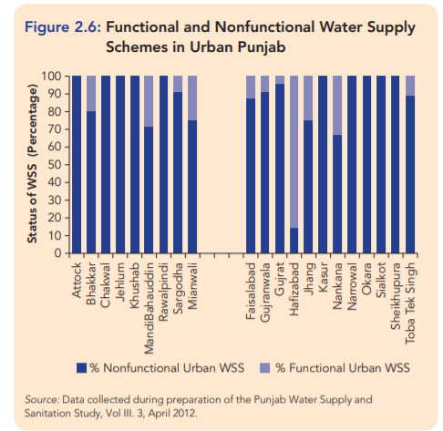

Slide 88
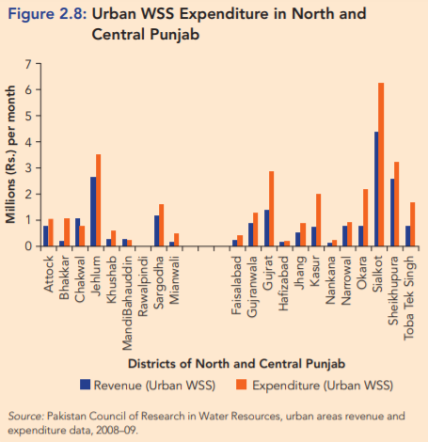

Slide 89
Percentage Distribution of Households by Type of Toilet
Area | Flush |  |  | Non Flush |  |  | No Toilet
 | Urban | Rural | Total | Urban | Rural | Total | Urban | Rural | Total
Pakistan 2004-05 | 86 | 30 | 54 | 7 | 30 | 20 | 6 | 40 | 26
Pakistan 2014-15 | 97 | 60 | 73 | 2 | 20 | 13 | 1 | 21 | 13
Punjab 2004-05 | 91 | 43 | 66 | 2 | 7 | 5 | 3 | 20 | 11
Punjab 2014-15 | 98 | 70 | 79 | 1 | 6 | 5 | 1 | 24 | 16
Sindh 2004-05 | 88 | 17 | 51 | 7 | 56 | 32 | 5 | 27 | 16
Sindh 2014-15 | 97 | 31 | 67 | 3 | 53 | 26 | 1 | 16 | 17
KPK 2004-05 | 81 | 32 | 48 | 13 | 36 | 28 | 6 | 32 | 24
KPK 2014-15 | 97 | 71 | 76 | 2 | 15 | 12 | 1 | 14 | 12
Balochistan 2004-05 | 63 | 7 | 23 | 33 | 48 | 44 | 4 | 45 | 33
Balochistan 2014-15 | 78 | 14 | 31 | 22 | 68 | 55 | 0 | 18 | 13
Faisalabad 2004-05 | 93 | 57 | 78 | 0 | 2 | 1 | 6 | 41 | 21
Faisalabad 2014-15 | 99 | 86 | 92 | 0 | 0 | 0 | 1 | 14 | 8

Slide 90
Percentage Distribution of Households by Source of Drinking Water 2004-05 and 2014-15
Area | Water Delivery System
 | Tap Water | Hand Pump | Motor Pump | Dug Well | Others | Total
Pakistan 2004-05 | 39 | 27 | 18 | 6 | 10 | 100
Pakistan 2014-15 | 27 | 26 | 33 | 3 | 11 | 100
Punjab 2004-05 | 32 | 34 | 31 | 1 | 2 | 100
Punjab 2014-15 | 18 | 28 | 45 | 1 | 9 | 100
Sindh 2004-05 | 45 | 36 | 6 | 6 | 8 | 100
Sindh 2014-15 | 41 | 33 | 11 | 4 | 10 | 100
KPK 2004-05 | 48 | 10 | 7 | 14 | 20 | 100
KPK 2014-15 | 35 | 12 | 26 | 8 | 18 | 100
Balochistan 2004-05 | 40 | 4 | 4 | 18 | 38 | 100
Balochistan 2014-15 | 33 | 7 | 18 | 11 | 30 | 100
Faisalabad 2004-05 | 31 | 26 | 38 | 0 | 5 | 100
Urban | 45 | 8 | 40 | 0 | 8 | 100
Rural | 12 | 51 | 36 | 0 | 1 | 100
Faisalabad 2014-15 | 13 | 18 | 41 | 0 | 28 | 100
Urban | 18 | 3 | 31 | 0 | 48 | 100
Rural | 8 | 30 | 50 | 0 | 11 | 100

Slide 91
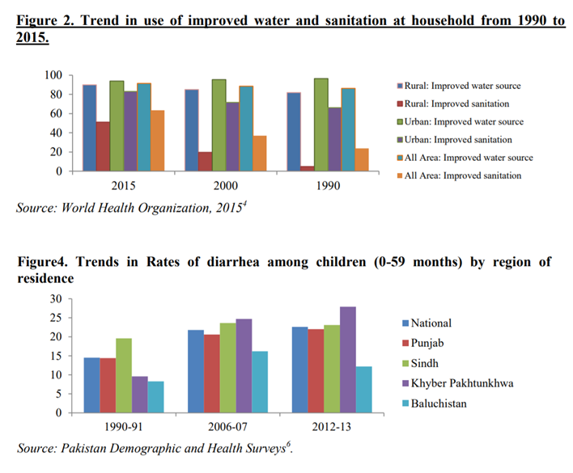

Slide 92
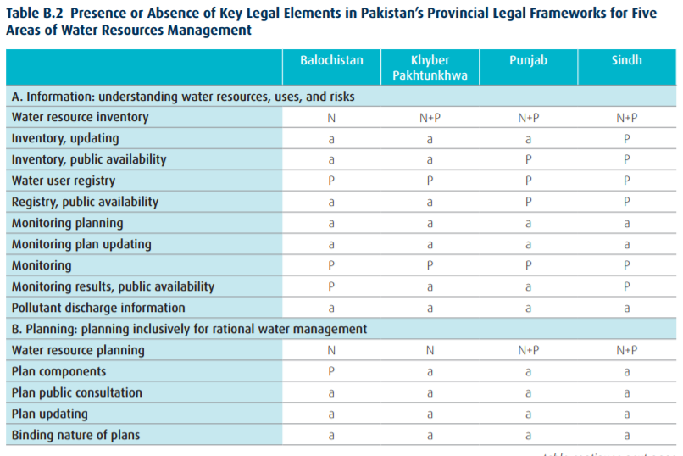

Slide 93
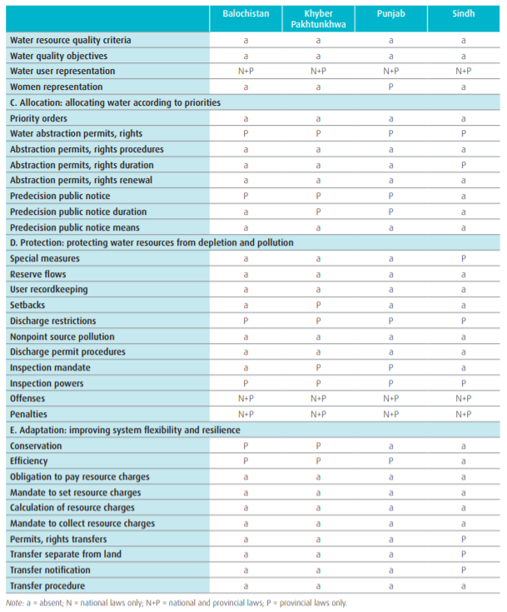

Slide 94
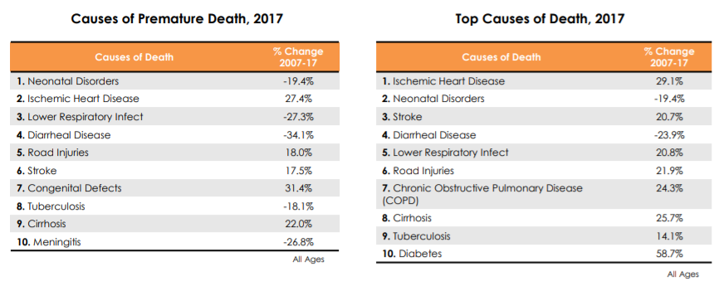

Slide 95
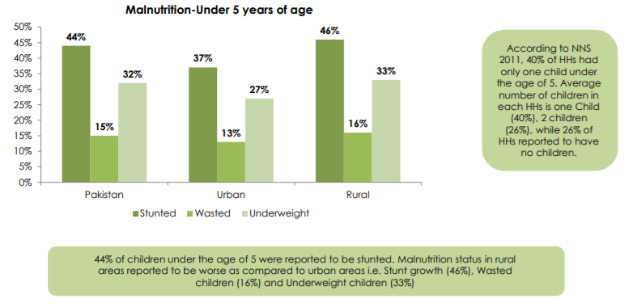

Slide 96
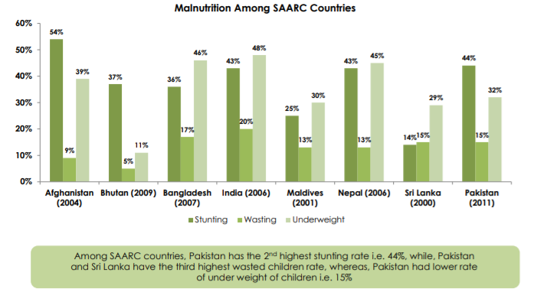

Slide 97
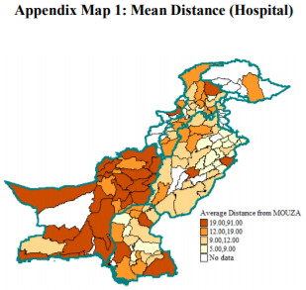
Health Statistics

Slide 98
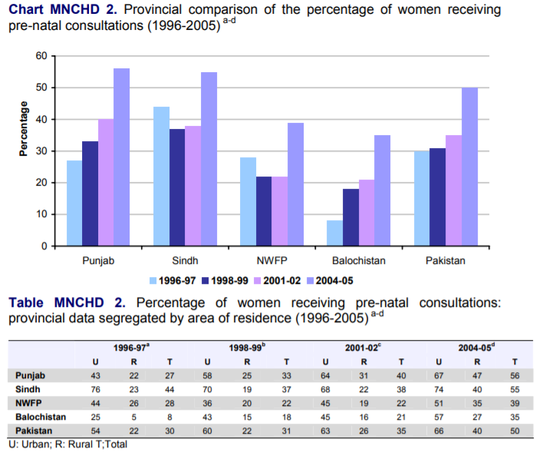

Slide 99
Health Facilities per Million Population, Punjab
Health Facilities Per Million Population, Punjab
Year | Hospitals | Beds | Doctors | Dentists | Nurses
1994 | 25 | 463 | 401 | 17 | 289
2016 | 17 | 452 | 654 | 69 | 614

Slide 100
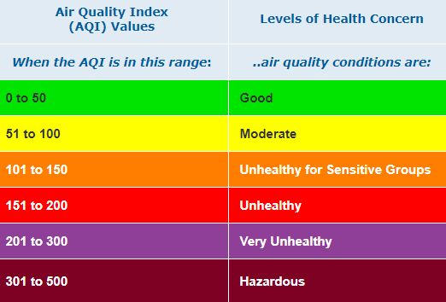
Air Quality
Faisalabad 3rd worst air quality in the world. Faisalabad: 146 AQI
Notes:
Source: AirVisual

Slide 101
Education

Slide 102
Crime: Punjab and Faisalabad
Number of Crimes Reported by Type, Punjab
Year | Total | Murder | Attempted Murder | Hurt | Rioting | Assault on Govt. Servants | Rape | Kidnapping | Dacoity | Robbery | Burglary | Motor Vehicles Theft | Cattle Theft | Ordinary Theft
2002 | 247,888 | 4,898 | 5,576 | 19,284 | 126 | 990 | 1,421 | 5,040 | 816 | 5,334 | 9,639 | 5,866 | 4,679 | 5,576
2016 | 408,283 | 4,112 | 4,564 | 17,088 | 25 | 1,886 | 2,942 | 13,334 | 951 | 13,675 | 11,627 | 16,042 | 589 | 1,541
Number of Crimes Reported by Type, Faisalabad
Year | Total | Murder | Attempted Murder | Hurt | Rioting | Assault on Govt. Servants | Rape | Kidnapping | Dacoity | Robbery | Burglary | Motor Vehicles Theft | Cattle Theft | Ordinary Theft
2002 | 20306 | 413 | 372 | 914 | - | 72 | 98 | 293 | 35 | 407 | 457 | 479 | 548 | 636
2016 | 31912 | 359 | 330 | 1371 | - | 138 | 248 | 769 | 112 | 1966 | 486 | 1365 | 397 | 1458

Slide 105
Social Change
Age Group 15 – 24:
Married percentage 1981 2006
Men 13.39 7 (extrapolated from the 1998 Census)
Women 37.45 17 (extrapolated from the 1998 Census)
Literacy percentage 1981 2006
Men 68.08 85 (extrapolated from the 1998 Census)
Women 64.01 81 (extrapolated from the 1998 Census)
Nuclear Family Formation: 1987 2006
Percentage of nuclear families 57.00 84.54
Court Marriages:
Data shows an increase in geometric progression
Women Students in Public Sector Universities:
Karachi University 68 %
Medical students 87 %
Engineering University 50 % (about)
Architecture and planning 92 %
Repercussions of social change
Changes in gender relations
Changes in use of public space
Conflict between tradition and social reality

Slide 107
Major Issues
Management
Identification of assets
Requirements for the managements of those assets
Case of Karachi
10,000 kms of roads
25,000 kms of pipelines
3 treatment plants of 151,000 gallons per day
6 million vehicles
2.5 million trips daily
No new project will succeed unless the existing infrastructure is not managed and maintained.

Slide 108
2. Required Urban Land Reform
A Land Ceiling Act: No one person should own more than 500 square meters of urban land
Minimum density for any urban development project should be 450 p/ha
There should be a large enough non-utilization fee on developed urban land so as to discourage speculative investment
No loans should be offered for housing to those who have already received loans previously
The development of a land inventory and its yearly updating and publication
Technical and financial support to communities and the informal sector in housing for the densification process

Slide 109
3. Ecology
No land development to be allowed on drainage channels.
No change in geological formations to be permitted.
No archaeological or cultural sites to be demolished (they should be protected even if they cannot be developed).
Protection of forest cover and increasing it.
Protection of mangroves, flora, and fauna.
Role of communities in the above process.

Slide 110
4. Community Participation
Means different things to different people
It is successful when:
Highly decentralized so that there is trust, ease of management and maintenance and low capital costs.
Miniaturization of technologies to make decentralization possible.
Freedom to choose structure of community participation and institutional arrangements.
Commitment.

Slide 111
5. Emerging Trends in Government Policy
Support to developers for creating large gated elite/middle income settlements on the city’s periphery.
The Sindh High Density Board Act.
The Sindh Development Board Act.
The Creation of utilities Companies.
Liberalization of finance for house building
Promotion of long term unaffordable transport projects

Slide 112
6. Climate Change
Flooding

Slide 115
7. Criteria for Evaluating Projects
Accepted that for the foreseeable future there will be only projects. Four criteria must apply for judging projects.
Projects should not damage the ecology of the region in which Karachi is located
Projects must determine land-use on the basis of social and environmental consideration and not on the basis of land value alone
Projects should serve the interests of the majority which are low and lower middle income groups
Projects should respect and enhance the tangible and intangible culture of the communities that live in Karachi

Slide 122
An Oath for Architects and Planners
“I will not do projects that will irrepairably damage the ecology and environment of the area in which they are located; I will not do projects that increase poverty, dislocate people and destroy the tangible and intangible cultural heritage of communities that live in the city; I will not do projects that destroy multi-class public space and violate building byelaws and zoning regulations; and I will always object to insensitive projects that do all this, provided I can offer viable alternatives.”
I took this pledge in 1983 and I have kept my word

